Slide 1
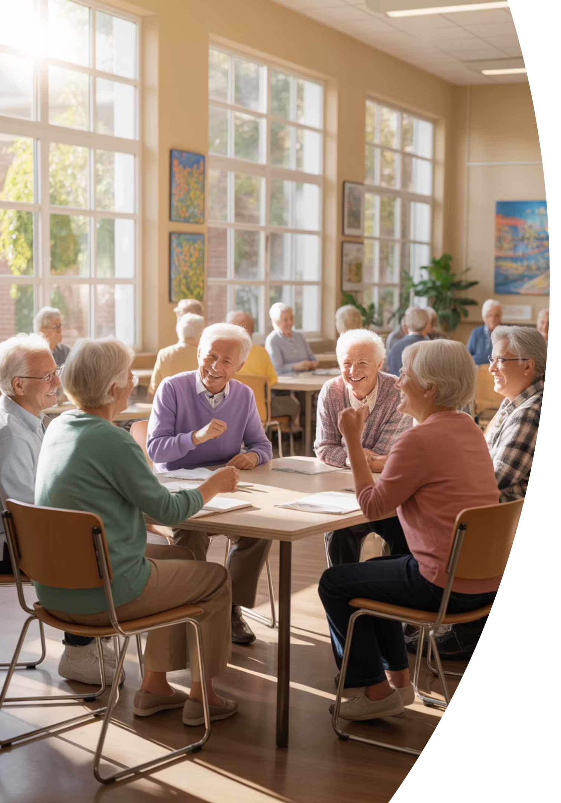
AI & ChatGPT Seminar
for Seniors
Notes:
Opening Slide
Good Afternoon
Coming right after lunch is a tough act to follow!
I hope I can keep this entertaining enough so that you don’t fall asleep.
Let’s walk through our handouts for a moment, so you have an idea of what we’re going to cover:
Overviews of AI & ChatGPT
Prompts
Staying Safe & Smart
Benefits
Demo Ideas
Accessing ChatGPT
Final Take-Aways
Put your mind at ease that you don’t have to write anything down to review this stuff later, if desired.

Slide 2
Welcome, Cromwell Senior Center (CSC) Members
A friendly, practical introduction to AI & ChatGPT
— no jargon, no pressure, and no tests!
Notes:
Welcome, everyone. Today, we're going to take a simple, friendly tour of Artificial Intelligence and ChatGPT.
-What they are,
- Why they matter, and
- How they genuinely make life easier
No Jargon, No Pressure, No tests!
This session is designed for everyday users — especially us seniors.
If you can ask a question,
email a letter,
or text a message,
you can use ChatGPT.
This seminar will use three methods of explanation:
- PowerPoint Slides to cover concepts:
- Video Clips, to reinforce these concepts; and
- Demos to show these concepts in action!

Slide 3



Meet Jim Kallaugher: CSC Member & Volunteer
Red Glen Electronics
Weekly Tech Tuesdays
Monthly Tech Presentations
Founder and operator, with
friendly “Home Tech Help for Hire” for Boomers.
Volunteer tech support and guidance to community members on Tuesday afternoons.
Conduct tech topic seminars for better understanding & to encourage confidence
With 25+ years of experience making technology clear, simple, and accessible.
Notes:
Hi, I’m Jim Kay-la-her, a Senior Center Member, Volunteer, and Home Tech Support Consultant
Red Glen Electronics:
I founded Red Glen Electronics as a friendly “Home Tech for Hire” for Boomers
Tech Tuesdays:
I‘m here every Tuesday afternoon for appointments.
I offer hands-on tech support or one-on-one training as a regular volunteer.
Monthly Tech Seminars:
Every month, I’ll lead tech topic seminars for a better understanding and to encourage confidence

Slide 4
Play ChatGPT for Seniors Video Clip #1
Notes:
Play ChatGPT For Seniors Video Clip #1

Slide 5
Today's Roadmap
01
02
What Are AI & ChatGPT? (5m)
Why they matter (5m)
03
04
How to stay safe? (5m)
Every day, senior-friendly uses (5m)
05
06
Live demos (5m) & Videos (5m)
Q&A (10m)
Notes:
Here’s our roadmap:
What AI is, in plain English
How ChatGPT works
Why It Matters
Safety guidelines
Everyday Uses
ChatGPT in Action with Live examples
And a question and answer chat to wrap up our review
The goal is clarity, confidence, and comfort.
We’ll go nice and slow — nothing to memorize.

Slide 6
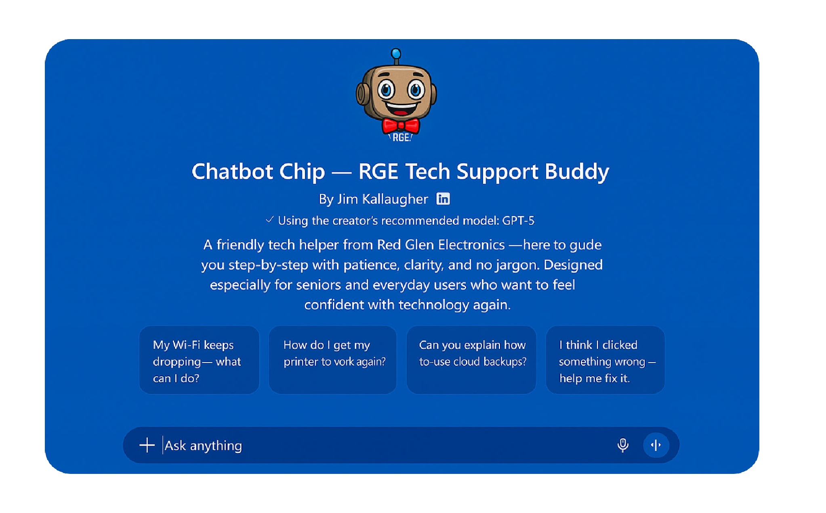
Notes:
“This is simply a picture of Chip, my virtual helper, on the screen.
— It works just like the regular ChatGPT page, but with a friendlier Red Glen wrapper.
The only thing I want you to notice right now is the prompt box at the bottom — that’s where we type a question, just like sending a text message.”
“If you ever want to try Chip at home, he’s right on the Red Glen website under ‘Chat with Chip.’ But for today, watch along — no tech skills needed.”

Slide 7
DEMO: See? It's Easy
LIVE DEMO
"Explain ChatGPT in one plain-English sentence. Then, try it in 3 separate tones
Show ChatGPT works like texting or drafting email sentences.
Notes:
Alright — now that you’ve seen what Chip looks like, let’s try a simple example together.
For this first demo, I’m going to ask ChatGPT to explain three things —
Wi-Fi, AI, and ChatGPT — each in one plain-English sentence. Nothing technical, nothing fancy. Think of this like asking a friend to ‘just tell it to me straight.
Then I’ll ask Chip to do the same thing in three different tones — so you can see how flexible it is.
The goal here is simple: show you that ChatGPT works just like texting or writing a short email.
You type something in the box, press Enter, and ChatGPT does the heavy lifting.
Okay, let’s give Chip his first question…
Explain Wi-Fi, AI, and ChatGPT — each in one plain-English sentence.
Now, try in 3 different tones…

Slide 8
Introduction to Artificial Intelligence - AI
Notes:
Introduction to Artificial Intelligence - AI

Slide 9
Two Words to Remember
Vast
Fast
Trained on trillions of examples
Usually answers in seconds
Notes:
AI in two words: Vast and Fast.
Vast: It has been trained on a massive amount of information.
Fast: It answers in seconds.
That's the core idea. That’s the heart of it.
Artificial Intelligence is pattern recognition.
It has seen so many examples of language that it can
explain things,
write things,
and help troubleshoot
— all in plain English.

Slide 10
What AI Is
Recognizes patterns
Trained on huge amounts of text
Explains, writes, plans, troubleshoots
Speaks plain English
Notes:
So, What Is AI?
Innovative software trained on patterns.
It reads & processes vast amounts of info, and
helps solve everyday problems
It Speaks in everyday English
AI Does Not Replace People!
It assists, doesn’t replace
You stay in control
Your judgment matters
Why It Sounds Human
Learns how people write
Mimics natural tone
Not consciousness — patterns

Slide 11
Honest Summary
AI knows a lot — but not everything.
Always double-check breaking news, dates, and prices.
Notes:
AI knows a lot, but not everything.
Always double-check breaking news, prices, dates, or time-sensitive info.
It Can Get Things Wrong
Sometimes makes mistakes
Sounds confident even when wrong
Check important info
Remember – Predicts – like a meteorologist –
Weather forecasters look at a bunch of data
quickly analyze and sometimes get things wrong!

Slide 12
Think of AI as a “Super Parrot.”
Mimics fluent English, but does not understand the meaning
Has no life experience — doesn’t know what “sunshine” or “heartache” feels like
Not sentient – but “Super” -- more than just language repetition: plans, writes, organizes, summarizes, helps
troubleshoot, etc.
Notes:
This idea is here to lower expectations, not raise fear.
AI is impressive — but it doesn’t experience life the way you do.
That’s actually good news, because it means your judgment still matters.
Think of AI as very skilled at language, but not wisdom.
It can help you get organized, unstuck, or started —
but it still needs you to steer the ship.

Slide 13
Your New Tireless Assistant
The Holmes & Watson Team
  You are Sherlock Holmes: You provide the genius, intuition, and direction.
  The AI is Dr. Watson: It handles the legwork and facts.
Notes:
This slide is about roles, not intelligence.
You don’t need to know how AI works under the hood.
Your job is to ask good questions and decide what matters.
AI’s job is to do the grunt work quickly.
If something feels off, you correct it — just like you would a helpful assistant.
That balance is where the power is.

Slide 14
Watch Out for "Confident Blunders" The 'Pattern' Trap
◦ Sometimes, AI sounds professional but invents details. This is sometimes called a “hallucination.”
◦ For example, asking for a biography of a fake person, 'Guadalupe O'Shea’ --1st Woman Astronaut landing on Mars via the Ares Space Mission -- can lead AI to invent a life, including fake awards and dates.
◦ Golden Rule: AI isn't lying on purpose but always verify facts!
Notes:
This is why we don’t treat AI like an authority figure.
It doesn’t know when it should say “I don’t know.”
So confidence doesn’t equal correctness.
The fix is simple:
ask follow-up questions, slow it down, or verify elsewhere.
Same common sense you already use with news, ads, or emails.

Slide 15





Everyday AI You Already Use
Netflix/Spotify suggestions
Smart speakers
Email spam filters
Photo enhancement
Voice Typing On Phones
Notes:
This slide is here to remove the intimidation factor.
You’re not stepping into something foreign —
you’re just stepping closer to the controls.
ChatGPT takes the same kind of technology you already use
and puts it in a conversation instead of a menu or button.
No learning curve — just curiosity.
“AI has been here quietly, all around us, for a while now.”

Slide 16
Play VIDEO #2 How AI Works
Notes:
Play Video #2 How AI Works…
Again, this is to reinforce the ideas we just went over…

Slide 17
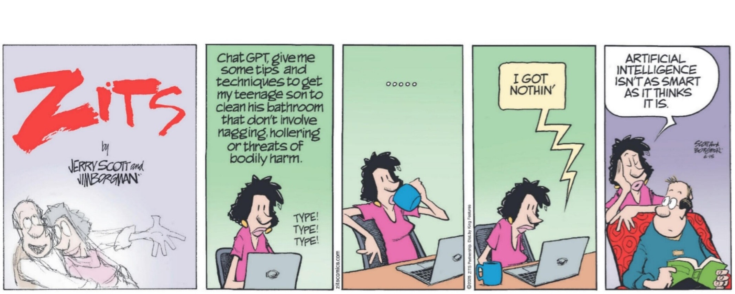
Notes:
Read Cartoon
Wait for Laugh & Pause for any Q’s

Slide 18
Stretch Break! Any Questions So Far?
Notes:
Stretch Break + Any Questions So Far?

Slide 19
Introduction to ChatGPT
Notes:
Introduction to ChatGPT

Slide 20
What Is ChatGPT?
Answer: AI that you talk to in plain English.
Explains things
Writes things
Helps plan & troubleshoot
Patient and friendly
Notes:
ChatGPT is an AI that communicates in plain English.
It can write,
explain,
simplify,
plan,
help with learning, and troubleshoot tech problems—
patiently and clearly. It's like having a helpful assistant you can ask anything.
Why This Matters
Saves time
Helps you learn new things
Simplifies technology
Makes everyday tasks easier
Think of it as a helper who never gets tired.

Slide 21



How ChatGPT Works (Simple)
Learns patterns
Predicts the following
best sentence
Does not browse the live internet
by default — unless your question
clearly asks for current information.
“What’s the best price for
gas, today?”
Notes:
It learns patterns in language.
It predicts the following best sentence.
It’s not browsing the live web.
Unless you ask it to
Or your question implies current data, like
What’s the best price for Gas, today?
Today, we’re focusing on simple question-and-answer use.
Ask → Answer.
Just like our Meteorologists from our earlier example of predictions ---
without a 100% accuracy rate!

Slide 22




Prompts = Your Instructions
A prompt is your question.
Examples:
"Explain this simply."
"Write a friendly note."
"Show steps one at a time."
There are no perfect questions — you can’t “break” it.
Notes:
A prompt is your question, or request to AI
No special wording needed.
Examples:
“Explain this simply.”
“Write a friendly letter.”
“Show steps one at a time.”
Talk/write normally
Be Clear – no need for fancy words.
“Prompts = instructions”
Why Prompts Matter
Better question = better answer
Be clear and specific
Tone and detail shape results

Slide 23
Tone Control
Friendlier
Shorter
More fun
More formal
Notes:
Tone Control
“Make it friendly.”
“Make it brief.”
“Explain like I’m new to tech.”
You can tell ChatGPT how to speak.
(…like our earlier demo.)
More formal, more friendly, shorter, funnier — whatever tone you prefer.
This gives you complete control.
You’re always in the driver’s seat.

Slide 24




Correcting AI
"Try again, simpler."
"Make it shorter."
"No wrong questions."
Notes:
If ChatGPT gives an answer you don’t like, correct it:
“Try again, simpler.”
“Make it shorter.”
“Give me options.”
It’s patient and flexible.
Tips for Clear Prompts
Say who it’s for
Say the tone you want
Ask for steps or a summary
It doesn’t get offended — it adjusts.

Slide 25
Real Everyday Uses
Travel plans
Notes & messages
Recipes
Tech troubleshooting
Senior phone help
Gift ideas
Memory joggers
Budget reminders
Event planning
Notes:
Popular real-world uses:
• Travel planning
• Recipes
• Writing messages
• Organizing notes
• Gift ideas
• Lists & reminders
• Troubleshooting tech
• Job searches, resumes, & interviews
Simple tasks you deal with every day.

Slide 26
Let’s Talk Safety Basics
Don't share private info
Double-check important answers
Ask for sources
Use common sense
Notes:
Let’s Talk Safety
Safety is simple:
• Don’t share private info
• Double-check important answers
• Ask for sources
• Use the same common sense you already use online
Golden rule: Never type anything you wouldn’t share with a stranger.

Slide 27
Safe vs Not Safe
Safe:
Not Safe:
recipes
SSN
notes
bank info
stories
Final medical or legal decisions
(always verify with a Doctor or Lawyer)
planning
Notes:
Safe to type:
Recipes, notes, stories, planning, creative ideas.
Not safe to type:
Social Security numbers, bank info, medical or legal decisions, and account numbers.
Rule of thumb: If you’re unsure, don’t type it.

Slide 28
Let’s Talk Accuracy
Accuracy Clues
Has sources → good
Vague → check
Confident but unsourced → verify
Notes:
Now, let’s consider Accuracy:
Reliable answers often:
• Give sources
• Provide details
• Explain steps
• Admit uncertainty
If something sounds too sure, ask to see sources.

Slide 29









Family Uses -- A Primary ChatGPT Benefit
Poems for grandkids
Birthday notes
Memory stories
Translate tech jargon
Plan events
Notes:
It makes communication easier with
Fun, personal uses for yourself or family members:
• Birthday messages
• Poems for grandkids
• Memory stories
• Translating tech jargon
• Planning events
• Travel ideas
• Cooking help
• Drawing creative ideas

Slide 30
Play “How ChatGPT Works” #3 Video Clip
Notes:
Play How ChatGPT Works Video Clip #3

Slide 31








AI & ChatGPT Boost Tech Independence
Learn privately
No embarrassment
Ask anything
Solve frustrations
Notes:
AI helps you stay independent.
You can learn privately at your own pace.
Ask anything, anytime.
No waiting, no embarrassment.
It’s help on your terms.
AI becomes a confidence booster.
Remember
Your Experience Matters
Life skills beat tech skills
Ask questions your way
You bring wisdom — AI brings the tools

Slide 32
LIVE DEMO
ChatGPT Concepts In Action
Notes:
ChatGPT Concepts In Action

Slide 33
Define Medicare
LIVE DEMO
"Explain Medicare in simple terms for a friend turning 65."
Notes:
Let’s continue with a live demo
Example prompt:
“Explain Medicare in simple terms for a friend turning 65”
This is a great example of where ChatGPT really shines.
Medicare is a complicated topic — lots of parts, acronyms, and fine print.
Most explanations make it feel harder than it needs to be.
What I’m going to show you here is how ChatGPT can take something complex
and translate it into everyday English — the way you’d explain it to a friend.
Notice what we’re not doing:
no jargon, no pressure, no assumption that you already understand the system.
This isn’t about replacing experts — it’s about getting clarity first,
so you can ask better questions later.
That ability to simplify, summarize, and re-explain
is where ChatGPT becomes genuinely useful.

Slide 34
Key Takeaways for Chat…G-P-T
AI = math, not magic
Creates — not copies
The “G”(Generative)
Snapshot — not live
The “P”(Pre-Trained)
Patterns = how it "thinks“
The “T”(Transformer)
Your words shape results
Notes:
Key Takeaways
• AI is math, not magic
• It creates, not copies (Generative)
• It’s a snapshot, not live (Pre-Trained)
• It uses patterns (Transformer)
• Your words shape the results
Now you know what the GPT Part of ChatGPT means:
if it comes up in Jeopardy!
You don’t need to master AI — feel comfortable asking questions.

Slide 35
You’re More Ready Than You Think, Right Now.
You bring wisdom, patience, and curiosity.
AI simply adds speed and clarity.
Notes:
You already have wisdom, patience, and curiosity.
AI simply adds speed and clarity.
You are more ready for this than you think.

Slide 36
You’re Still in Charge
You don’t need to trust AI — you need to know how to use it wisely.
Notes:
This is the part I really want you to remember.
AI doesn’t replace your judgment.
It doesn’t replace experience, common sense, or wisdom — and let’s be honest, you’ve got plenty of that already.
AI simply adds speed, clarity, and a second set of hands.
You don’t need to trust AI blindly.
You just need to know how to use it wisely — and when to double-check it.
Think of ChatGPT as a helpful assistant — not the boss.
You’re still in charge. Always.
And if nothing else, I hope today showed you this:
You’re more ready for this than you think.
You’ll see Red Glen Electronics mentioned on your handout and in the finale as a “fee-based” service
because that’s where this project came from —
But for today, Tech Tuesdays, and for this seminar series, this is strictly educational.
No sales, no pressure, no obligations.
Thank you all — truly — for the great questions and energy today. You made this a joy.
If today sparked curiosity or follow-up questions, that’s wonderful —
and the best place to dig in together is Tech Tuesdays, where we can take our time one-on-one.
That’s All Folks – Happy Computing!

