Slide 1
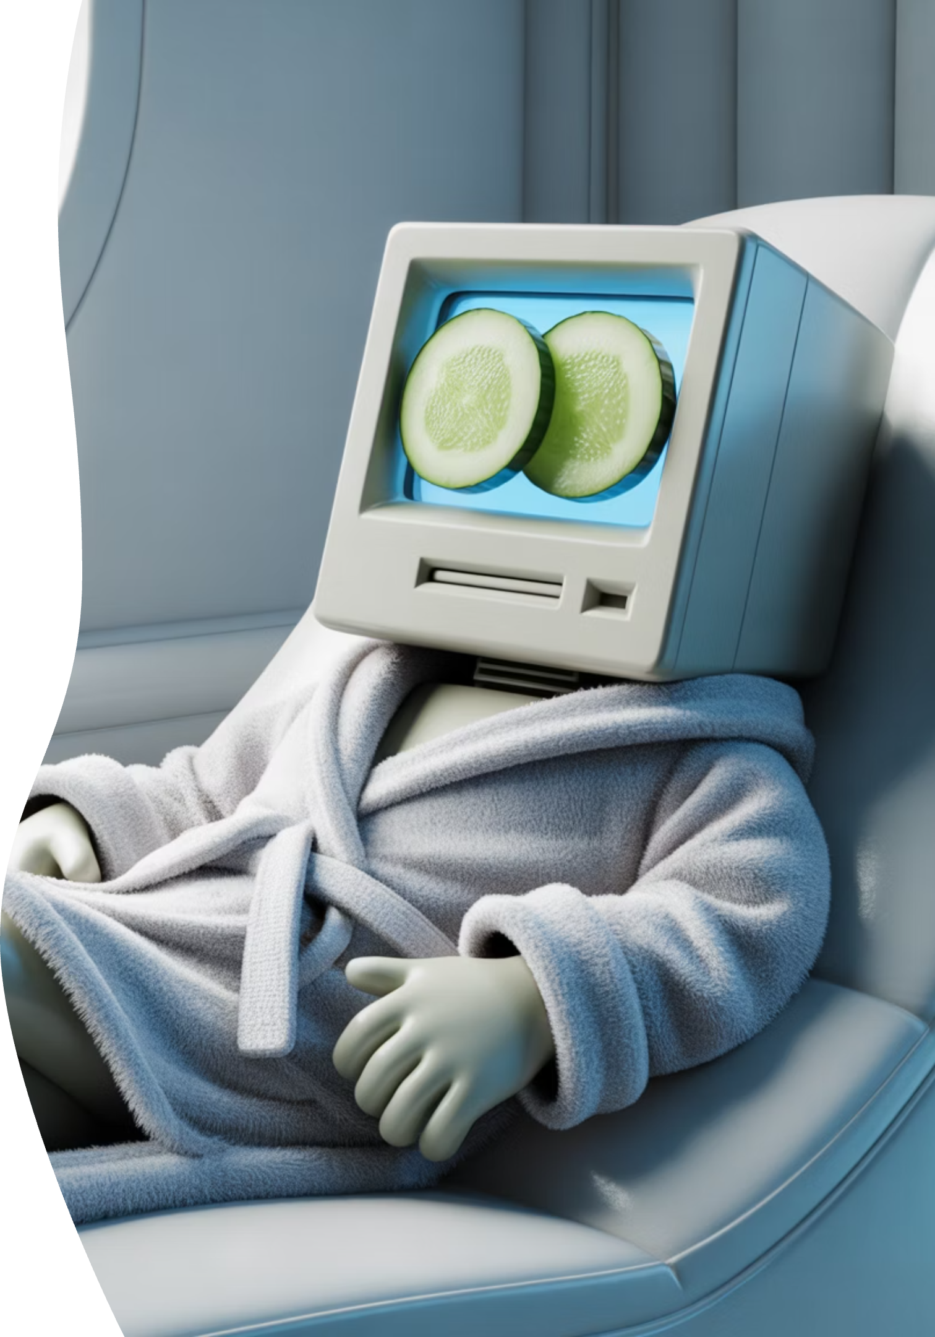

KEEPING YOUR PC / LAPTOP TUNED-UP
Give Your Computer a Spa Day — Not an ER Visit
Notes:
Good Afternoon, everyone! Let’s start with a truth the big box stores won’t tell you. Most computers don’t actually “die” when they get slow. They get overwhelmed. They suffocate under digital clutter and physical dust. Quick show of hands — who here has been told, “That thing is ancient, you need a new one”? And who wasn’t entirely convinced? Today, I’ll help you become the honest mechanic for your own computer.

Slide 2



Meet Jim Kallaugher: CSC Member & Volunteer
Red Glen Electronics
Weekly Tech Tuesdays
Monthly Tech Presentations
Founder and operator, with
friendly “Home Tech Help for Hire” for Boomers.
Volunteer tech support and guidance to community members on Tuesday afternoons.
Conduct tech topic seminars for better understanding & to encourage confidence
With 25+ years of experience making technology clear, simple, and accessible.
Notes:
Hi, I'm Jim Kay-la-her, a Senior Center Member, Volunteer, and Home Tech Support Consultant representing Red Glen Electronics. I founded Red Glen Electronics as a friendly "Home Tech Help for Hire" for Boomers. "Tech Tuesday" afternoons: I'm here every Tuesday afternoon for appointments. I offer hands-on tech support or one-on-one training as a regular volunteer. Monthly Tech Seminars: Every month, I'll lead tech topic seminars for a better understanding and to encourage confidence

Slide 3
Welcome, Cromwell Senior Center (CSC) Members
Fast. Safe. Out of Trouble. (No IT Degree Required)
Play Seminar Video Overview Clip
Notes:
Welcome -- today is not about learning computer code or becoming an IT expert. We’re here for one reason: confidence. Think of this like basic car maintenance for your computer — the kind that keeps it out of the emergency room.

Slide 4
What Today Is (and Is Not)
✔ Simple habits anyone can do
✔ Safe, everyday tune-ups
✖ No repairs
✖ No sales
✖ Not “about blame”.
“If you can click a mouse and restart a computer, you’re already qualified for everything we’re talking about today.”
Notes:
“Before we go any further, I want to slow down for a second — because this slide is important.
“Today is about simple, safe habits you can do yourself — the kind of things that keep your computer running well without taking risks.”
“We’re not fixing anything. We’re not opening the computer. And we’re definitely not doing anything that could break it.”
“This is also not a sales pitch. No one is leaving here being told they need to buy a new computer or new software.”
“If your computer has ever acted up, that doesn’t mean you did anything wrong. Computers are like cars — they need routine care.”
“Think of today as giving your computer a spa day, not an emergency room visit.”
“If at any point something sounds unfamiliar, that’s okay. You don’t have to remember everything — I’ll highlight the few things that really matter.”
“And if a question pops into your head later, that’s normal. There are no bad questions here.”

Slide 5
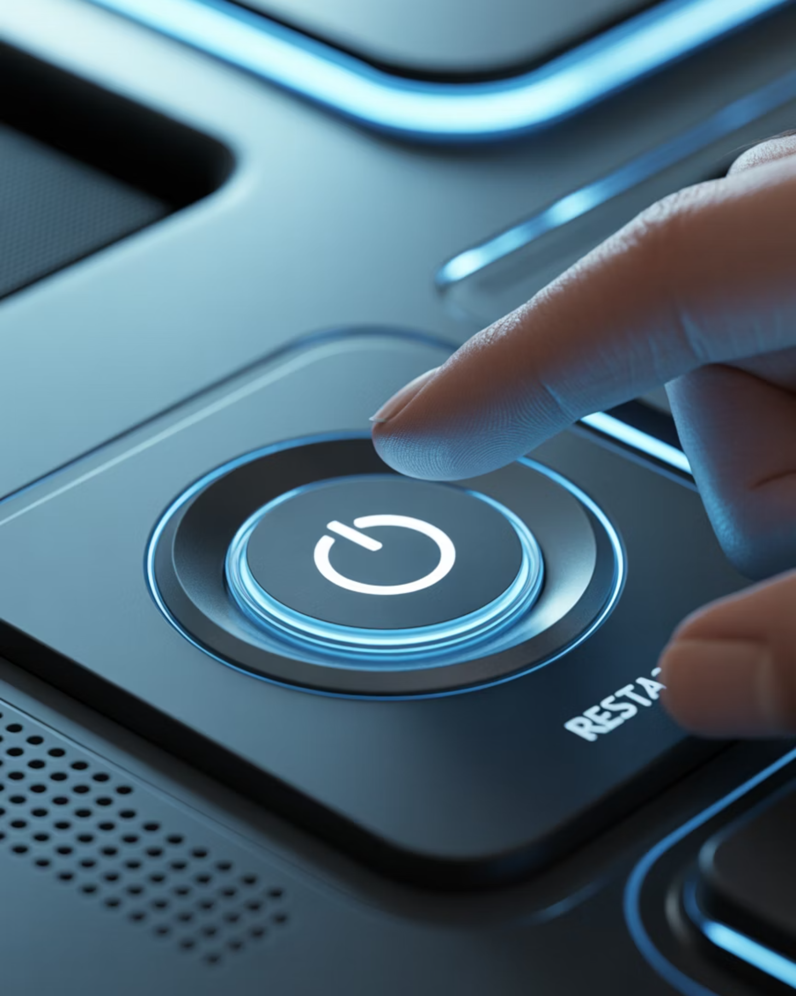
The #1 Fix in Tech
Have You Tried Turning It Off and On Again?
This solves more problems than anything else we’ll talk about today.
Notes:
It’s the oldest joke in tech support — and it’s a joke because it works. If you remember only one thing today, let it be this: restarting fixes about half of all strange computer problems. It clears out the cobwebs and lets the computer start fresh.

Slide 6
Sleep vs Restart
Sleep = Nap
Restart = Deep Sleep
The computer is still half-awake, still holding onto problems;
still running in the background
s
A deep, dreamless sleep that clears everything
Notes:
Most of us just close the laptop lid. That’s Sleep mode. The computer is still half-awake, still holding onto problems. A Restart is a deep, dreamless sleep. The Red Glen Rule: restart your computer at least once a week.

Slide 7
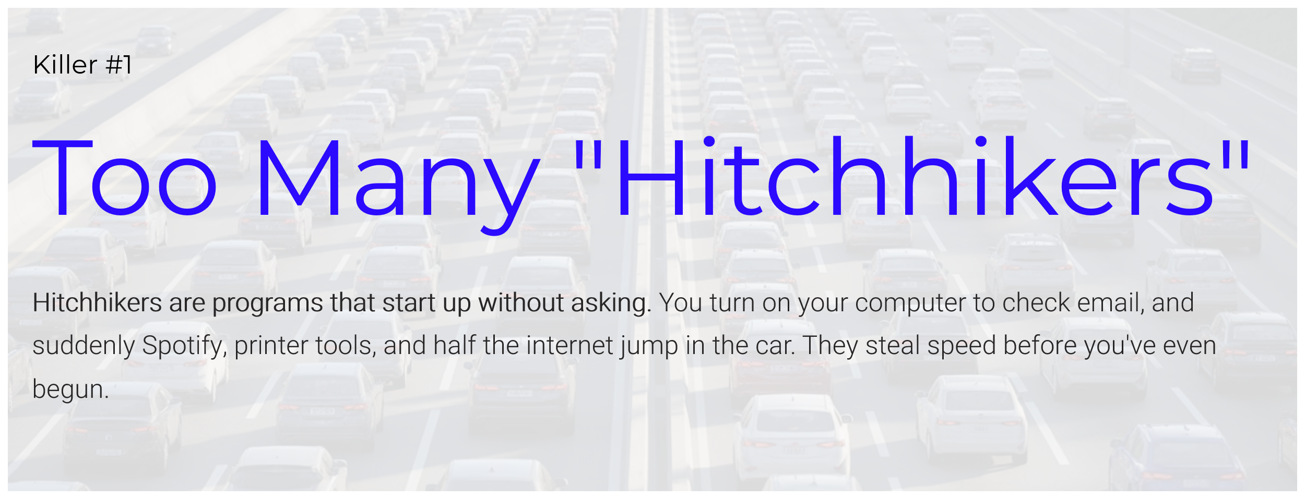
Some of the things we’ll cover today will need adjustment with guidance —
Not a click-around experiment– Start Programs; Cache clear; Uninstalls.
Set-up a “Tech Tuesday” Appointment Today!
Notes:
Hitchhikers are programs that start up without asking. You turn on your computer to check email, and suddenly Spotify, printer tools, and half the internet jump in the car. They steal speed before you’ve even begun.

Slide 8

Browser Tabs
1 Tab = 1 Grandkid
50 Tabs = Chaos
Notes:
We’re all guilty of this. Each open tab uses memory. Think of each one as a grandkid in the kitchen. One or two is lovely. Fifty? Flour on the ceiling and no one can find the spatulas. If you’re not using it right now — close it.

Slide 9
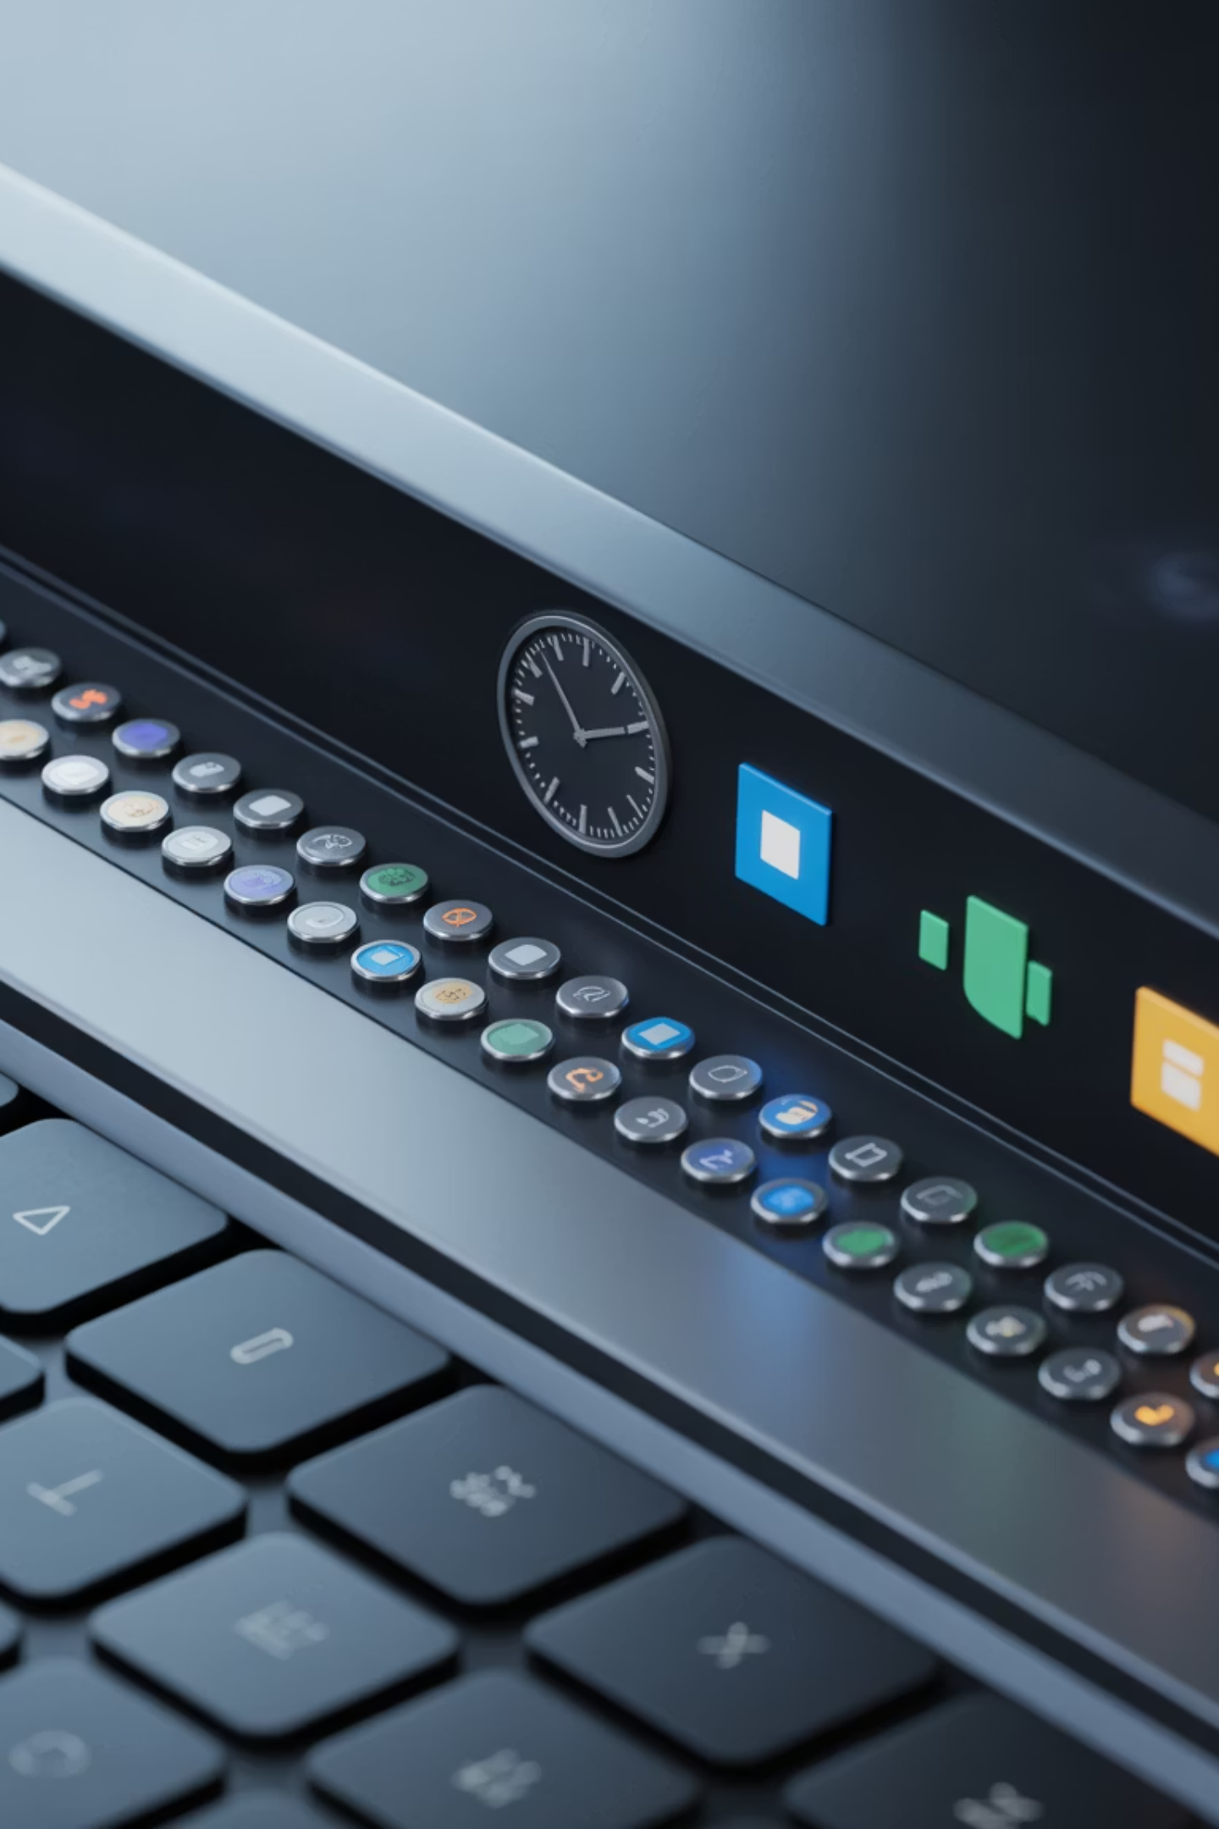
System Tray Icons
This is that little area down by the clock.
Tiny Icons = Speed Leaks
Notes:
Look near the clock on your screen. Every tiny icon is a program currently running and taking a paycheck from your computer’s power. If you don’t recognize it, it probably doesn’t need to be running.

Slide 10
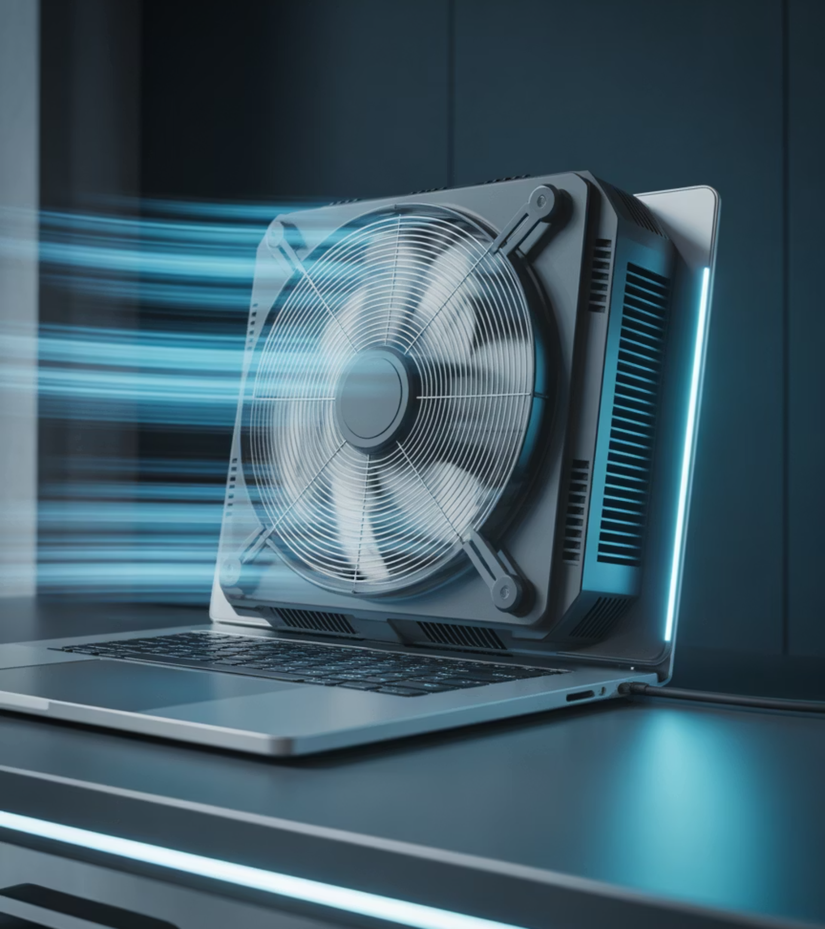
Listen to Your Computer
Jet Engine = Overworked
If it sounds like it’s working hard while you’re doing nothing, that’s a clue.
Notes:
Your computer talks to you. If it sounds like it’s trying to take off, it’s overheated and overwhelmed — not broken. That’s your cue to close things or check for dust.

Slide 11
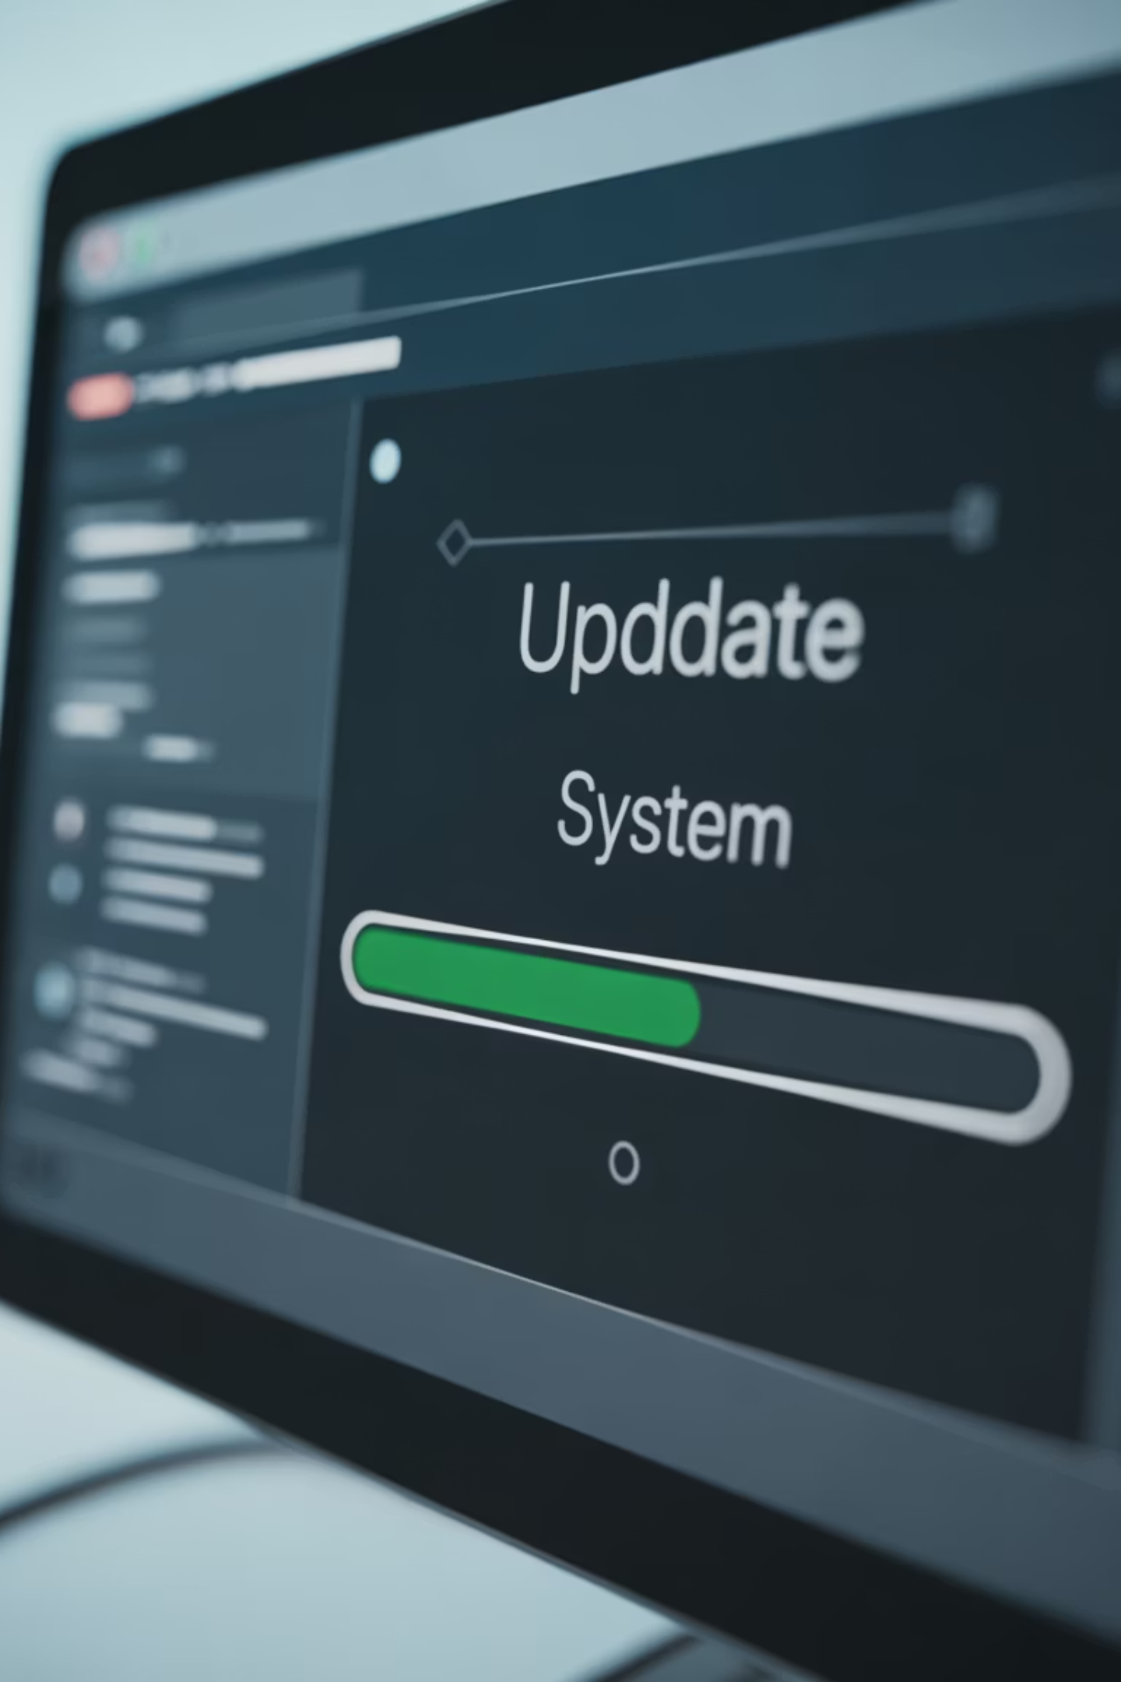
Updates
Updates = Flu Shots
Antivirus isn’t something you install and forget.
It’s something you let update quietly in the background — like smoke detector batteries
If your computer is updating itself regularly, you’re probably okay for everyday use
Notes:
Updates are annoying. They always pop up at the worst time. But they protect you from hackers and fix glitches. Skipping updates is like leaving your front door unlocked in a storm
If you ever feel unsure about your security, that’s not a failure — that’s a hand-off moment. Get a second set of eyes before clicking anything scary
.

Slide 12

Stop Postponing
You’re not in trouble — we’ve all done this
Let's Make a Pact
No more "Remind me tomorrow" for weeks on end. Next time it asks, click "Okay." Five minutes of updating beats five days of problems.
Notes:
No more “Remind me tomorrow” for weeks on end. Next time it asks, click “Okay.” Five minutes of updating beats five days of problems.

Slide 13
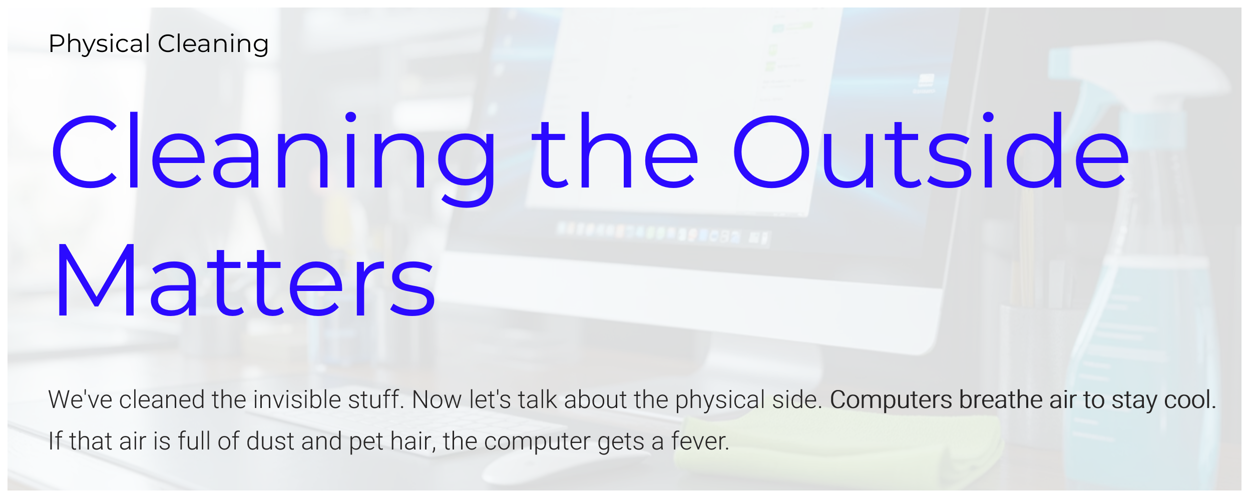
Note: You’re cleaning around the computer, not inside it
Notes:
We’ve cleaned the invisible stuff. Now let’s talk about the physical side. Computers breathe air to stay cool. If that air is full of dust and pet hair, the computer gets a fever.

Slide 14
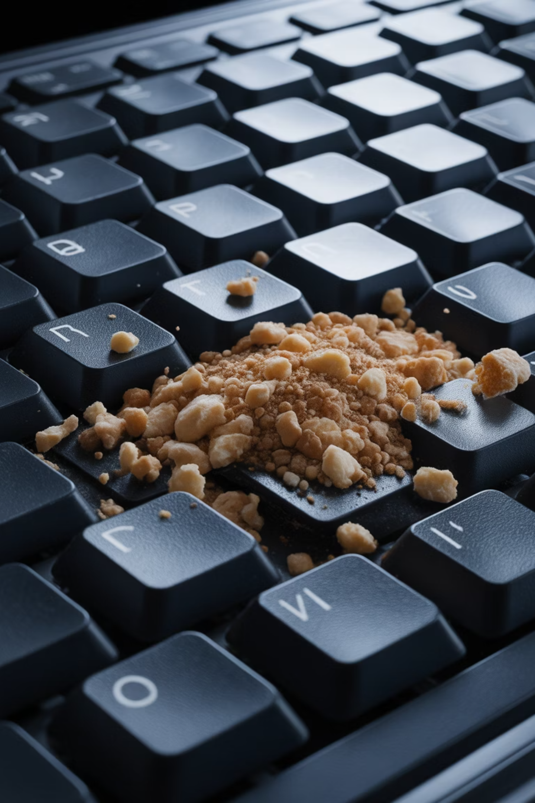
Keyboard Snack Bar
What's Living Under Your Keys?
Notes:
Be honest — who snacks while using their computer? Crumbs get under keys and cause sticky behavior. Turn the keyboard upside down and gently shake. You may discover last Tuesday’s muffin.

Slide 15

Canned Air
Dust = Heat
Heat = Slow
Notes:
A $5 can of compressed air is one of the best investments you can make. Short bursts into the vents will blow out dust and help your computer cool down.

Slide 16
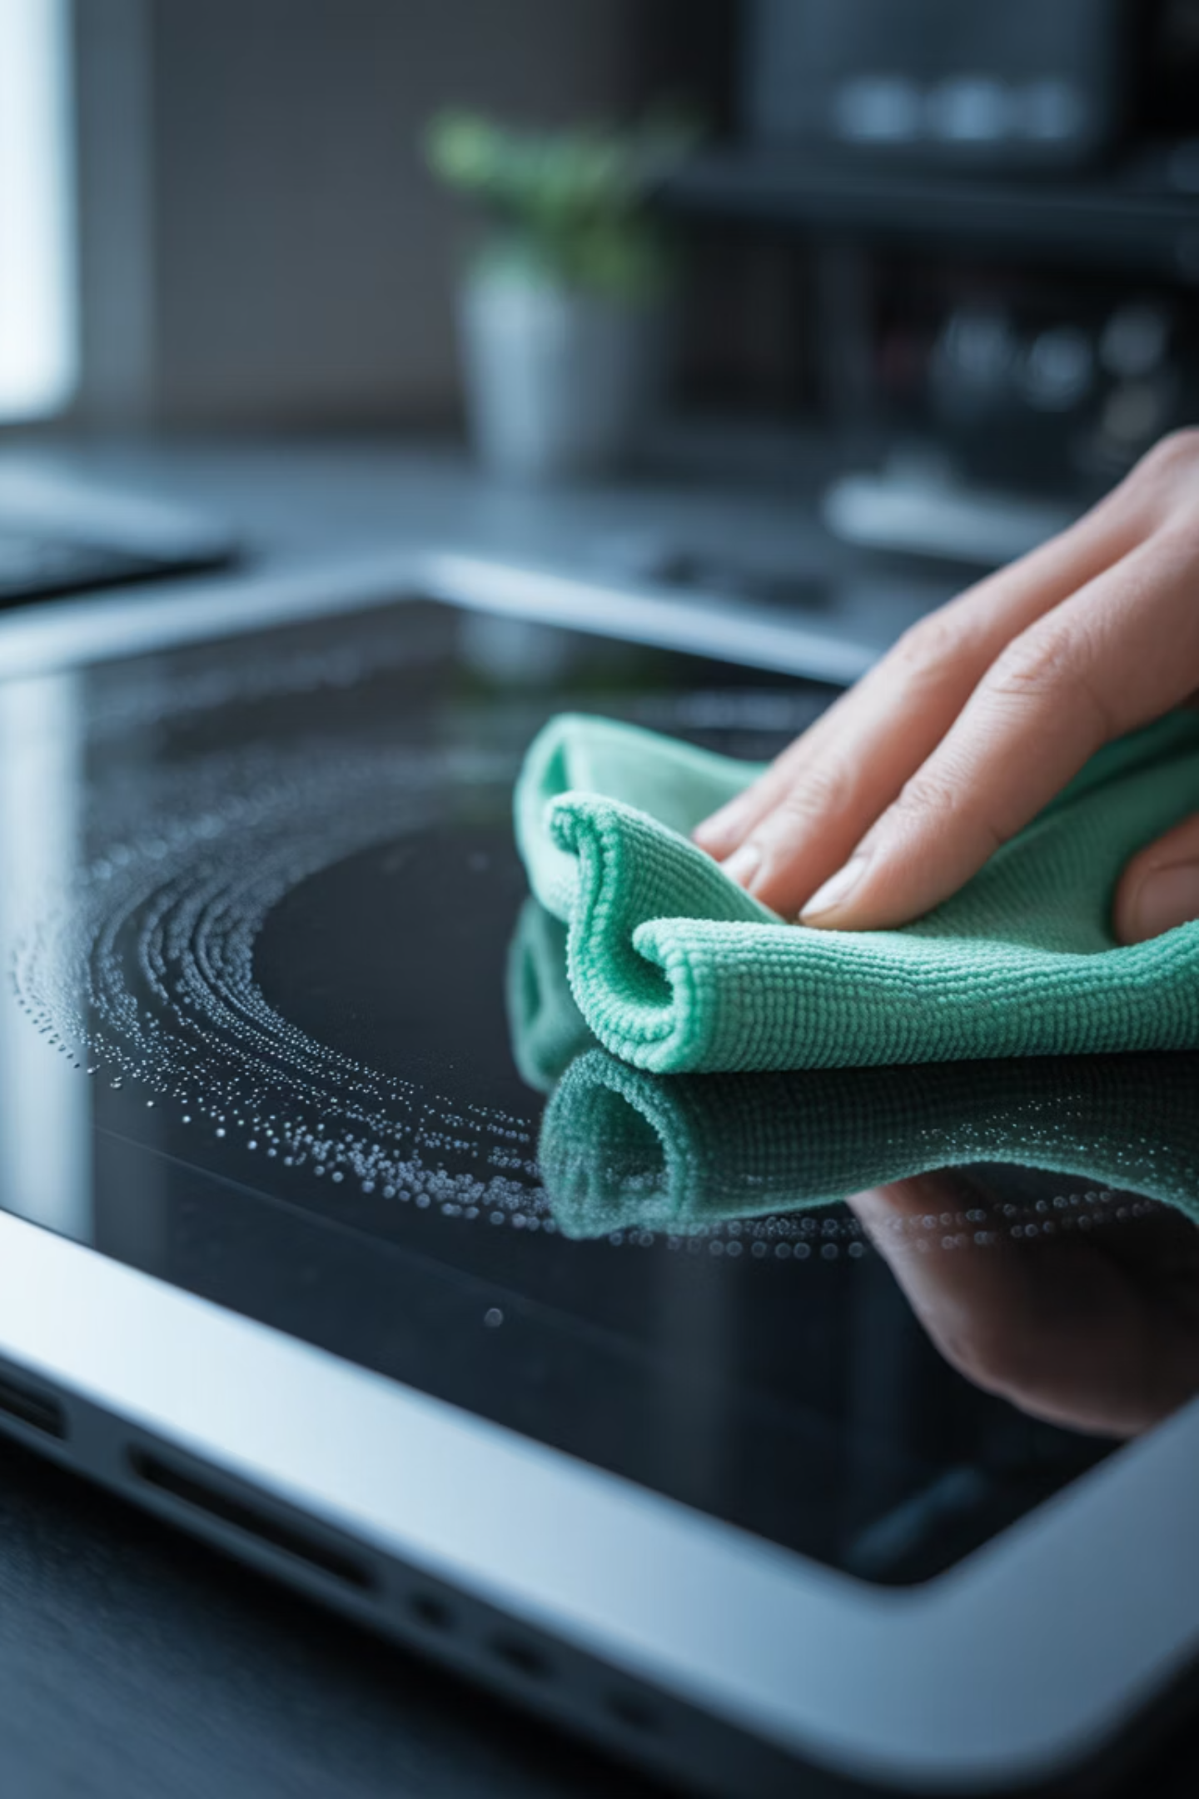
Screen Cleaning
Spray the Cloth — Not the Screen
Notes:
Never spray liquid directly on the screen. Spray a microfiber cloth lightly and wipe gently. Liquids that seep inside can damage electronics.

Slide 17
Safety Tip
Don't Shake the Can
Keep canned air upright. Shaking it or turning it upside down can spray freezing liquid onto delicate parts. Calm, short bursts are the way to go.
Notes:
Keep canned air upright. Shaking it or turning it upside down can spray freezing liquid onto delicate parts. Calm, short bursts are the way to go.

Slide 18
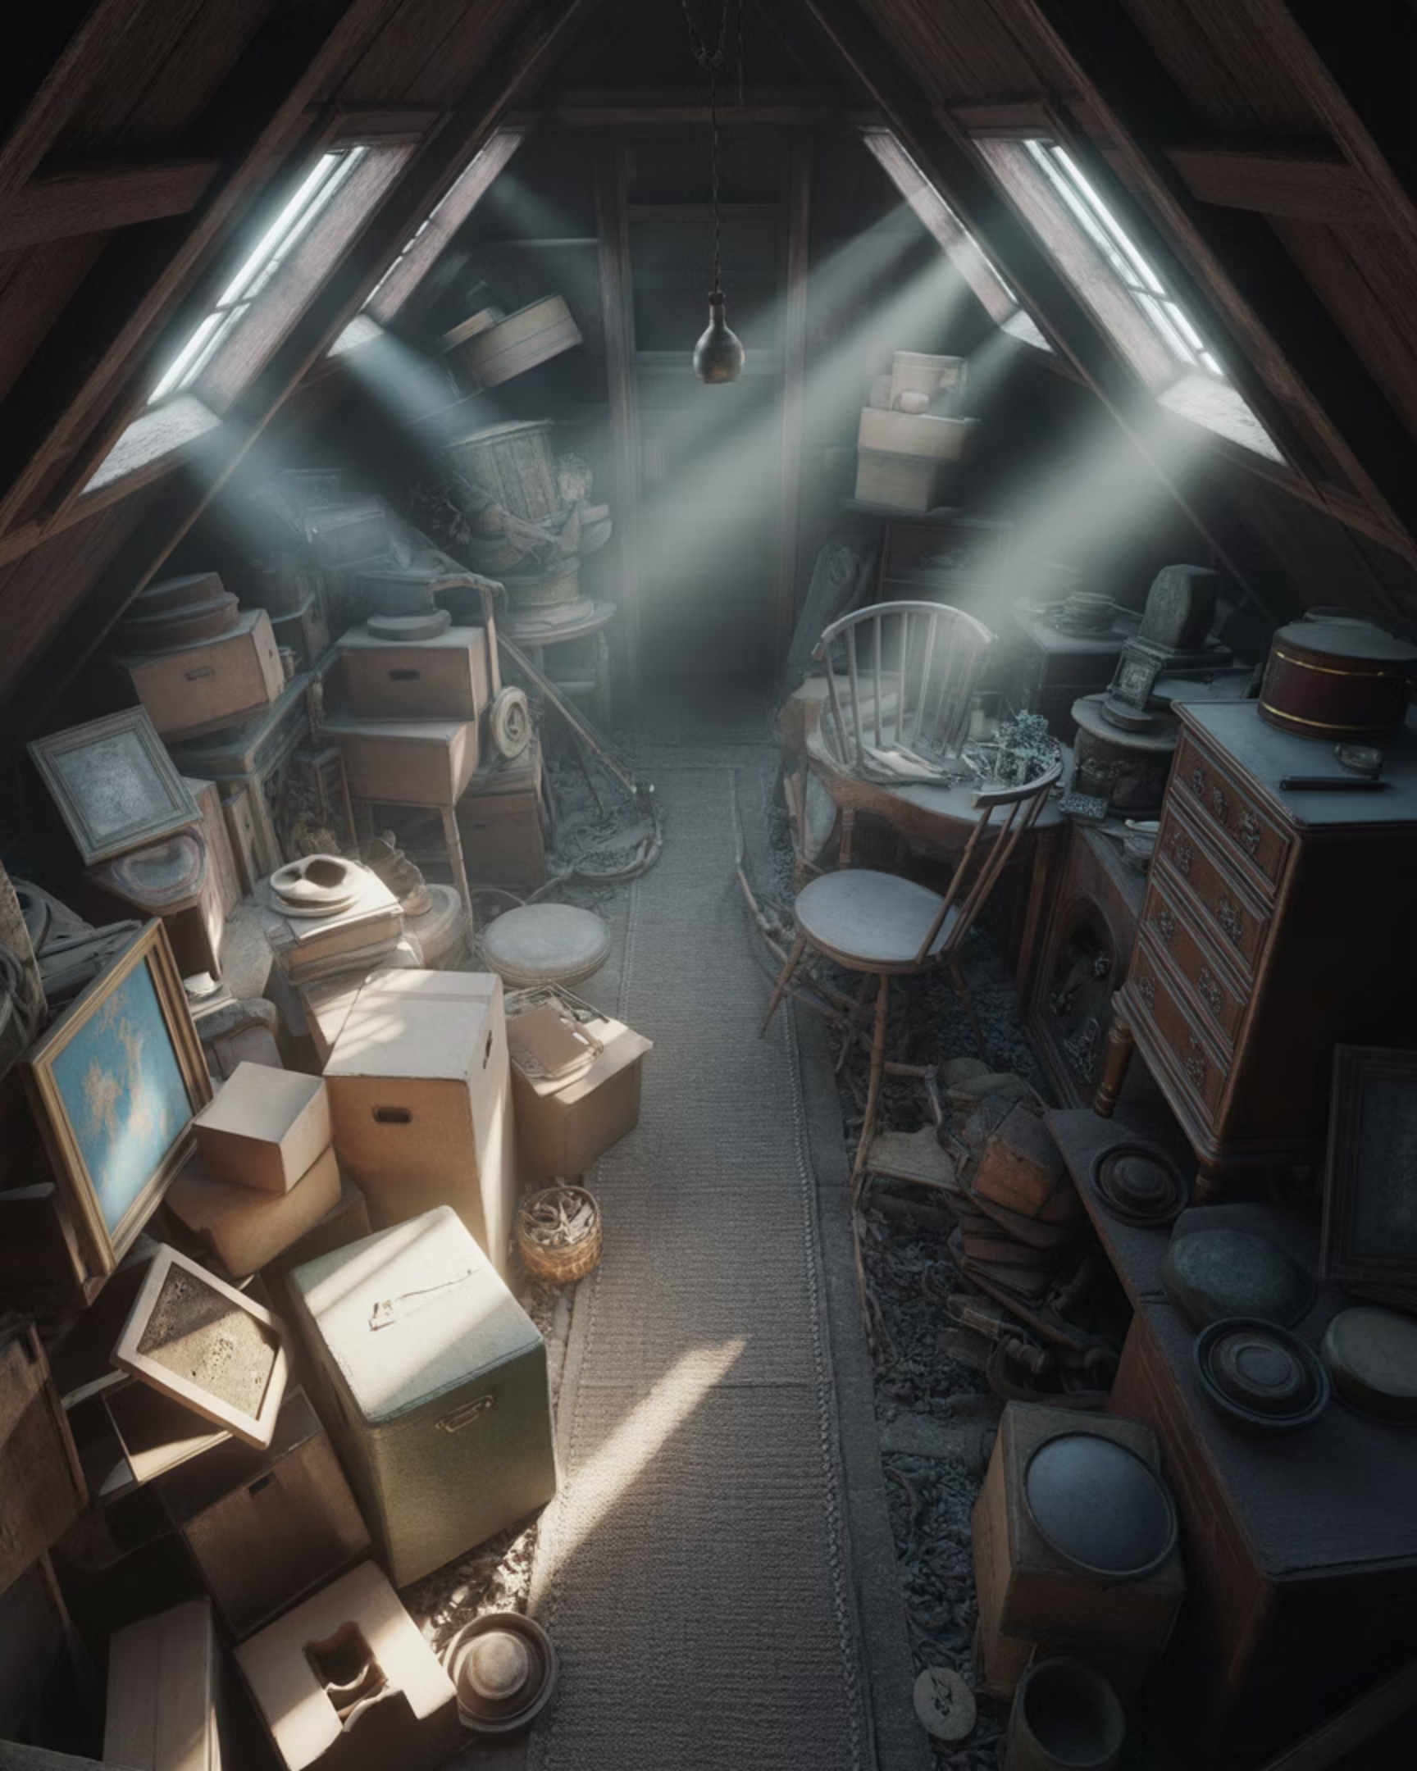
Storage Space
Your Digital Attic
Notes:
A hard drive that’s almost full is like an attic you can’t walk through. Your computer needs breathing room — ideally 15% free space — just to function properly.

Slide 19

Photos & Videos
The Biggest Space Hogs
Notes:
One short video can take more space than thousands of emails. You don’t need to delete memories — just move older ones to an external drive or the cloud.

Slide 20
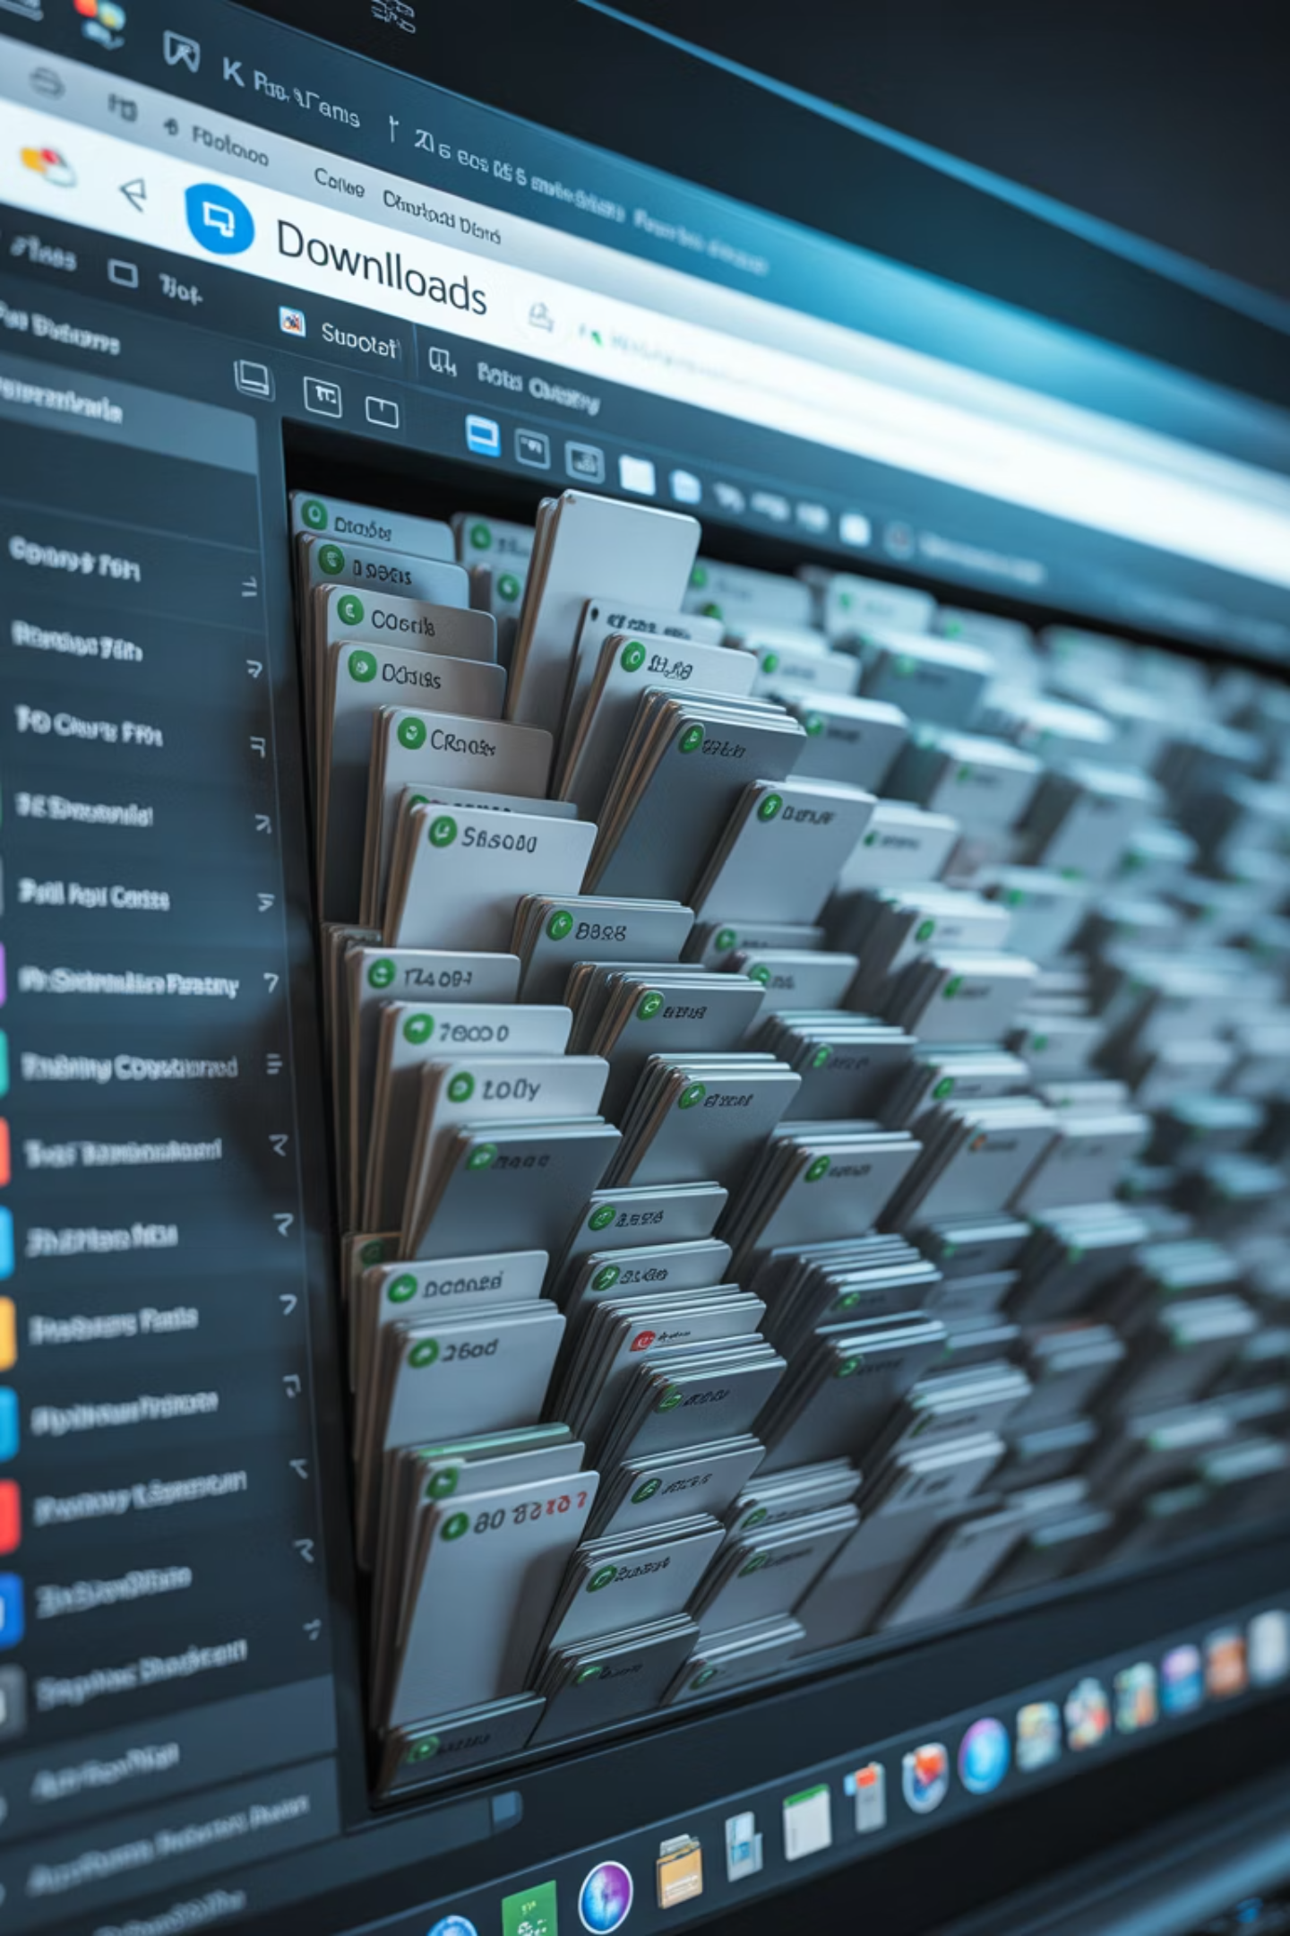
Downloads Folder
The Junk Drawer
Notes:
Most people forget this folder exists. Old menus, forms, and duplicates pile up. If you’ve already used it, move it or delete it.

Slide 21

Empty the Trash
Delete Isn't Final --
Until you empty the trash, the computer still thinks it owns those files
Notes:
Deleting moves files to the trash — they’re still in the house. Empty the Recycle Bin or Trash to actually get space back.

Slide 22

Unused Programs
If You Don't Use It — Lose It
Notes:
If you haven’t used a program in years, uninstall it. It’s taking up space and sometimes running quietly in the background.

Slide 23
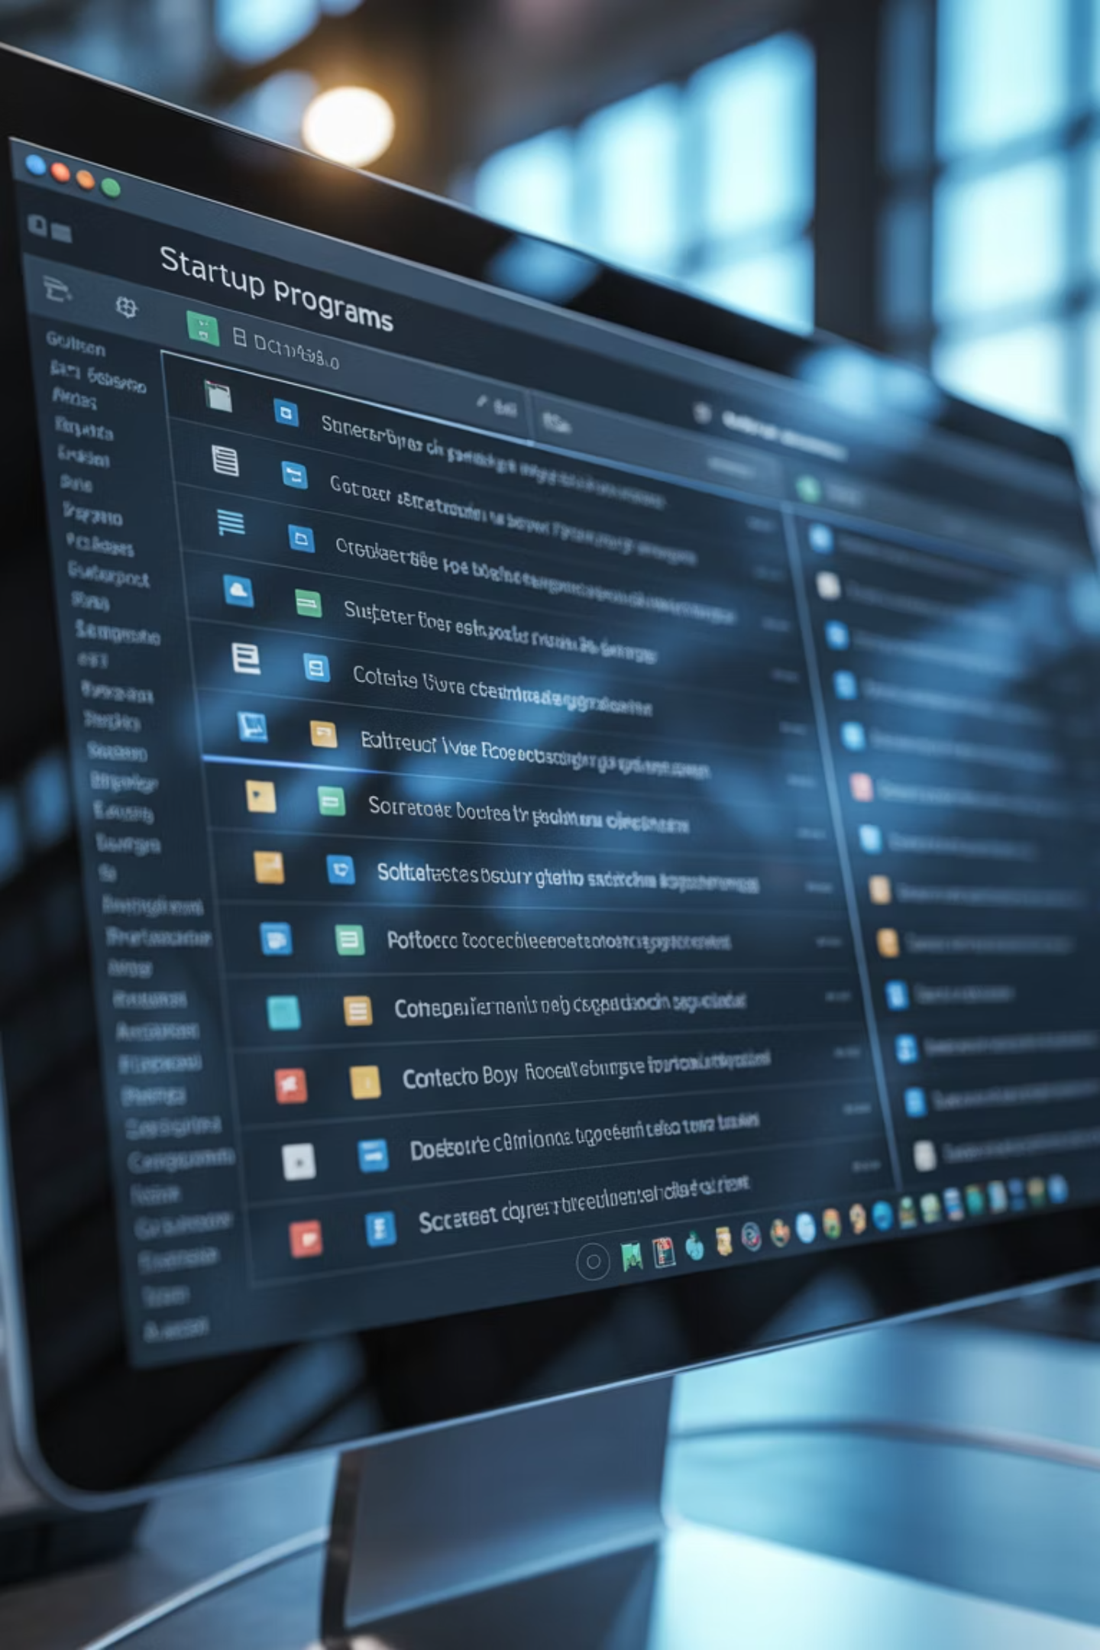

Startup Programs
"Not Yet!"
Notes:
We’re not deleting these programs — just telling them they can wait. This is one of the fastest ways to make an older computer feel younger.

Slide 24

Antivirus
Security Is a Habit
You don’t need to buy anything today.
Notes:
More antivirus programs don’t mean more safety — they can actually fight each other. One good program, run monthly, is enough.

Slide 25
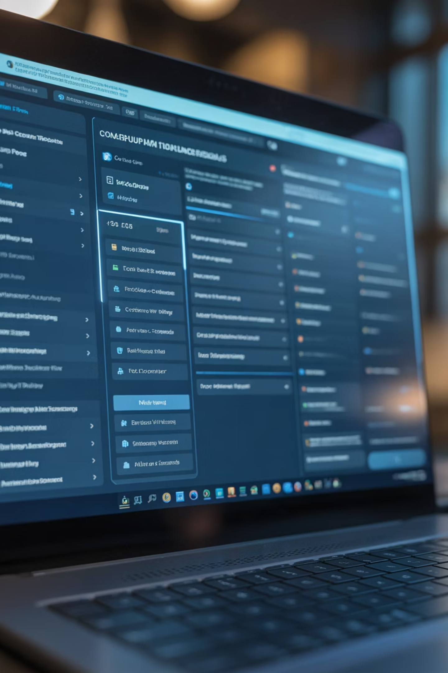
Built-In Tools
Let the Computer Clean Itself
These are tools that already came with your computer — you already paid for them.
Notes:
Windows and Macs include cleanup tools. Think of them as built-in housekeeping services. They safely remove junk for you.

Slide 26

Browser Cache
Wiping the Chalkboard
.
Notes:
If a website acts strangely, clearing the browser cache often fixes it. It’s like erasing old chalk so the new lesson shows clearly.

Slide 27
Web Data: Cache vs. Cookies: Key Differences
Primary Purpose
Cache: A “memory bank” that speeds up websites by saving static files on your device.
Cookies: An “ID badge” that remembers who you are, including preferences and login status.
Content & Storage
Cache: Stores large items such as images, logos, videos, and fonts.
Cookies: Store small text data such as usernames, session IDs, and site settings.`
.
Notes:
The Cache is a "Memory Bank" for fast loading, while Cookies are an "ID Badge" for your logins.
The Cache saves the building for everyone, but Cookies remember the person inside.

Slide 28
Web Data: Cache vs. Cookies: Key Differnces (Cont’d)
Personalization
Cache: Stores general website data that’s the same for all visitors.
Cookies: Store personalized information specific to you and your browsing session.
Storage Impact
Cache: Can grow large over time (hundreds of MBs or more).
Cookies: Very small files that take up almost no space.
Summary Tip
Think of it this way: The Cache saves the building, while Cookies remember the person inside the building.
.
Notes:
The Cache stores general data that can clutter storage, while Cookies are tiny files for personal settings.
A "Spa Day" clears the large Cache files, while clearing Cookies resets your identity on sites.

Slide 29

Repair or Replace?
When Is "Old" Too Old?
Notes:
Sometimes a computer really is ready for retirement. The question is whether it needs a tune-up — or a replacement.

Slide 30
The 5-Year Rule
Tune-Up vs Replace
Under 5 Years Old?
Over 6 or 7 Years?
Almost always worth fixing.
The hardware may simply be outdated.
That’s not failure — that’s just time doing its thing.
This is about being practical — not wasteful.
Notes:
Under 5 years old? Almost always worth fixing. Over 7 or 8 years and struggling? The hardware may simply be outdated.

Slide 31

The Grandchild Test
Museum-Ready?
If your grandkid sits down and says, "Wow… what is this?" — that's your sign. If they can make it run faster, you just need a Spa Day.
Notes:
f your grandkid sits down and says, “Wow… what is this?” — that’s your sign. If they can make it run faster, you just need a Spa Day.

Slide 32
Quick Checklist
Your Monthly Spa Day
1
2
3
Restart Weekly
Clean Dust Seasonally
Empty the Trash
Give your computer a fresh start regularly.
Keep the physical components clean.
Remove unnecessary files and clutter.
Do these simple things and you'll avoid most major problems.
Notes:
Restart weekly. Clean dust seasonally. Empty the trash. Do these simple things and you’ll avoid most major problems.

Slide 33
Ask Me Anything -- No Question Is Too Small
Notes:
What’s the most annoying thing your computer does? This is the time to ask. You’re probably not the only one wondering.

Slide 34
You're the Boss
Thank you for coming and give your computer a Spa Day.
Notes:
Technology should serve you — not intimidate you. The computer may smell your fear sometimes… but it can’t survive you pulling the plug. Thank you for coming, and go give your computer a Spa Day.

Slide 35
Suggested Questions for Consideration
How many people here leave their computer on for days — or even weeks — at a time?
Has anyone ever opened their computer and thought, “Why does this feel slower than it used to?”
Was there one thing today that surprised you, even a little?
Is there something you’ve been afraid to click in the past, but feel better about now?
What’s one small habit from today that feels doable — even if it’s just restarting once a week?
Notes:
Suggested Questions for Consideration

