Slide 1
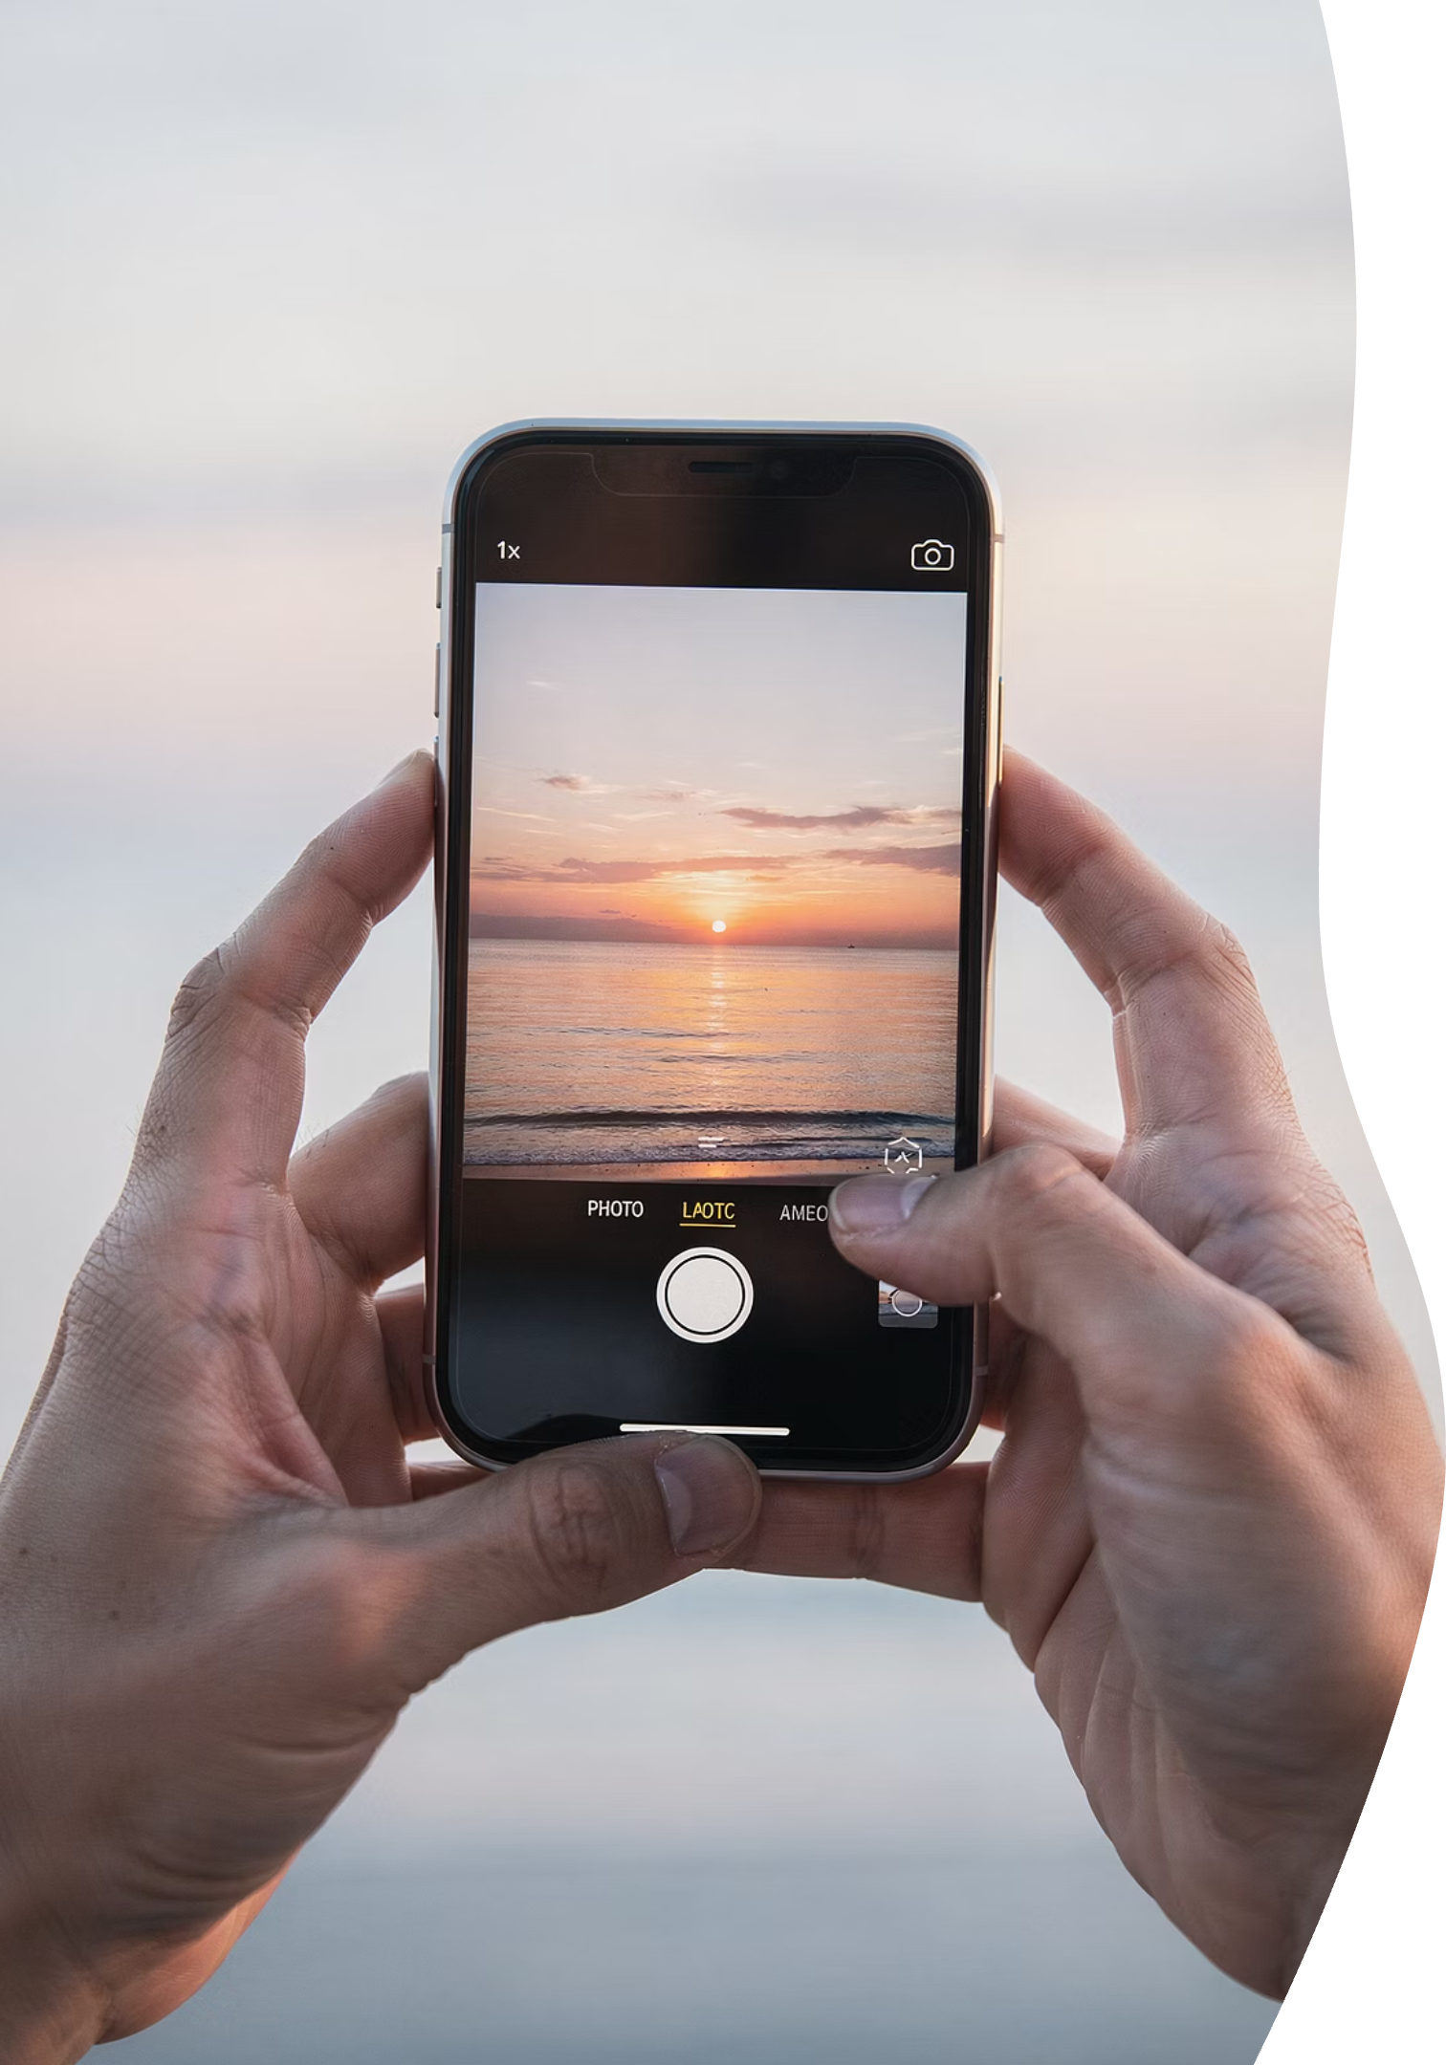
📘 iPhone Essentials Intro 101 — Part 2 (April 2026)
Camera, Photos & Everyday iPhone Mysteries
Red Glen Electronics – Middletown, CT
A Boomer Helping Fellow Boomers
Notes:
Welcome back, everyone — I'm really glad you're here. This is Part 2 of our iPhone Essentials series. When we first planned this program back in March, it was originally designed as a two-part series. But as we started teaching it — and as you asked great questions — it became clear that photos deserved their own calm, unrushed session.
Photos are one of the most emotional parts of the iPhone. They involve family, memories, and moments you don't want to lose. So we slowed this down on purpose.
That's also why this series became three parts instead of two — not because it's complicated, but because you shouldn't have to rush to understand it.
If you missed Part 1, I strongly recommend watching it in the RGE Seminar Archives. And before you leave today, I encourage you to sign up for Part 3, where we'll focus on making your iPhone more personal, more useful, and more secure.

Slide 2
Welcome, Cromwell Senior Center (CSC) Members
A friendly, practical introduction to iPhone 101 – Part 2
— no jargon, no pressure, and no tests!
Notes:
Welcome To Part 2 of iPhone 101 Essetials
Whether you attended this live or you’re watching the replay later, you’re exactly where you should be.
This session was designed for real, everyday iPhone use — not the stuff buried in manuals or hidden in settings menus. We’re keeping this practical, friendly, and pressure-free.

Slide 3



Meet Jim Kallaugher: CSC Member & Volunteer
Red Glen Electronics
Weekly Tech Tuesdays
Monthly Tech Presentations
Founder and operator, with
friendly “Home Tech Help for Hire” for Boomers.
Volunteer tech support and guidance to community members on Tuesday afternoons.
Conduct tech topic seminars for better understanding & to encourage confidence
With 25+ years of experience making technology clear, simple, and accessible.
Notes:
Hi, I’m Jim Kay-la-her, a Senior Center Member, Volunteer, and Home Tech Support Consultant
Red Glen Electronics:
I founded Red Glen Electronics as a friendly “Home Tech Help for Hire” for Boomers
Tech Tuesdays:
I‘m here every Tuesday afternoon for appointments.
I offer hands-on tech support or one-on-one training as a regular volunteer.
Monthly Tech Seminars:
Every month, I’ll lead tech topic seminars for a better understanding and to encourage confidence

Slide 4
Module 1
Camera Confidence
Notes:
Camera Configence

Slide 5
Welcome Back: iPhone 101, Part 2
iPhone Essentials Intro 101
Part 2: Camera, Photos & Everyday Mysteries
Red Glen Electronics
A Boomer Helping Fellow Boomers
Notes:
This is Part 2 of our iPhone Essentials series, and today we’re focusing on photos, the camera, and finding things again — three areas that cause a lot of unnecessary stress for people.

Slide 6
Why Photos Cause Stress
Photos move
Photos duplicate
Photos seem to disappear
Notes:
Photos seem to move.
They appear to duplicate.
And sometimes they feel like they disappear.
None of this means anything is broken — it just means the phone organizes things differently than we expect.

Slide 7
Reassurance First
You can't ruin photos by looking
Nothing breaks easily
Notes:
This is one of the most important ideas of the entire session:
You cannot ruin your photos by looking at them.
Opening photos, swiping, tapping — all of that is safe. iPhones are designed to survive exploration. You have to take very specific actions to actually delete or damage anything.
So today, curiosity is allowed. Fear is optional.

Slide 8
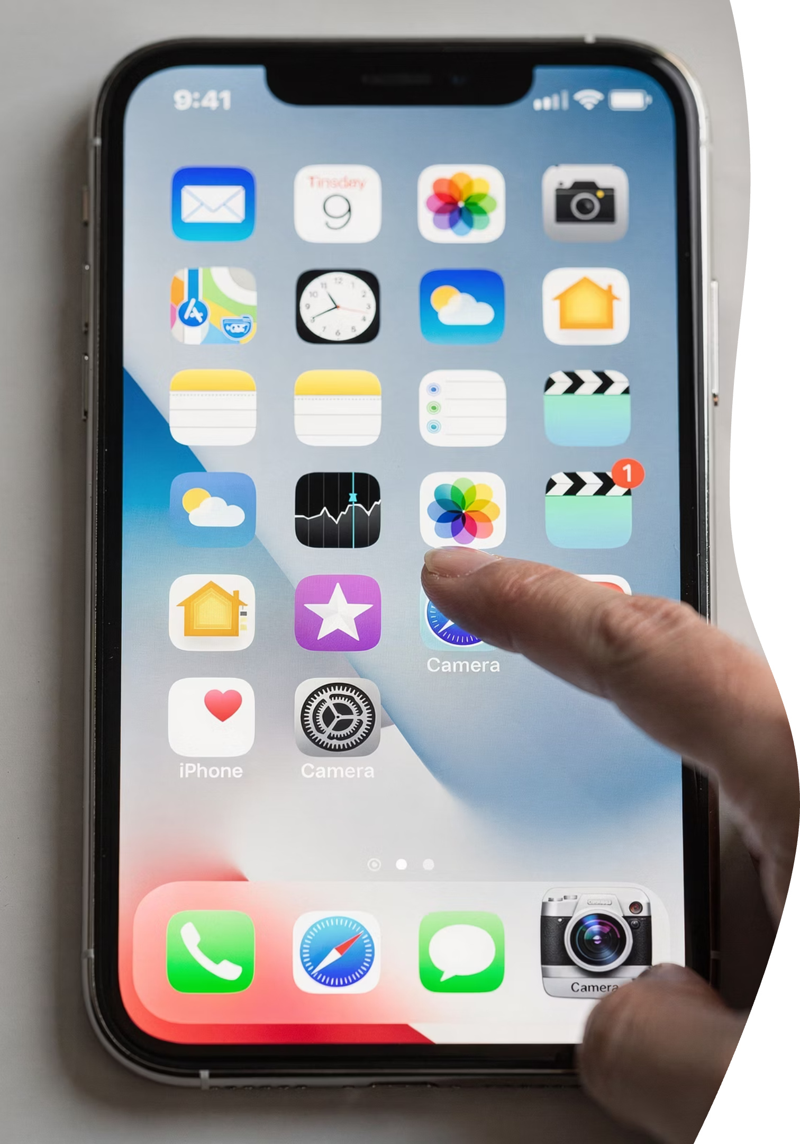


Opening the Camera
Camera app takes photos
Does not store photos
Notes:
The Camera app does exactly one job: it takes pictures.
It does not store them. That's an important distinction. Think of the Camera app like a camera lens — it captures the moment, then hands it off somewhere else for storage. That "somewhere else" is the Photos app, which we'll talk about shortly.

Slide 9


Taking a Photo
Tap the white button
One tap = one photo
Notes:
Taking a photo is intentionally simple. One tap on the white button — that's it.
There's no "Are you sure?" screen. There's no danger. If you hear a click or see a quick flash, the photo has been taken successfully.

Slide 10
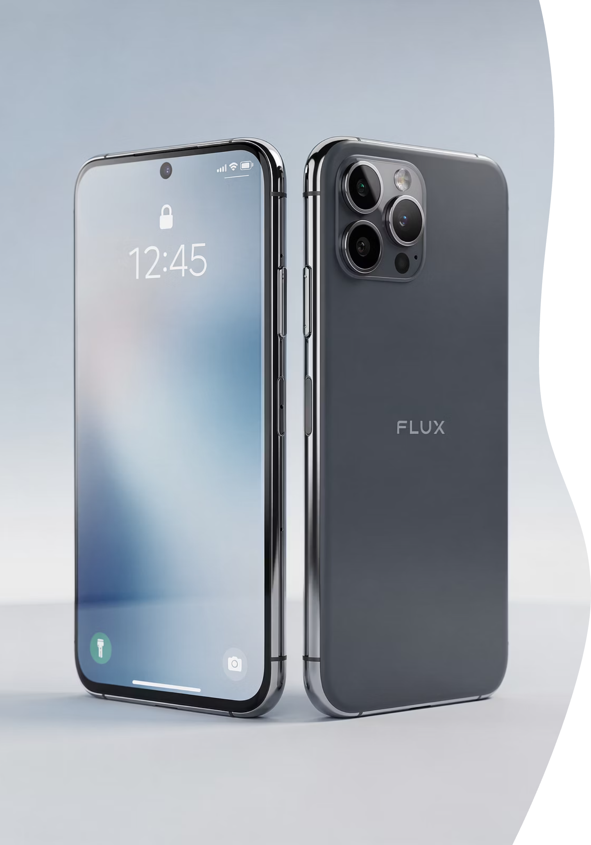
Front vs Back Camera
Back camera faces away
Front camera faces you
This is usually the best quality camera. It's pointed away from you, capturing what you're looking at.
This is the selfie camera. If you suddenly see your own face, you've switched to the front camera.
Notes:
If the camera is pointed away from you, you're using the back camera — that's usually the best quality.
If you suddenly see your own face on the screen, you're using the front camera. That's not a mistake — that's how selfies and FaceTime work. Surprise selfies happen to everyone.

Slide 11



Zoom, Flash & Live Photos
Pinch to zoom
Flash adds light
Live Photos capture motion
Brings things closer on screen
Brightens dark scenes
Records a second or two of movement
Notes:
Pinching zooms in.
Flash adds light when things are dark.
Live Photos capture a second or two of motion.
None of these change or harm your photo — they just change how it’s captured.

Slide 12
Photo Anxiety Reset
Looking is safe
Photos are not fragile
Notes:
I want to reset something here: photos are not fragile objects.
They don't crack. They don't break. They don't get "used up."
Looking at photos is always safe.

Slide 13
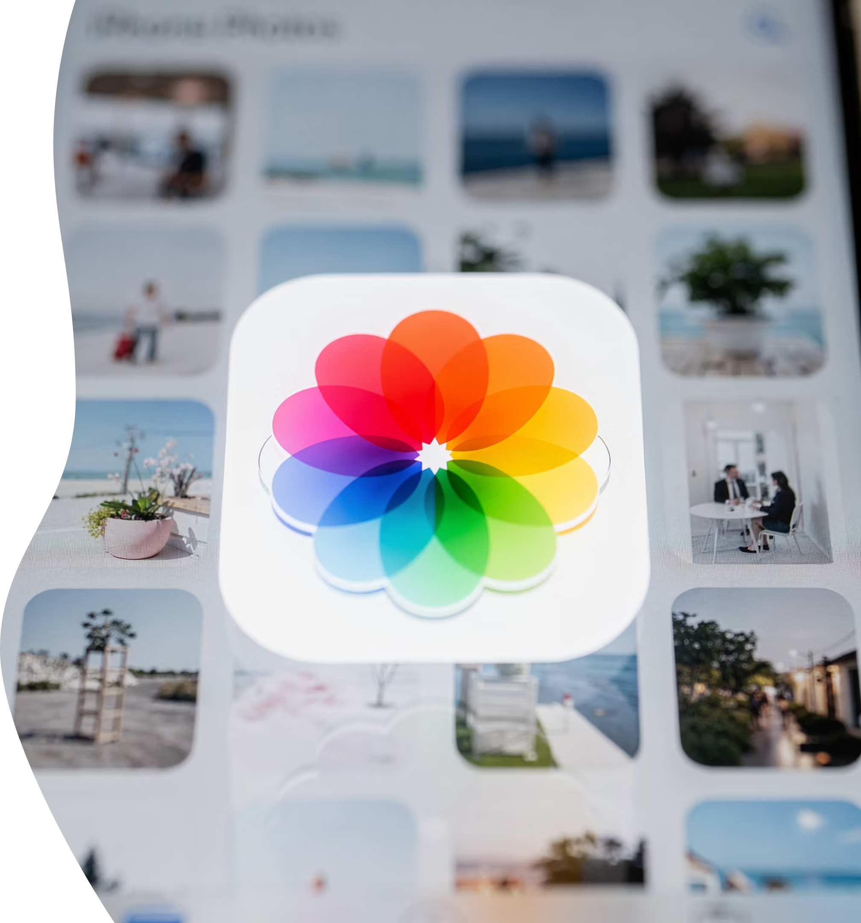


Module 2
Photos App Demystified
Where Photos Actually Live
Photos app stores photos
Camera app does not
Notes:
Every photo you take, receive, or save lives in the Photos app.
That’s your digital photo album.
If you ever wonder where something went, this is the first place to look.

Slide 14
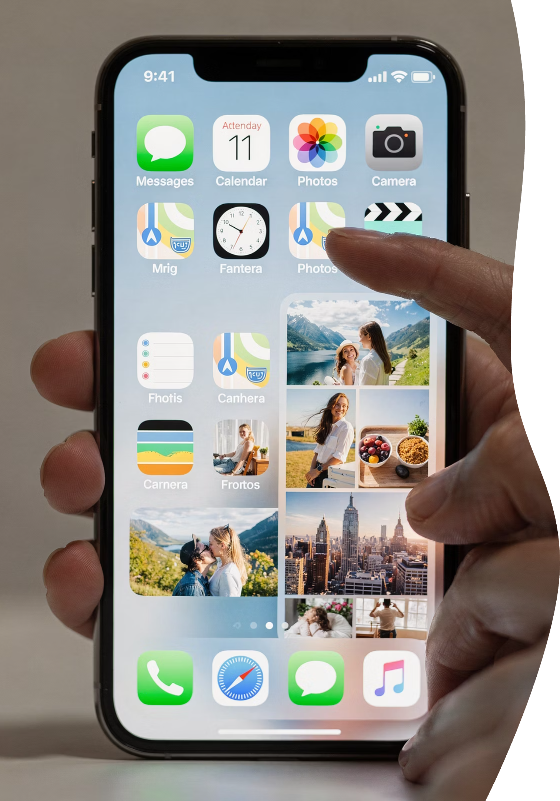

Opening the Photos App
Photos = your photo library
Notes:
When you open Photos, you’re opening your entire photo library.
Everything is there.
Nothing is hidden.

Slide 15
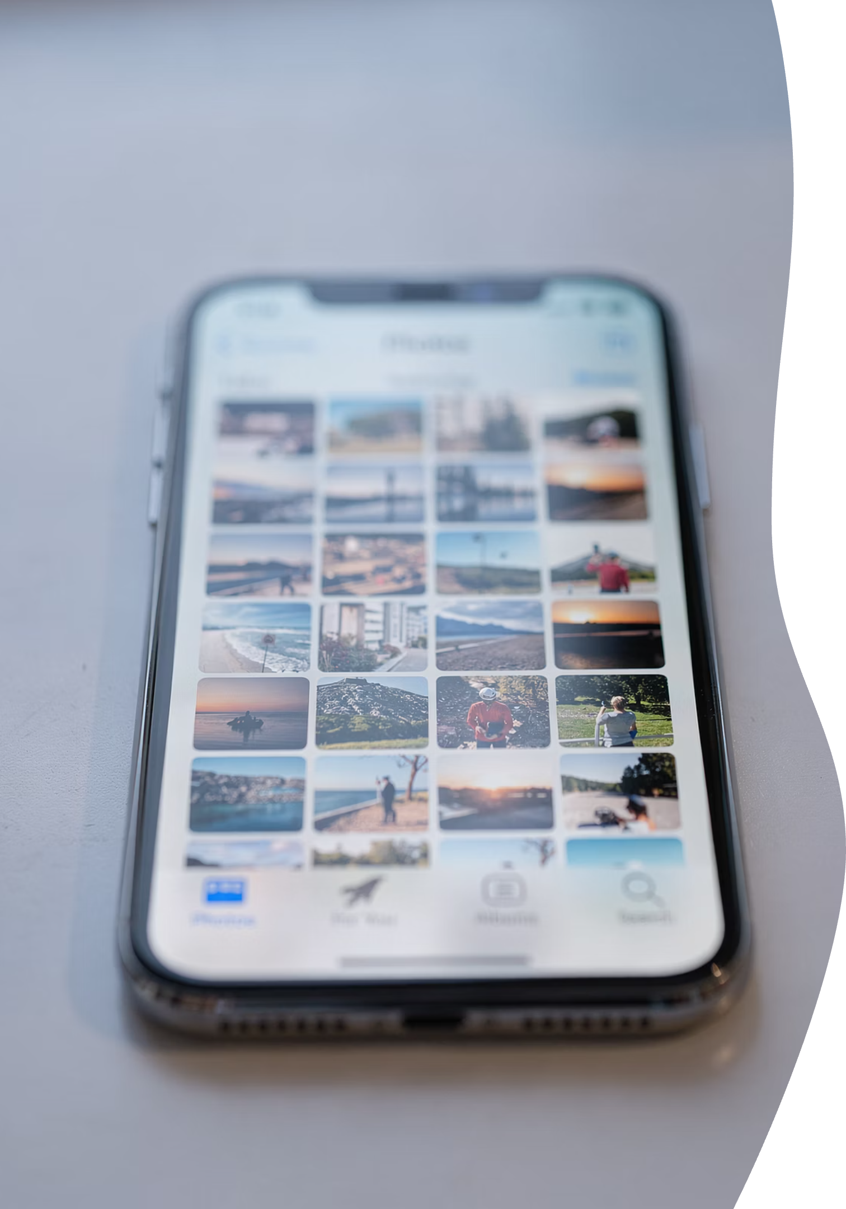
Library View Explained
1
Newest photos at the bottom
This is the default view in your photo library
Notes:
The newest photos usually appear at the bottom, not the top.
That surprises many people — and it explains why photos seem to “move.”
They didn’t move. The view changed.

Slide 16
Albums Are Not Copies
Albums organize
Photos are not duplicated
Think of albums like playlists for music. They're just different ways to view the same photos.
The same photo can appear in multiple albums without taking up extra space.
Notes:
Albums organize photos — they don’t duplicate them.
Think of albums like music playlists.
The same photo can appear in several albums without taking up extra space.

Slide 17



Common Albums
Recents
People
Screenshots
Your most recently added photos
Photos organized by faces the iPhone recognizes
Images you've captured from your screen
Notes:
Recents, People, Screenshots — these are created automatically.
You don’t have to manage them unless you want to.
They’re helpers, not chores.

Slide 18
"Where Did My Photo Go?"
It didn't disappear
It moved
Notes:
Photos almost never vanish.
When something seems gone, it’s usually just being viewed differently.
Stay calm — it’s almost always still there.

Slide 19
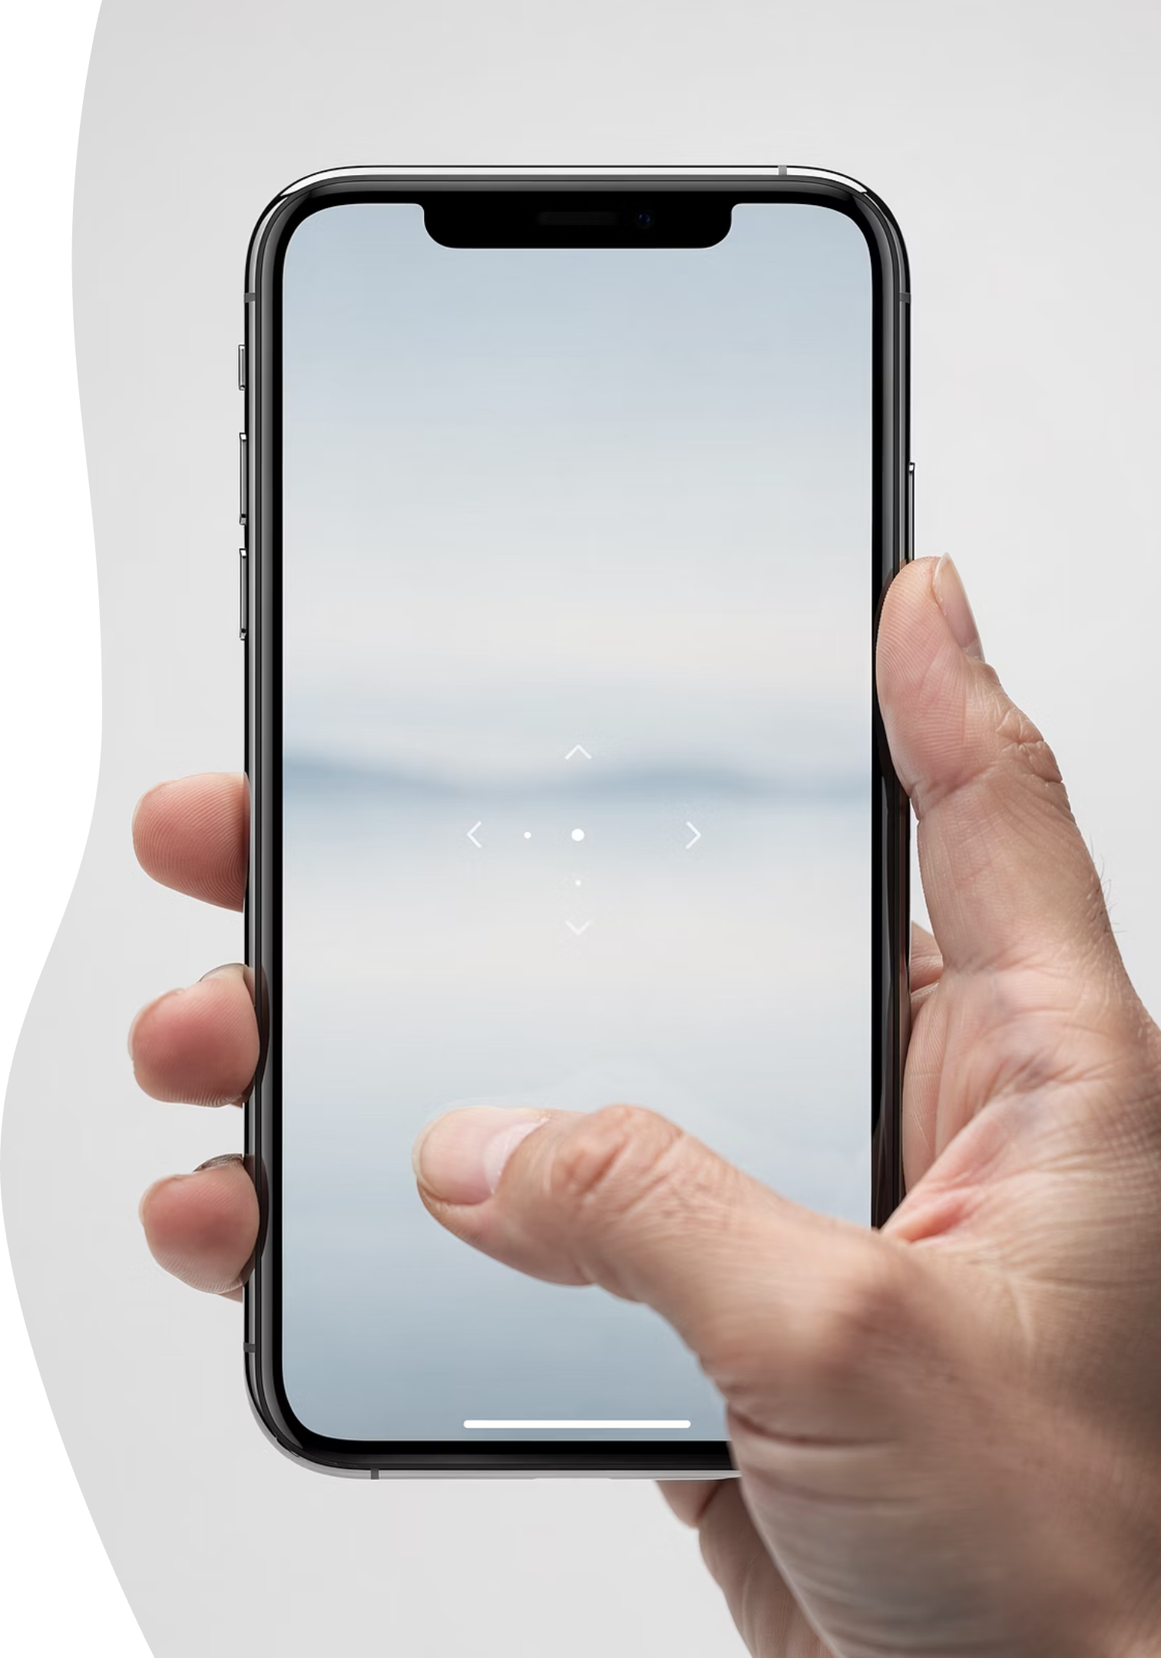


Viewing Photos Full Screen
Tap to view
Opens the photo in full screen mode
Swipe to move
Swipe left or right to see other photos
Notes:
Tap to view a photo full screen.
Swipe left or right to move between photos.
This doesn’t change anything — it’s just viewing.

Slide 20

Deleting Photos Safely
Deleted ≠ gone forever
Deleted photos go into Recently Deleted and stay there for about 30 days. This is your safety net.
Slide 17 — Recovering Mistakes
30-day recovery window
You have plenty of time to undo accidental deletions
1
Notes:
Deleted photos are not gone forever.
They go into Recently Deleted for about 30 days.
That’s your safety net.
Accidental deletions are common — and fixable.
Apple expects mistakes.
You have time to undo them.

Slide 21

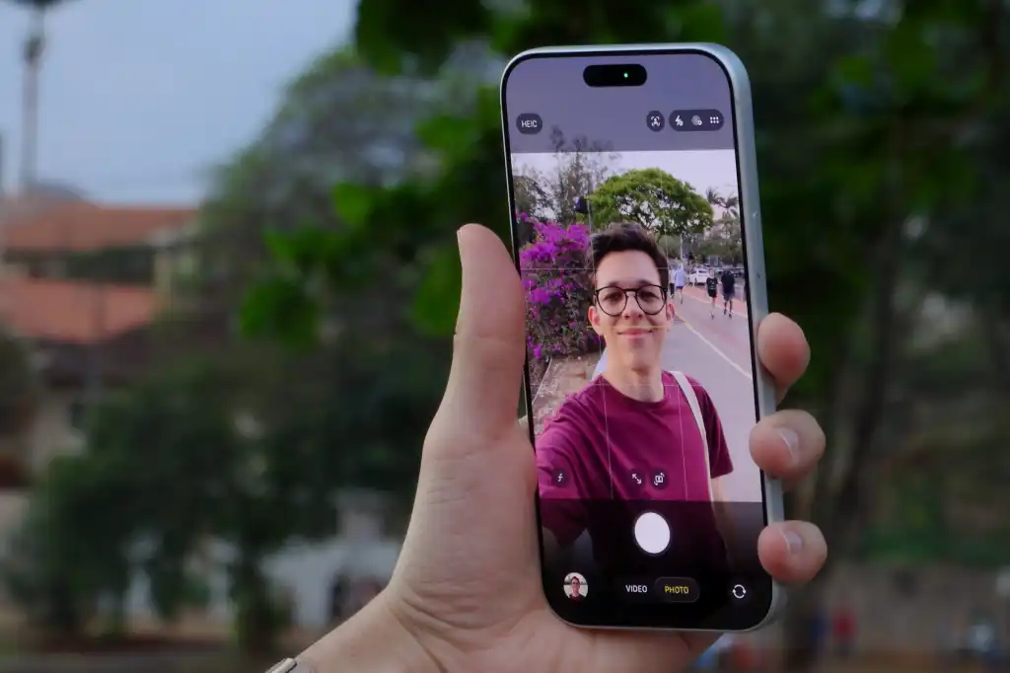
Module 3
Sharing Photos
The Share Icon
Square with arrow
This is the universal share icon on iPhone
Sharing creates a copy. It does not remove the original from your phone.
Texting a Photo
Best for 1–2 photos
Quick and convenient for sharing with friends and family
Texting is quick and convenient, but it may slightly reduce photo quality.
Notes:
Slide 18 — Sharing Photos
Sharing creates a copy.
It does not remove the original from your phone.
Nothing disappears when you share.
Slide 19 — Texting a Photo
Texting is great for one or two photos.
It’s quick and convenient, though it may reduce quality slightly.

Slide 22

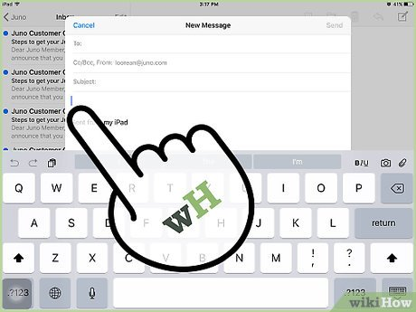
Emailing a Photo
Better for quality
Email preserves photo quality better than texting, making it ideal when someone wants to print your photos.
Notes:
Email is better when quality matters — especially for printing.
It keeps photos clearer.

Slide 23
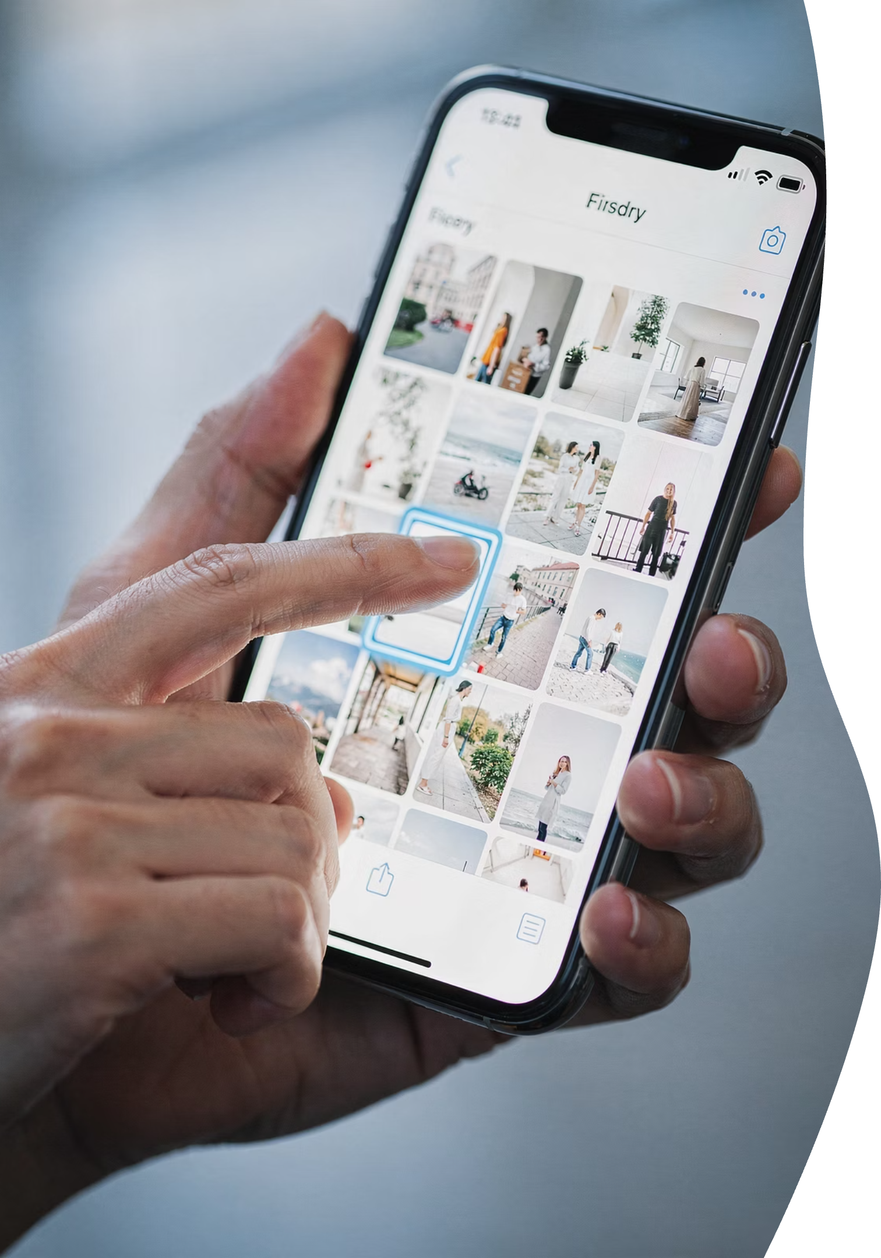
Sharing Multiple Photos
You can select multiple photos at once — the phone will guide you step by step.
Notes:
You can select more than one photo at a time.
The phone will guide you step by step.

Slide 24
Common Sharing Mistakes
Sending screenshots
Screenshots are pictures of pictures. They work, but they're usually not ideal.
Notes:
Screenshots are pictures of pictures.
They work, but they’re not ideal unless you need them.

Slide 25
Privacy & Oversharing
Pause before sending
Once a photo is shared, you may not be able to take it back. A pause is a powerful tool.
Notes:
Pause before sending.
Once a photo is shared, it may not be possible to take it back.
That’s normal — not dangerous

Slide 26
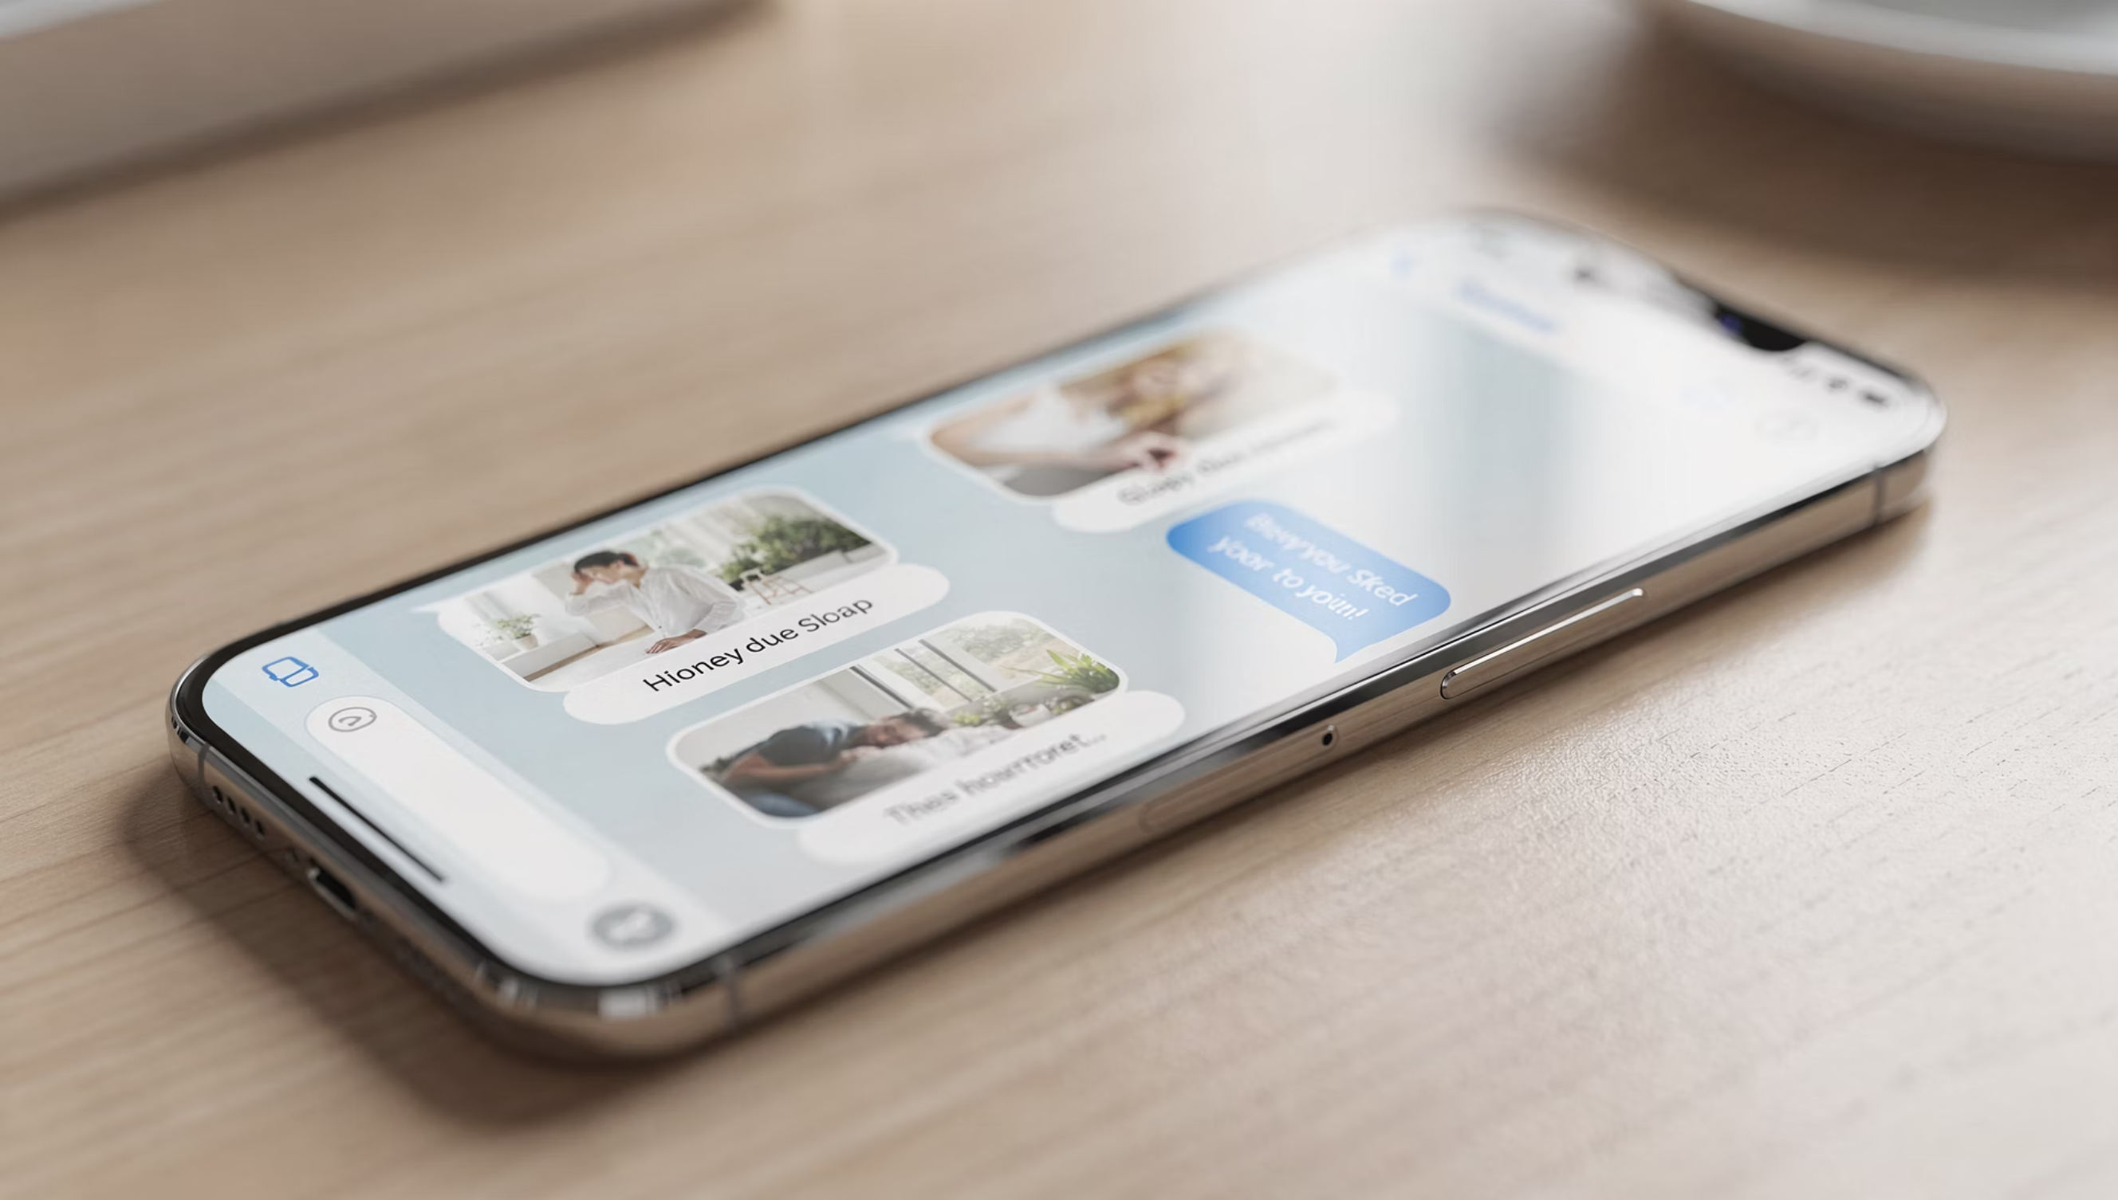
Undo Expectations
Sharing is often permanent
Not everything has an undo button. That's normal — not dangerous.
Notes:
Not everything has an undo button.
That doesn’t mean you did something wrong.

Slide 27
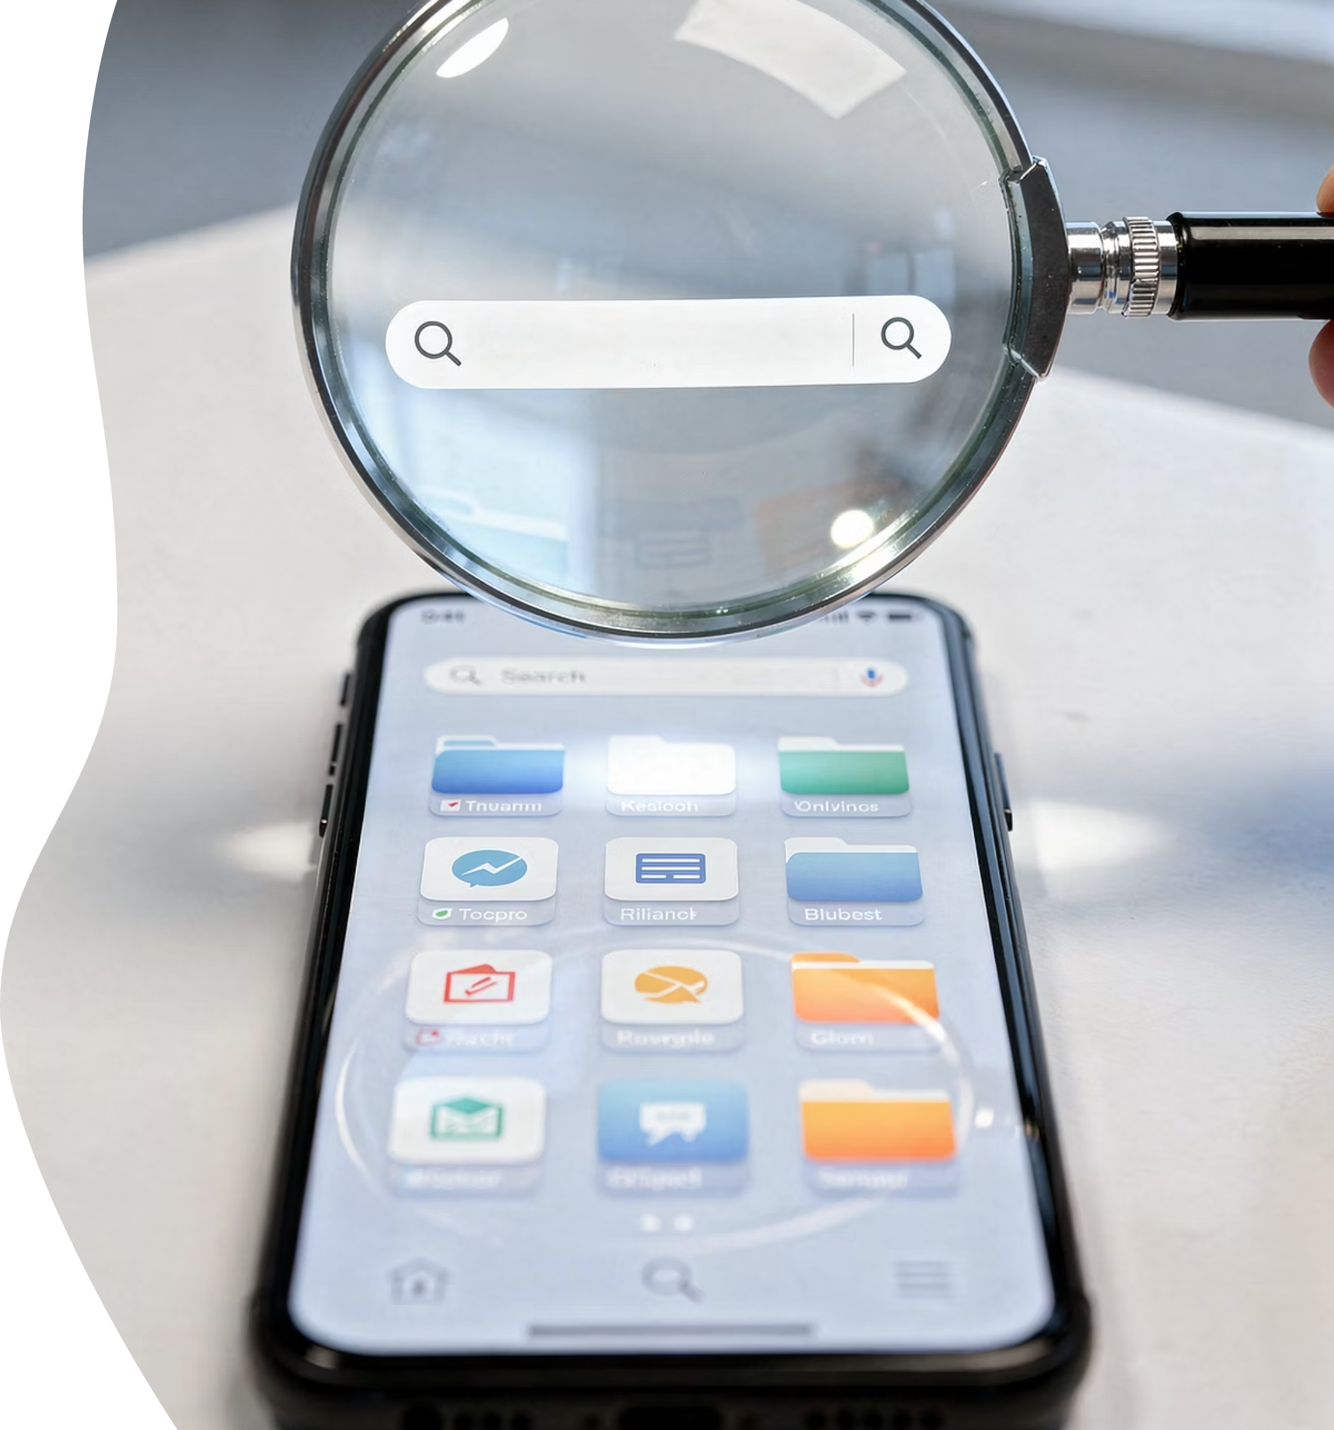
MODULE 4
Finding Things Again
Notes:
Let’s talk about finding things when they feel lost — calmly and confidently.

Slide 28
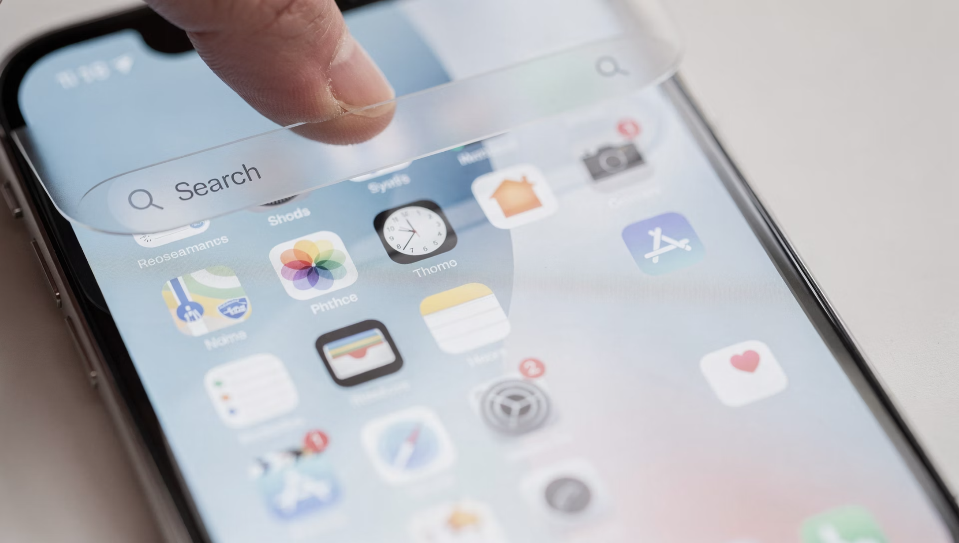
Spotlight Search
01
Swipe down to search
Spotlight is one of the most powerful tools on the iPhone. It finds apps, photos, and contacts instantly.
Notes:
Swipe down on the home screen to search.
Spotlight can find apps, photos, and contacts quickly

Slide 29
Finding Lost Apps
Search first
Most apps are not deleted — just moved.
Notes:
Most apps are not deleted — they’re just moved.
Search first before assuming anything is gone.

Slide 30

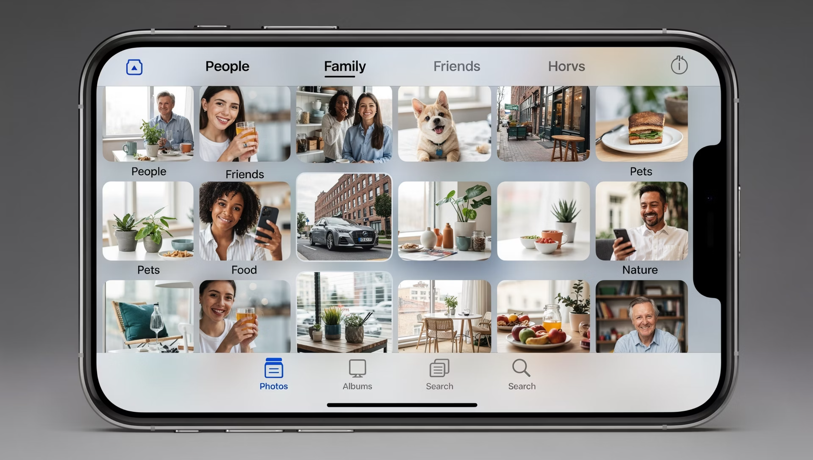
Searching Photos
Search by people or words
The phone can search photos by faces, places, and even objects. It feels magical — but it's normal.
Notes:
You can search photos by people, places, or even objects.
It feels magical — but it’s normal.

Slide 31

When Something Disappears
Stay calm
Panic causes more problems than the phone ever will.
Notes:
Stay calm.
Panic causes more problems than the phone ever will.

Slide 32
Don't Reinstall Apps
Reinstalling causes problems
Reinstalling apps can erase data. Always ask first.
Notes:
Reinstalling apps can erase data.
Always ask first before doing that.

Slide 33
Recovery Mindset
Phones are forgiving
iPhones are designed with recovery in mind. Mistakes are expected.
Notes:
iPhones are designed with recovery in mind.
Mistakes are expected.

Slide 34

When to Ask for Help
Asking is smart
Asking for help is not failure — it's efficiency.
Notes:
Asking for help is not failure — it’s efficiency.
It usually saves time and frustration.

Slide 35

WRAP-UP
Part 2

Slide 36
What You Can Do Now
Take photos
Find photos
Share safely
You now understand how photos behave — and that alone removes most frustration.
Notes:
You can take photos, find them again, and share safely.
Understanding how photos behave removes most frustration.

Slide 37
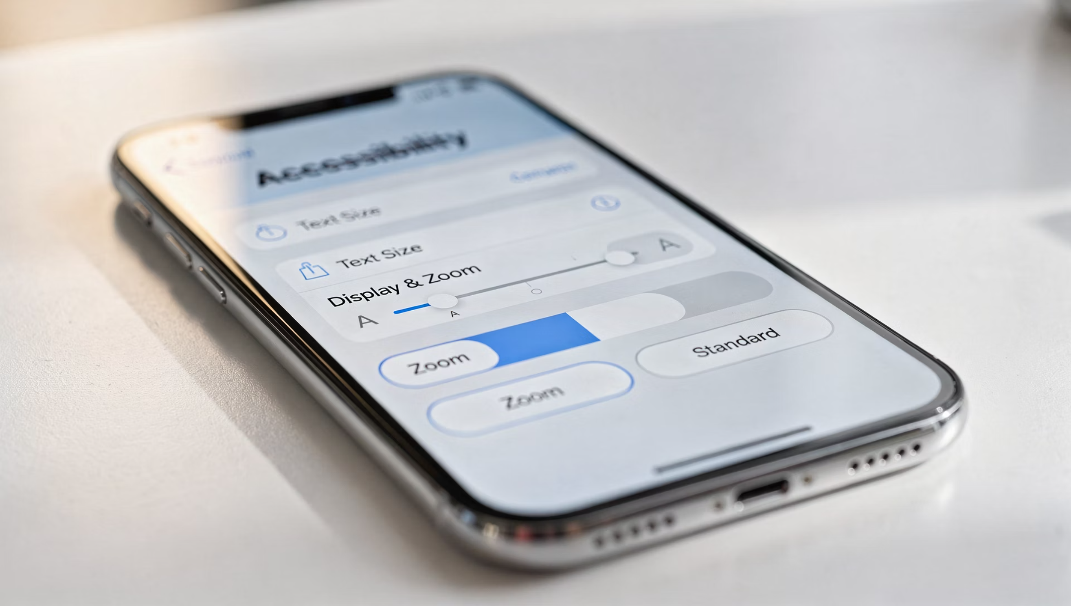
Accessibility Reminder
Larger text
Zoom options
Your phone should adjust to you — not the other way around.
Notes:
Larger text and zoom options exist to help you.
Your phone should adjust to you — not the other way around.

Slide 38


Safety Basics
Passcodes
Find My iPhone
These tools protect you, not Apple.
Notes:
Passcodes and Find My iPhone protect you — not Apple.
They’re there for peace of mind.

Slide 39

Support Options
Free Tech Tuesday 1-on-1s
Help is always available, and questions are always welcome.
Notes:
Don’t forget to take advantage of Tech Tuesdays!

Slide 40
Final Reassurance
You didn't break anything
You didn't break anything — you learned something. In our next session, Part 3, we'll take this confidence and use it to make your iPhone more personal, more useful, and more secure.
Notes:
— Final Reassurance
You didn’t break anything.
You learned something.
And that confidence carries forward into Part 3.

