Slide 1
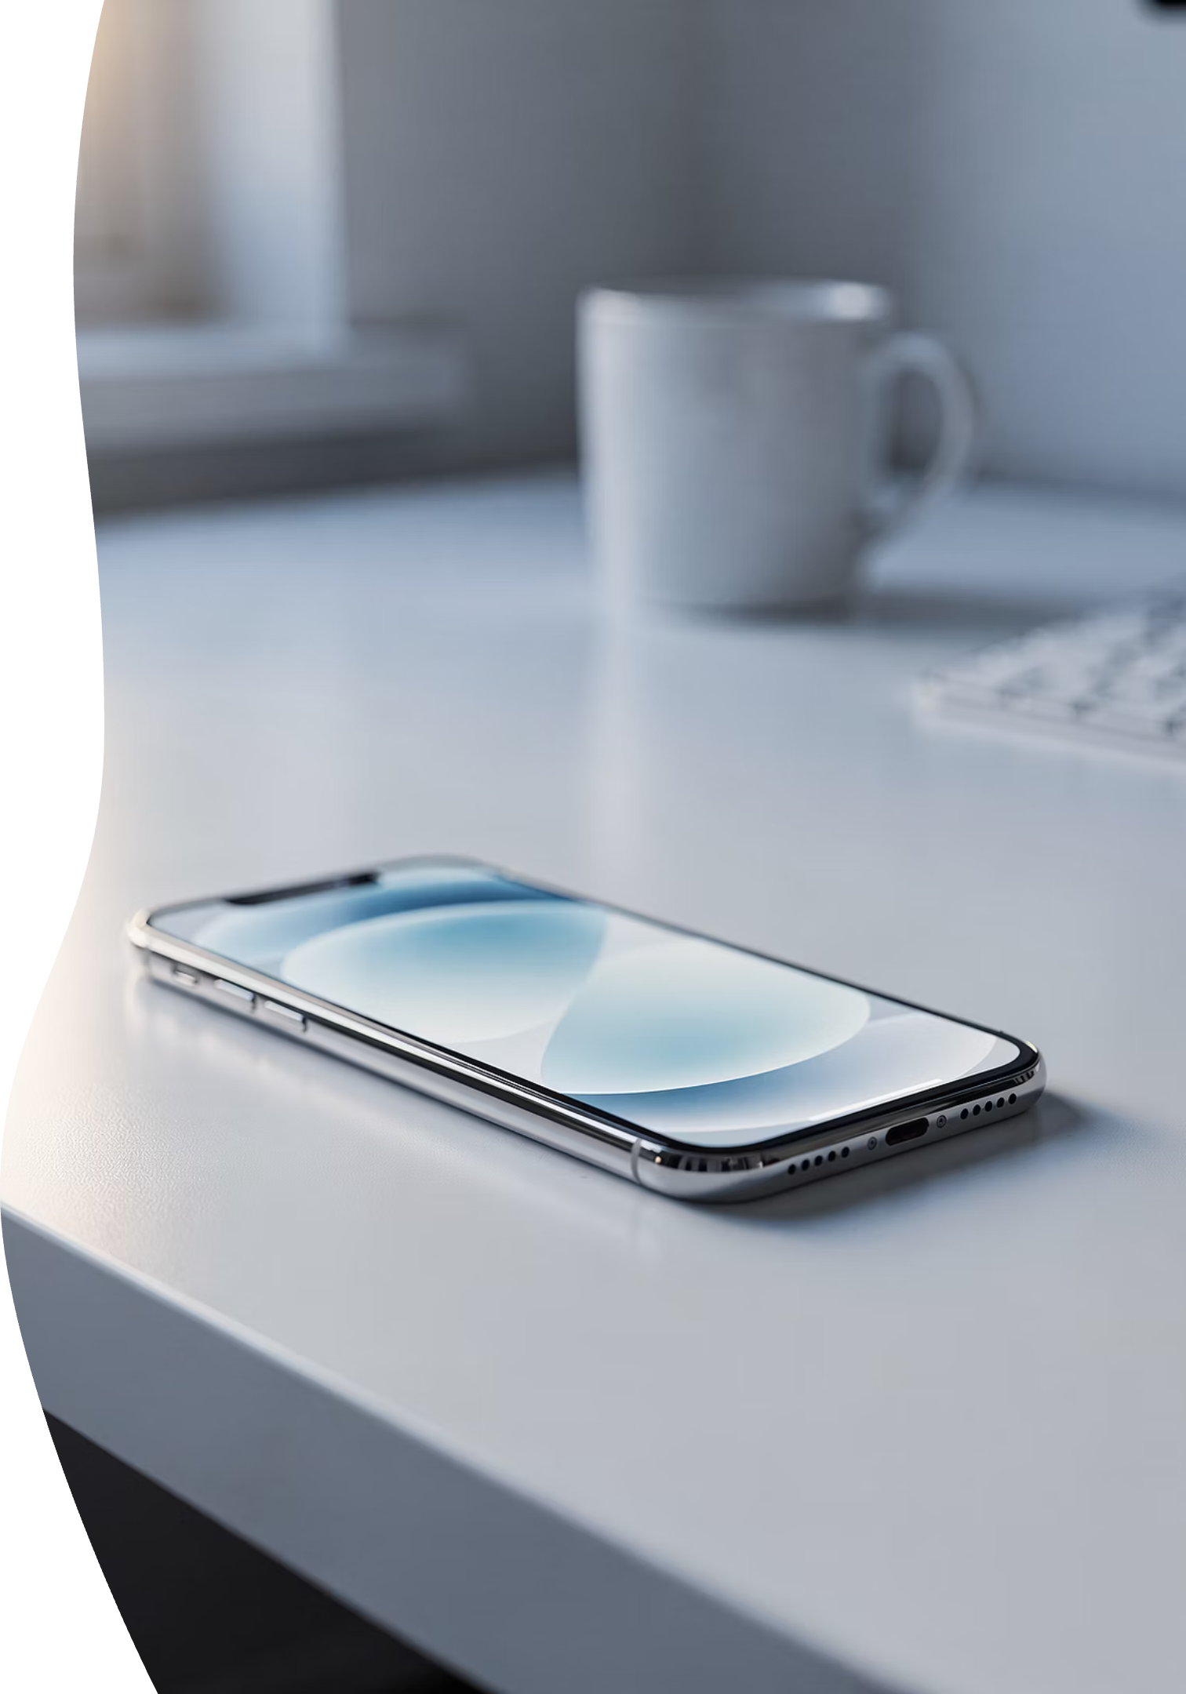
iPhone Essentials Intro 101 — Part 3
Make It Yours • Make It Safe • Make It Useful
Red Glen Electronics – Middletown, CT
A Boomer Helping Fellow Boomers
May 2026
Notes:
Good Afternoon – Totally’s Seminar covers Part 3 of iPhone Essentials Intro 101

Slide 2


MODULE 1
Welcome, Context & Expectations
Today marks an important milestone in your iPhone journey. We're building on everything you've learned so far and taking the next step toward true ownership of your device. This session is designed to help you feel confident, safe, and in control.
Notes:
Welcome everyone. I’m really glad you’re here today. This is Part 3 of our iPhone Essentials series, and it’s the final chapter in our spring trilogy. If this is your first session, don’t worry — you’re still very welcome here. And if you’ve been with us for Parts 1 and 2, today is where everything starts to come together.

Slide 3
Welcome, Cromwell Senior Center (CSC) Members
A friendly, practical introduction to iPhone 101 – Part 3
— no jargon, no pressure, and no tests!
Notes:
Today marks an important milestone. Up to now, we’ve focused on comfort and understanding. Today, we move into ownership — helping your iPhone feel like your tool, not something you’re afraid to touch. Our goal is confidence, safety, and usefulness — not speed, not perfection.
Whether you attended this live or you’re watching the replay later, you’re exactly where you should be.
This session was designed for real, everyday iPhone use — not the stuff buried in manuals or hidden in settings menus. We’re keeping this practical, friendly, and pressure-free.

Slide 4



Meet Jim Kallaugher: CSC Member & Volunteer
Red Glen Electronics
Weekly Tech Tuesdays
Monthly Tech Presentations
Founder and operator, with
friendly “Home Tech Help for Hire” for Boomers.
Volunteer tech support and guidance to community members on Tuesday afternoons.
Conduct tech topic seminars for better understanding & to encourage confidence
With 25+ years of experience making technology clear, simple, and accessible.
Notes:
Hi, I’m Jim Kay-la-her, a Senior Center Member, Volunteer, and Home Tech Support Consultant
Red Glen Electronics:
I founded Red Glen Electronics as a friendly “Home Tech Help for Hire” for Boomers
Tech Tuesdays:
I‘m here every Tuesday afternoon for appointments.
I offer hands-on tech support or one-on-one training as a regular volunteer.
Monthly Tech Seminars:
Every month, I’ll lead tech topic seminars for a better understanding and to encourage confidence

Slide 5



INTRODUCTION
Welcome to iPhone 101, Part 3
iPhone Essentials Intro 101
Part 3 Focus
Red Glen Electronics
Your comprehensive guide to mastering the fundamentals
Make It Yours • Make It Safe • Make It Useful
A Boomer Helping Fellow Boomers
Welcome back, everyone — I'm really glad you're here. Today is Part 3, the final chapter in our spring iPhone Essentials trilogy.
In Part 1, we focused on getting comfortable with the phone — learning that it's not fragile and that curiosity is safe. In Part 2, we tackled photos and finding things again — two of the most common sources of frustration.
Today is different. Today is about ownership. This is where your iPhone stops feeling like a mystery and starts feeling like your tool — something that works for you, protects you, and supports how you live.
Notes:
Let’s quickly ground ourselves. In Part 1, we learned that the phone is not fragile and that curiosity is safe. In Part 2, we tackled photos and finding things again — two of the biggest frustration points. Today builds directly on that foundation. Nothing here is random.

Slide 6
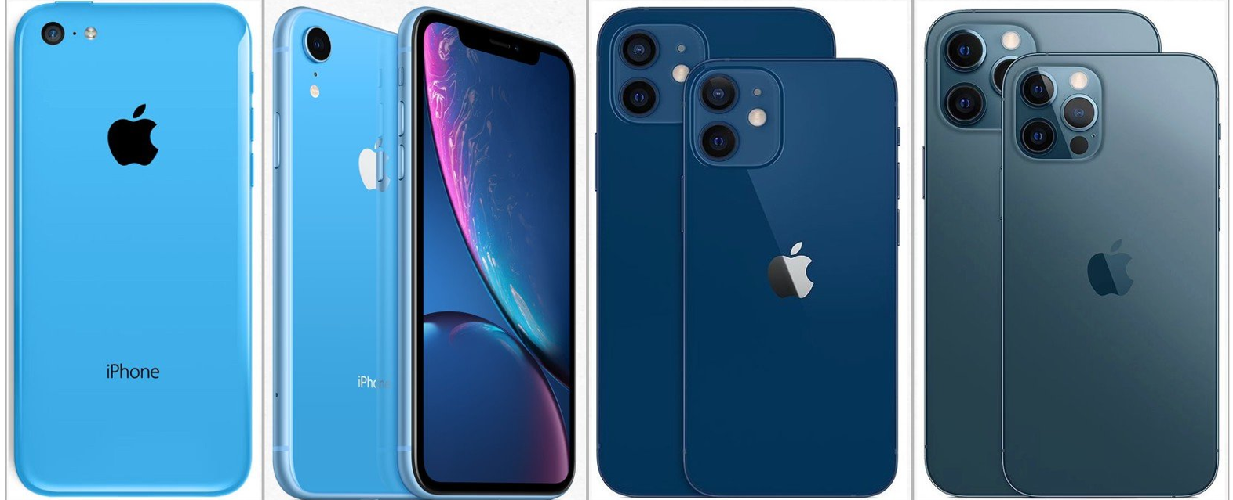
Before We Go Further — One Important Reminder
You don’t need to do everything today
Many items are “good to know,” not “must do.”
You can revisit this session anytime in the archives
Help is always available
“Some of this is for today, some of this is for later — and some of it is just so nothing surprises you.”
Notes:
“Before we go any further, I want to pause for just a moment and set the tone for today.”
You do not need to do everything we talk about today. Some of what you’ll see is simply meant to help you understand what’s possible, not to give you a to-do list.
Many of these items are what I call ‘good to know,’ not ‘must do right now.’ If something feels useful, great. If something feels optional, it probably is — and I’ll point that out as we go.
Also remember: you can come back to this session anytime. The archives are there so you don’t have to rely on memory or take notes at lightning speed. Watching something a second time often makes it click in a whole new way.
And finally — help is always available. You’re not expected to figure everything out on your own. Asking questions, pausing, or getting one-on-one help isn’t a setback — it’s part of how this is designed to work.
So take a breath, stay curious, and remember: today is about confidence and comfort — not perfection.”

Slide 7

How This Series Evolved
01
02
Original Plan
Listening to You
Two comprehensive sessions covering all essentials
Your thoughtful questions revealed we needed more time
03
Better Approach
Expanded to three parts for optimal pacing and retention
Notes:
When we first designed this program, it was meant to be two sessions. But your questions told us something important — learning works better when it’s calm and spaced out. This third session exists so we can cover personalization and safety without overload.

Slide 8

How Today Fits In
Part 1: Getting Comfortable
Building the foundation — learning that your iPhone is safe to explore and that curiosity won't break anything.
Part 2: Photos & Finding Things
Organizing the rooms — mastering the two most common pain points for new iPhone users.
Part 3: Ownership, Usefulness & Safety
Moving in and making it yours — adjusting settings, protecting your information, and gaining confidence.
Notes:
Think of this series like a house. Part 1 laid the foundation. Part 2 organized the rooms. Today is where you move in and make it yours — adjusting things so they fit you and protect you.

Slide 9

No Pressure, Just Support
Today will feel much more familiar if you've seen Parts 1 and 2, but there's no penalty if you missed them.
RGE Seminar Archives
Watch & Re-watch
Available anytime at your own pace
Many find that viewing sessions multiple times helps everything sink in
If you missed either session, the RGE Seminar Archives are available anytime, and they're designed specifically to help everything click at your own pace. Many people find that watching a session once live and once later makes it sink in even better.
Notes:
If you missed Part 1 or Part 2, there’s no penalty. The archives are there so you can watch and rewatch at your own pace. Many people find that a second viewing makes everything click more easily.

Slide 10
What Today Will (and Won't) Do
✓ What We Will Do
Build your confidence with everyday features
Focus on safety and peace of mind
Cover staying connected and protecting information
Make your phone easier and more useful
✗ What We Won't Do
Rush through complex topics
Overwhelm you with advanced settings
Focus on hidden tricks you don't need
Make you feel pressured or behind
Notes:
Today is not about hidden tricks or advanced settings. We’ll focus on everyday usefulness and peace of mind. If something is optional, I’ll say so. Our priority is confidence over complexity.

Slide 11


MODULE 2
Apple ID: The Key to the iPhone
Your Apple ID is the single most important account on your iPhone. Understanding it removes mystery and prevents many common problems. Let's explore what it is, why it matters, and how to manage it with confidence.
Notes:
This section sounds bigger than it feels. Your Apple ID is simply your main account with Apple. Understanding it removes mystery and prevents many common problems.

Slide 12

What Is an Apple ID?
Your Main iPhone Account
Think of it as your identity with Apple — it's how Apple knows who you are across all their services.
Not an App You Open
You won't find an "Apple ID" app on your home screen. It works quietly in the background.
Required for Key Features
Many essential iPhone features depend on having an Apple ID properly set up and signed in.
Notes:
An Apple ID is not an app you open. It works quietly in the background. Think of it as your identity with Apple — it connects your apps, photos, and services together.

Slide 13




Why Apple ID Matters
Downloading Apps
Saving Photos
Every app you download from the App Store requires your Apple ID. It's how Apple keeps track of what you own.
iCloud Photos uses your Apple ID to back up and sync your precious memories across devices.
FaceTime Calls
Find My iPhone
Video calls with family and friends work through your Apple ID — it's how people reach you.
If your phone gets lost, Find My iPhone uses your Apple ID to help you locate it and keep it secure.
Notes:
Your Apple ID is involved in downloading apps, saving photos, FaceTime calls, and finding your phone if it’s lost. When something mysteriously stops working, this account is often involved — which is why understanding it matters

Slide 14




Apple ID Safety & Hygiene
One Apple ID Per Person
Never Share Passwords
Store Information Safely
Each person should have their own Apple ID, even within families. Sharing accounts creates confusion and sometimes permanent problems.
Your Apple ID password is private — not even family members should use it. Sharing passwords compromises security.
Write down your Apple ID and password. Keep them somewhere safe like a locked drawer or password notebook.
Remember: Everyone Forgets
Writing down your login information isn't a sign of weakness — it's smart planning. You're not forgetful, you're prepared.
Notes:
Each person should have their own Apple ID. Sharing accounts creates confusion. Never share your password, and always write your login information down somewhere safe. That’s smart planning — not weakness

Slide 15
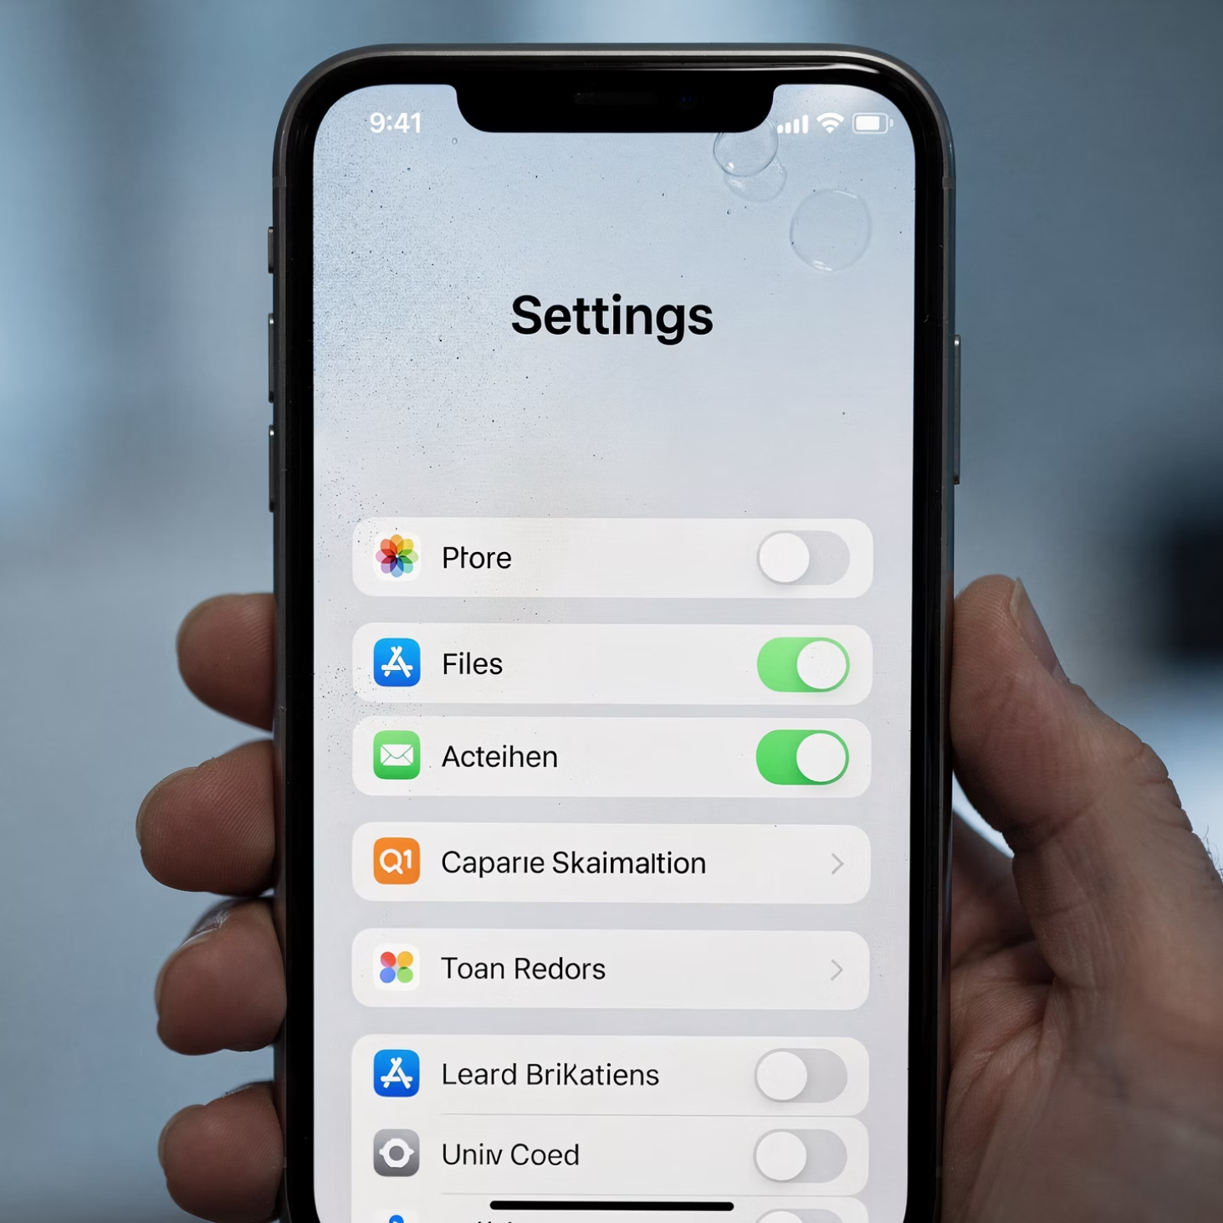
Where to Find Your Apple ID
1
Open Settings
Tap the gray gear icon on your home screen labeled "Settings"
2
Look at the Top
Your name appears at the very top of the Settings screen
3
That's Your Apple ID
The email address shown there is your Apple ID username
Notes:
Each person should have their own Apple ID. Sharing accounts creates confusion. Never share your password, and always write your login information down somewhere safe. That’s smart planning — not weakness

Slide 16


Common Apple ID Confusions
"My son set this up for me, and I don't know what email he used."
"I think I have multiple Apple IDs, but I'm not sure which one is the right one."
"I created a new Apple ID because I forgot my password, and now nothing works."
I hear these situations all the time: "My son set this up for me," or "I don't remember which email I used," or "I think I created more than one account."
These situations are very common — and they are fixable. The important thing is not to guess or keep creating new accounts. Each new Apple ID creates more problems, not fewer. If you're unsure, ask for help before making changes. There's no shame in needing assistance with this — it's actually the smart move.
Notes:
Many people tell me a family member set this up, or that they think they have more than one Apple ID. These situations are common and fixable — but guessing or creating new accounts usually makes things worse. Asking for help is the smart move

Slide 17
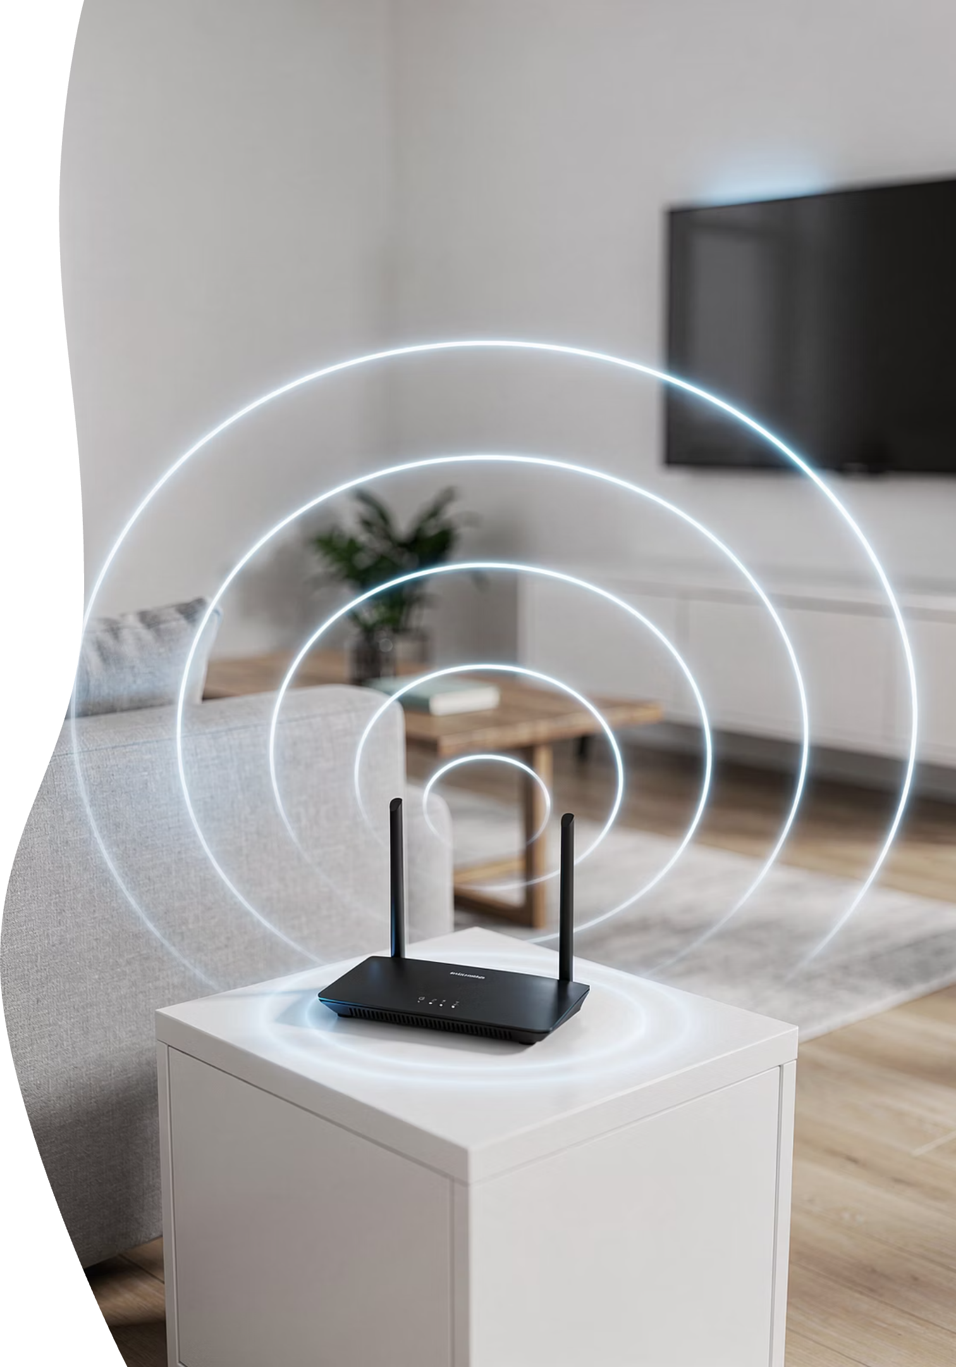

MODULE 3
Wi-Fi: Staying Connected Calmly
Wi-Fi is one of those things that feels mysterious until someone explains it clearly. Let's remove the mystery and help you understand how to connect, stay connected, and troubleshoot calmly when things go wrong.
Notes:
Wi‑Fi feels mysterious until it’s explained clearly. Wi‑Fi connects your phone to the internet through a router. It’s different from cellular data, and most apps work best when Wi‑Fi is connected.

Slide 18
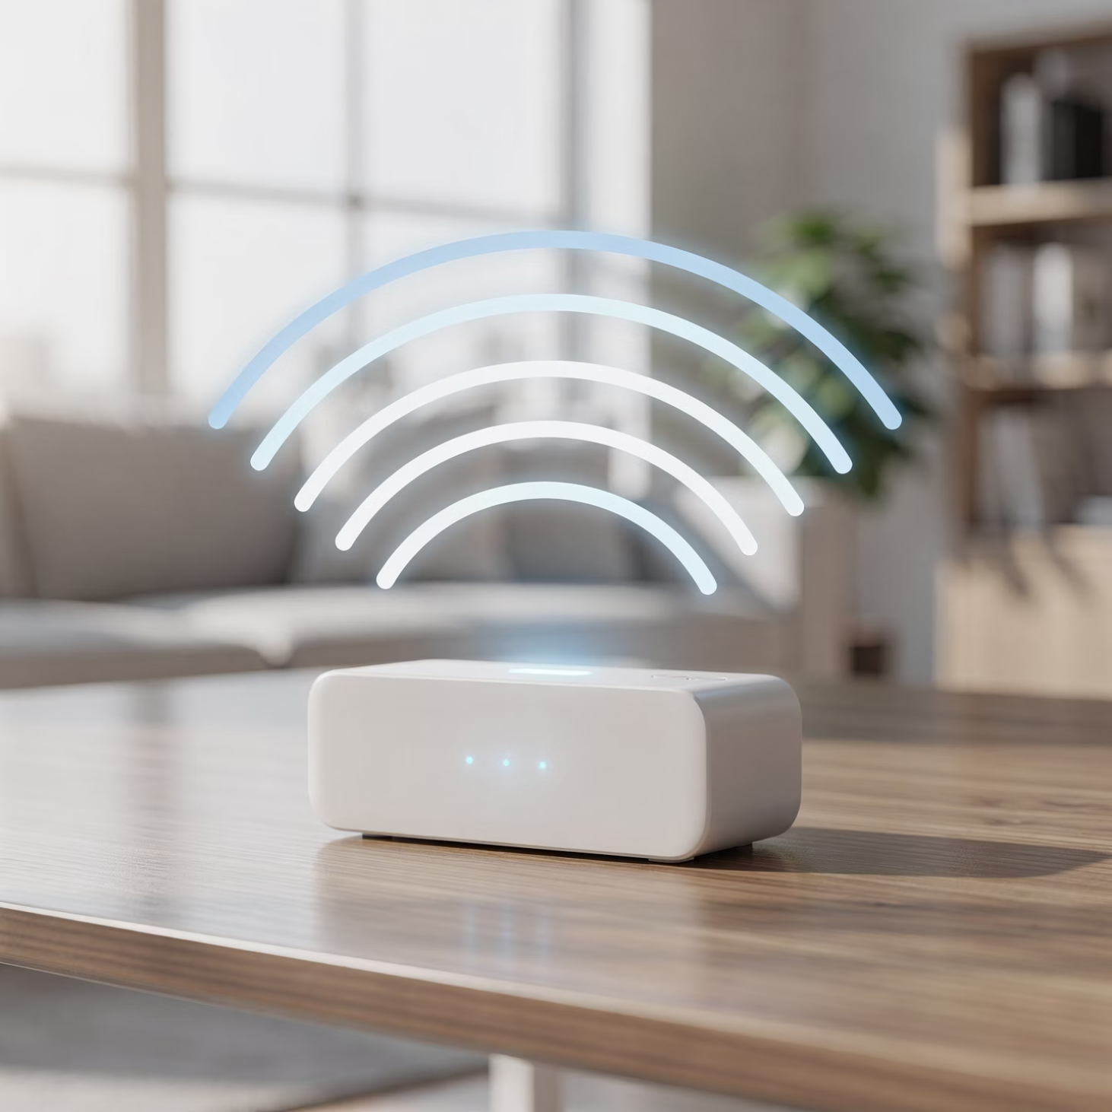
What Wi-Fi Actually Is
Internet Connection
Wi-Fi connects your iPhone to the internet through a wireless router — usually in your home or a public location like a coffee shop.
Different from Cellular Data
Cellular data comes from your phone plan through cell towers. Wi-Fi comes from your home internet service or public networks.
Notes:
Most apps and features work best on Wi-Fi because it's typically faster and doesn't use your cellular data allowance. When you're at home, Wi-Fi is usually your primary connection — and understanding how it works helps you stay connected confidently.

Slide 19




Connecting to Wi-Fi
Open Settings
Tap Wi-Fi
Tap the gray gear icon
Near the top of Settings
Choose Network
Enter Password
Select your network name
Type carefully — capitals and spaces matter
Take Your Time
Wi-Fi passwords can be long and tricky. There's no rush — double-check each character before tapping "Join." Capital letters, numbers, and special symbols all matter.
Notes:
Take your time entering Wi‑Fi passwords. Capital letters and symbols matter. There’s no rush — slow and careful works best.

Slide 20
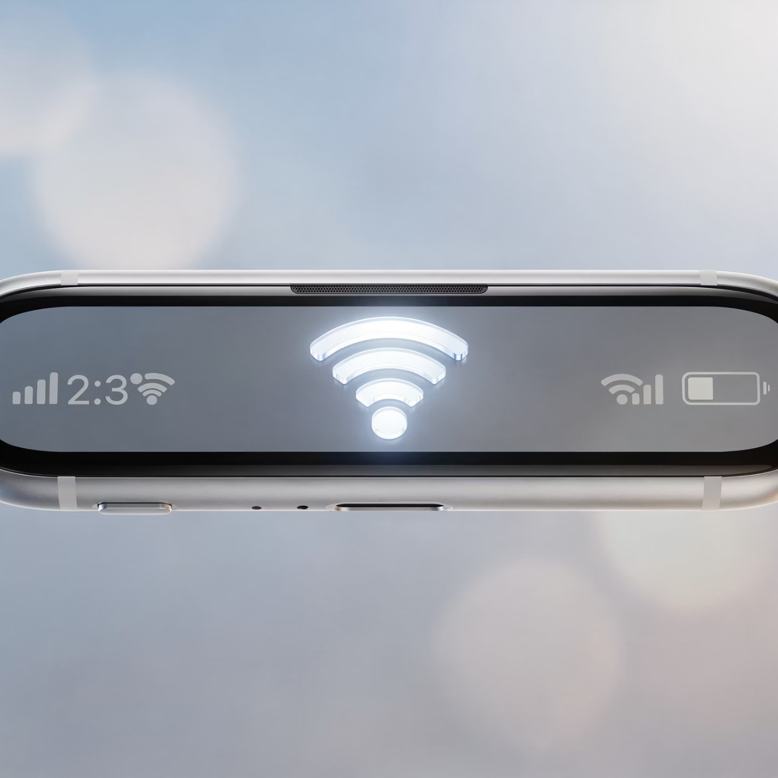
How to Tell If You're Connected
Wi-Fi Symbol at the Top
Checkmark on Network Name
Look for the curved lines that look like a fan in the upper-left corner of your screen. That's the Wi-Fi indicator.
In Settings under Wi-Fi, your connected network will have a blue checkmark next to it.
Apps Load Smoothly
When Wi-Fi is working, apps open quickly and content loads without delays or error messages.
Notes:
Look for the Wi‑Fi symbol at the top of your screen and a checkmark next to the network name in Settings. Those are your reassurance signs.

Slide 21




Common Wi-Fi Problems
Wrong Password
The most common issue — one wrong character prevents connection. Try retyping slowly and carefully.
Out of Range
Wi-Fi signals weaken with distance. If you're far from the router or in another room, the signal may be too weak.
Router Needs Restarting
Routers occasionally need to be unplugged for 30 seconds and plugged back in — this fixes many problems.
Internet Service Issue
Sometimes the problem isn't your phone or router — your internet service provider may be having problems.
Notes:
Most Wi‑Fi problems are not caused by you. Password mistakes, weak signals, or routers needing a restart are normal technology issues — not personal failures

Slide 22
When Wi-Fi "Breaks"
Don't Panic
Don't Delete Apps
Wi-Fi issues are usually temporary and fixable. Take a breath before taking action.
Deleting apps won't fix Wi-Fi problems — it just creates more work when you have to reinstall them later.
Don't Reset Settings
Ask for Help Early
Resetting network settings erases all your saved Wi-Fi networks and passwords — avoid this unless guided by tech support.
Getting help sooner rather than later saves time, prevents frustration, and often fixes the problem in minutes.
When Wi-Fi stops working, pause first. Deleting apps or resetting settings usually makes things worse, not better. Most Wi-Fi problems have simple solutions — you just need to know where to look or who to ask. Asking for help early saves time and stress.
Notes:
Pause first. Don’t delete apps or reset settings unless guided. Asking for help early usually fixes things faster and with less stress

Slide 23

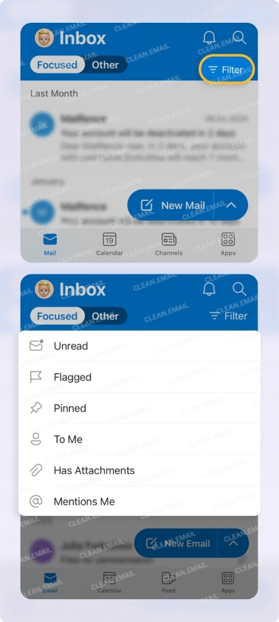

MODULE 4
Email on Your iPhone
Why Email on iPhone Matters
Email is often how companies verify accounts, send important notices, and communicate with you about bills and services. Having it set up properly helps everything else work smoothly.
Bills and Statements
Banks, utilities, and other services send important documents via email
App Recovery
Many apps use email to verify your identity and help you recover passwords
Family Messages
Email remains a reliable way to stay in touch with loved ones
Opening Email Is Always Safe
You can't harm your iPhone just by opening and reading an email. The danger comes from clicking suspicious links or downloading unexpected attachments — but we'll cover that together.
Notes:
Email matters because it’s how companies send bills, verify accounts, and help you recover passwords. Opening an email is safe — the risk comes from clicking suspicious links, which we’ll talk about carefully.

Slide 24

Module 5 — FaceTime & Apps
Notes:
Module 5 — FaceTime & Apps

Slide 25
Slide 21
What FaceTime Is (and Isn't)
Video & audio calls
Apple devices only
Notes:
FaceTime is simply a way to see or hear people you know on Apple devices. It's not social media and it doesn't post anything publicly.

Slide 26
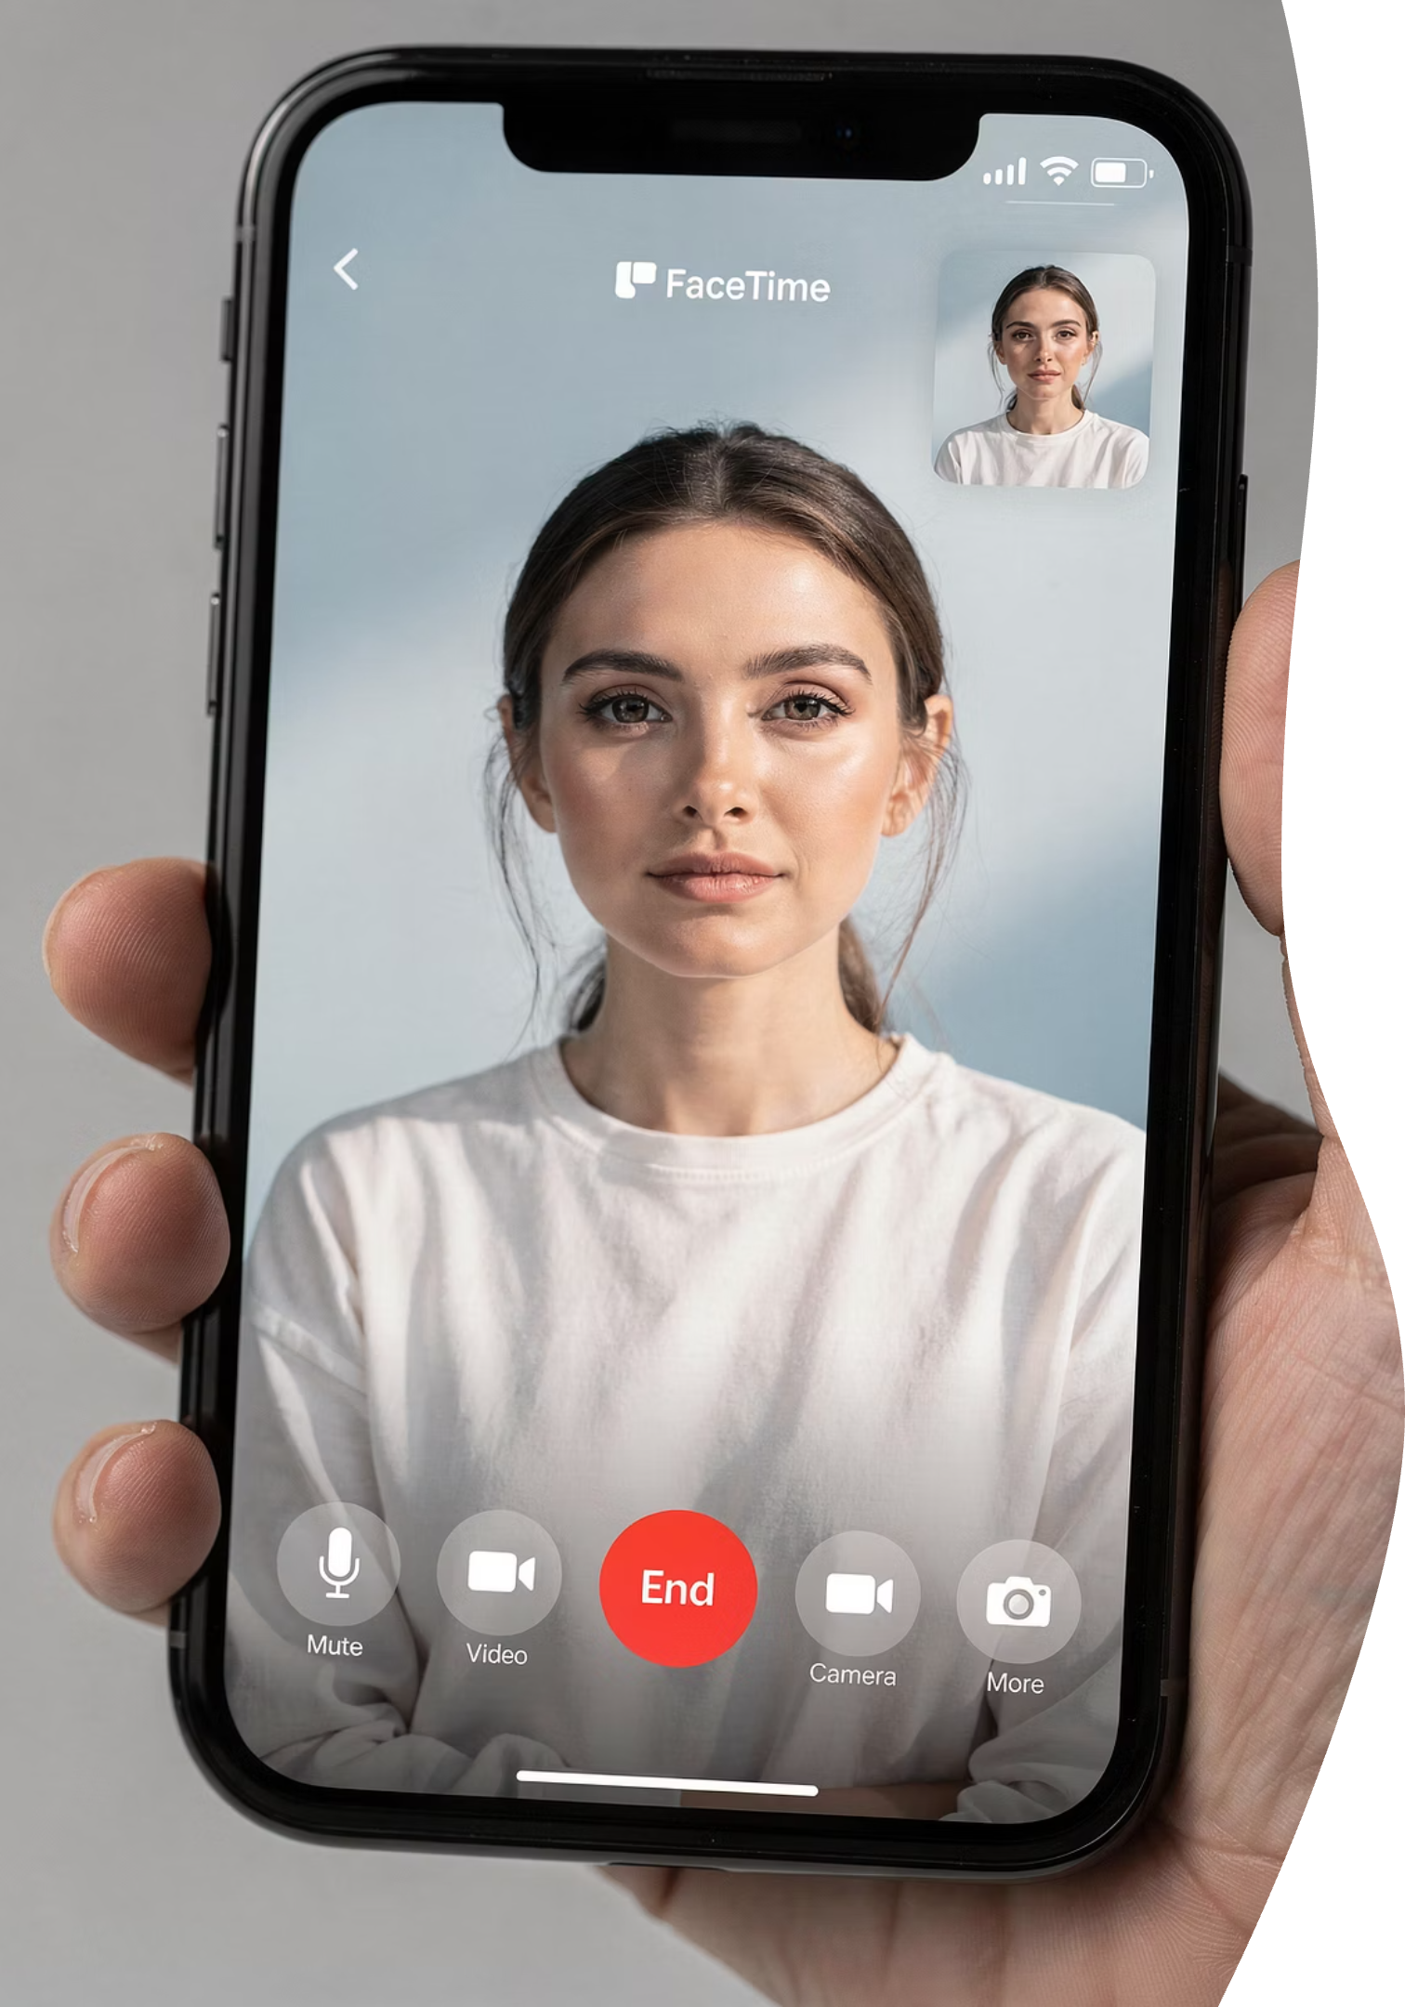
Slide 22
Using FaceTime
Start a call
Answer a call
Camera optional
Notes:
You can turn the camera off anytime. Audio-only calls are completely fine.

Slide 27
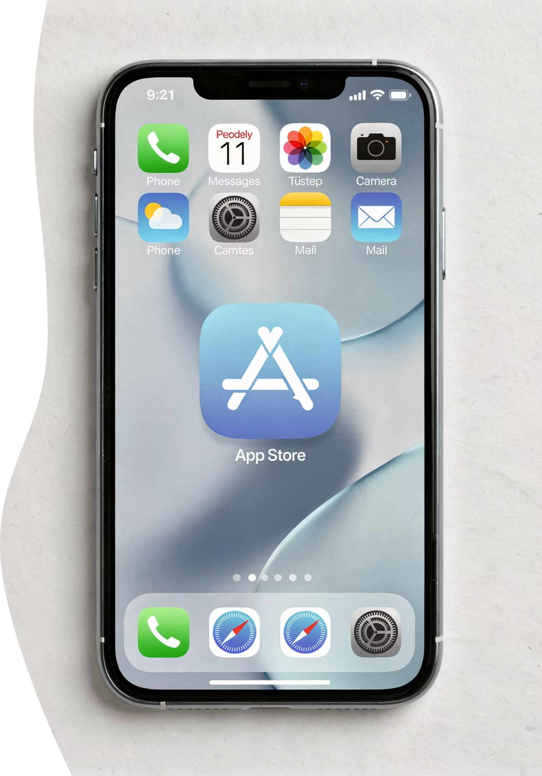
Slide 23
The App Store Explained
Official app source
Avoid pop-ups
Apps should only come from the App Store.
Pop-ups asking you to download software should be ignored.
Notes:
Apps should only come from the App Store. Pop-ups asking you to download software should be ignored. Face ID and passwords prevent accidental downloads

Slide 28

Slide 24
Downloading Apps Safely
01
02
Tap Get
Use Face ID or password
Face ID and passwords prevent accidental or unwanted downloads.
Notes:
Face ID and passwords prevent accidental or unwanted downloads.

Slide 29
Slide 25
Managing Apps
Apps move
Deleting removes app
Apps don't usually disappear — they move.
Deleting removes them completely, so it's okay to pause and ask first.
Notes:
Apps often move — they don’t usually disappear. Deleting an app removes it completely, so it’s okay to pause and ask before doing that.

Slide 30
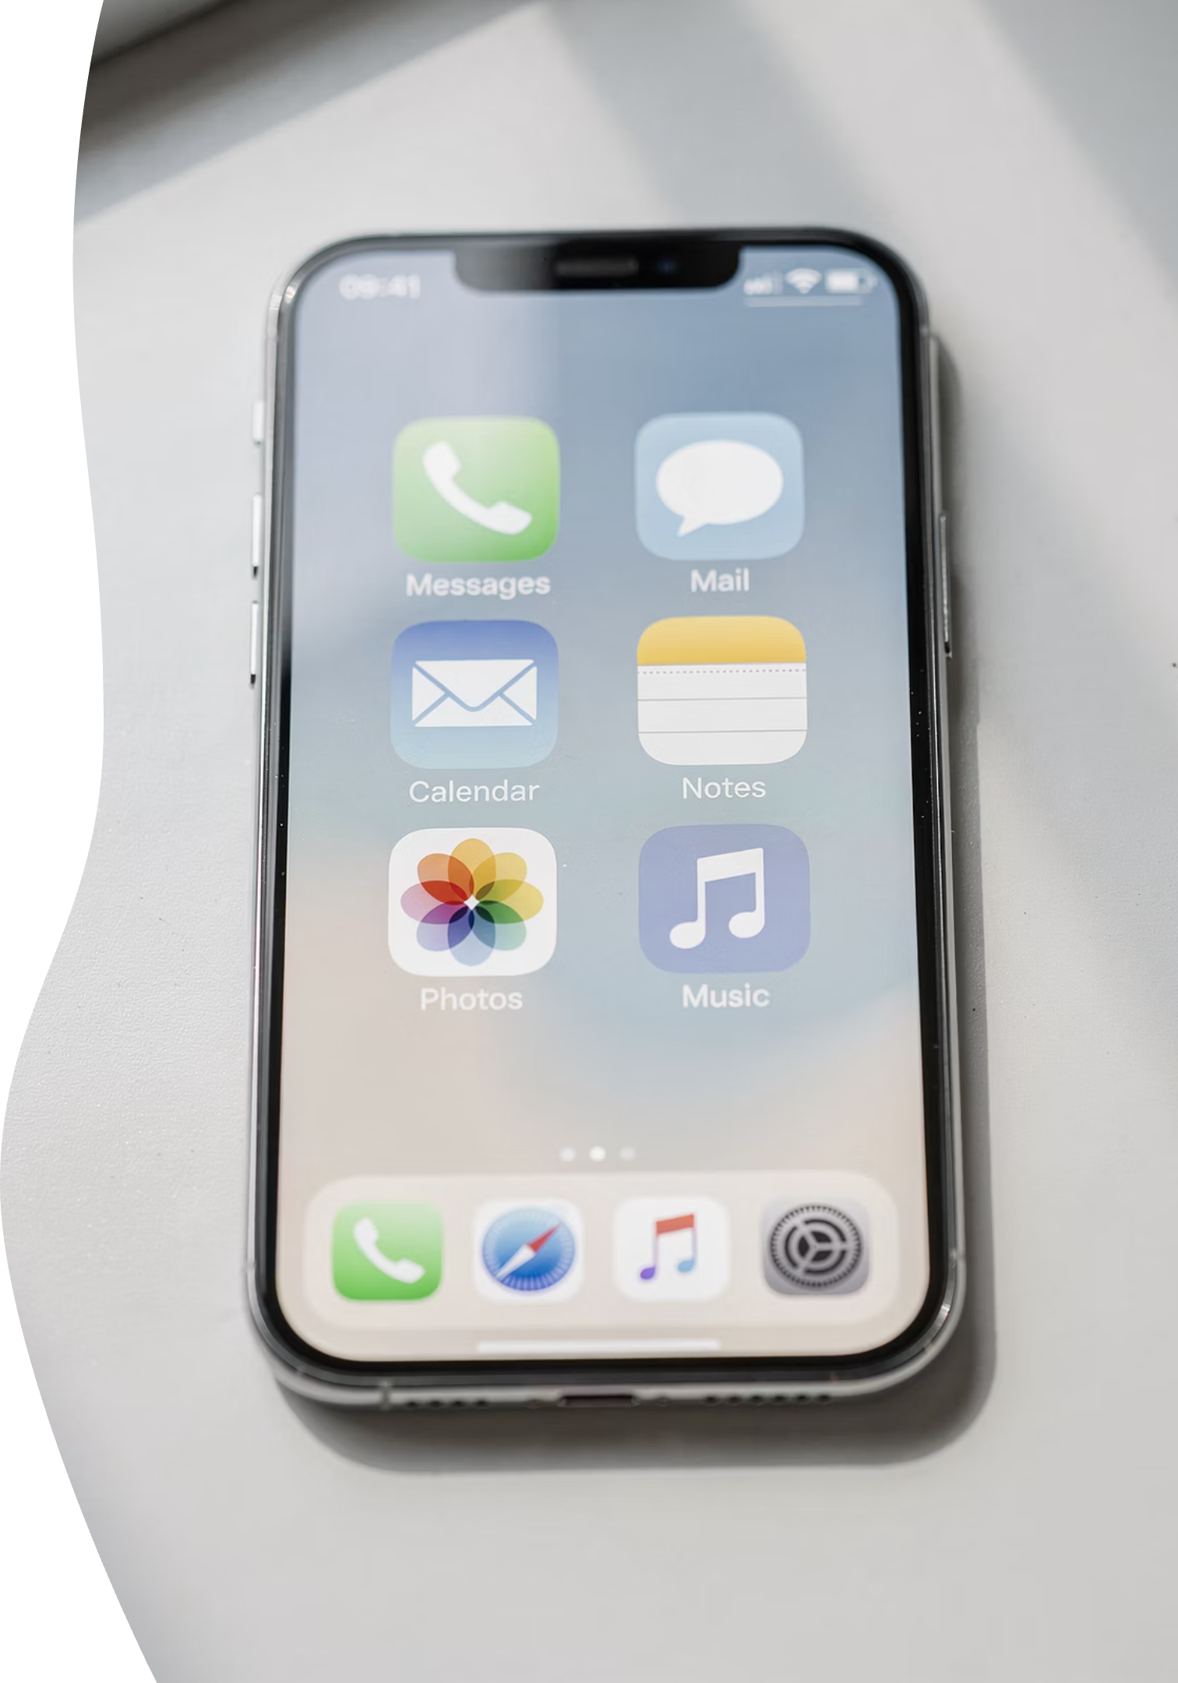
Slide 26
App Confidence Rule
Fewer apps = less confusion
Notes:
A simpler phone is easier to enjoy. You don't need every app — just the ones that serve you.

Slide 31
Module 6
Accessibility & Safety
Notes:
Accessibility features exist because everyone’s eyes, hands, and needs are different. Adjusting text size or using zoom is smart, not a workaround

Slide 32
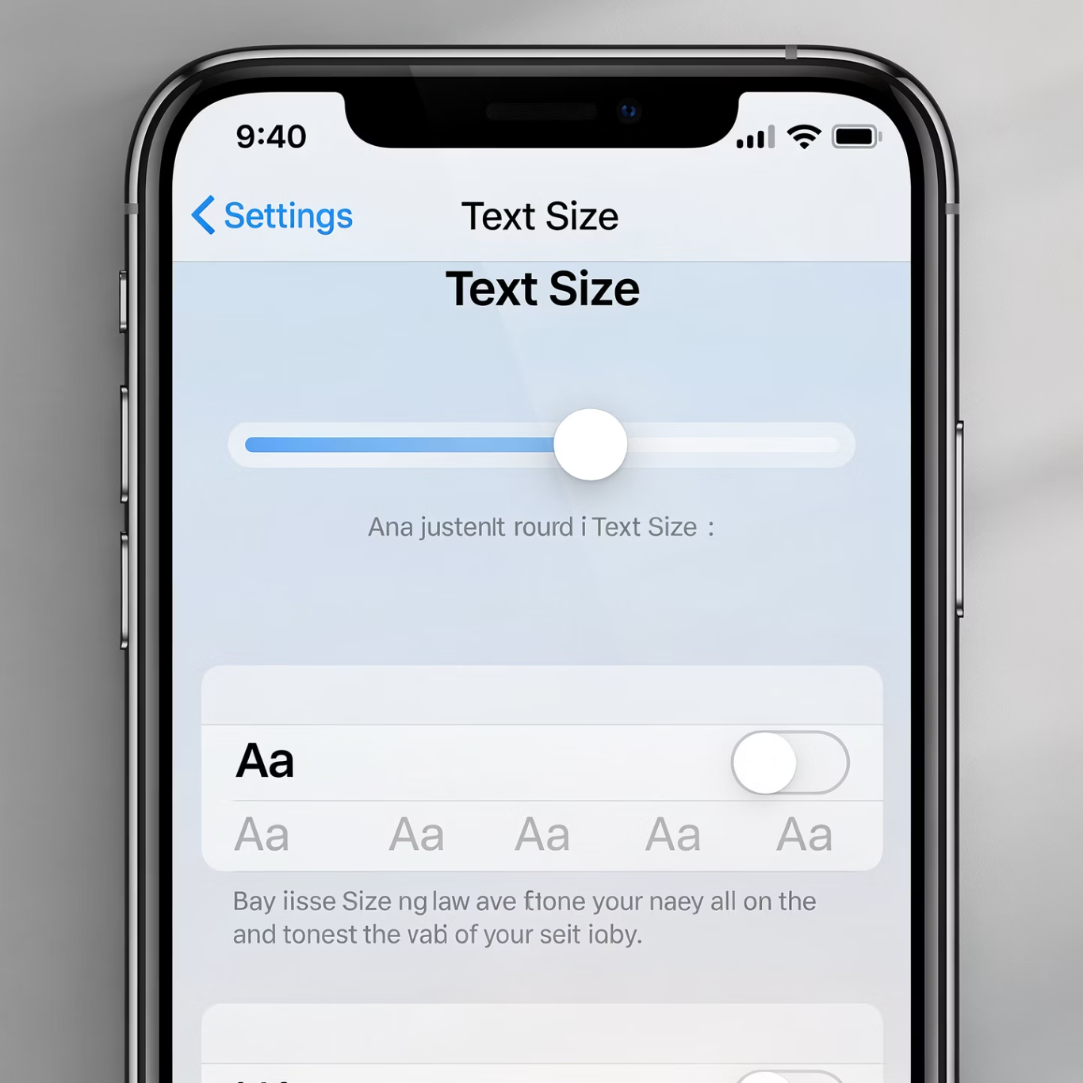
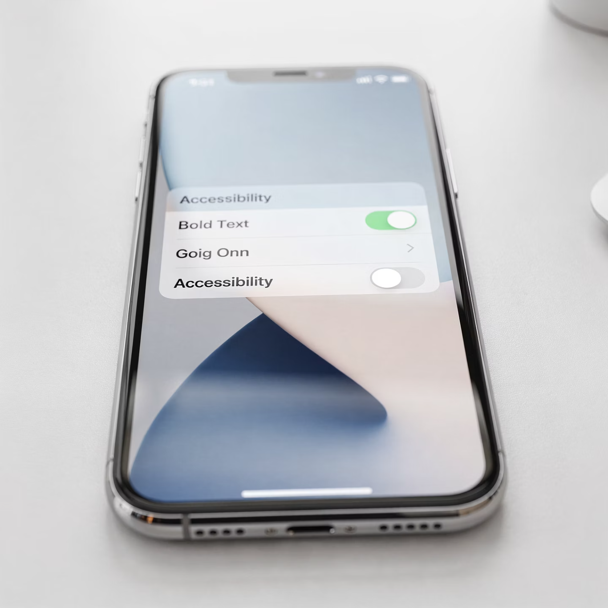
Slide 27
Making the iPhone Easier to See
Larger text
Bold text
Notes:
These options exist because everyone's eyes are different. Adjusting them is smart, not a workaround.

Slide 33


Slide 28
Zoom & Voice Assistance
Zoom
VoiceOver
Magnify any part of your screen for easier viewing.
Have your iPhone read screen content aloud to you.
Notes:
These tools are optional. Use what helps and ignore what doesn't.

Slide 34



Slide 29
Passcodes & Face ID
Protects your phone
Easier unlocking
Security can be both strong and convenient at the same time.
Notes:
Security can be strong and convenient at the same time. Passcodes, Face ID, and Find My iPhone protect you and provide peace of mind

Slide 35
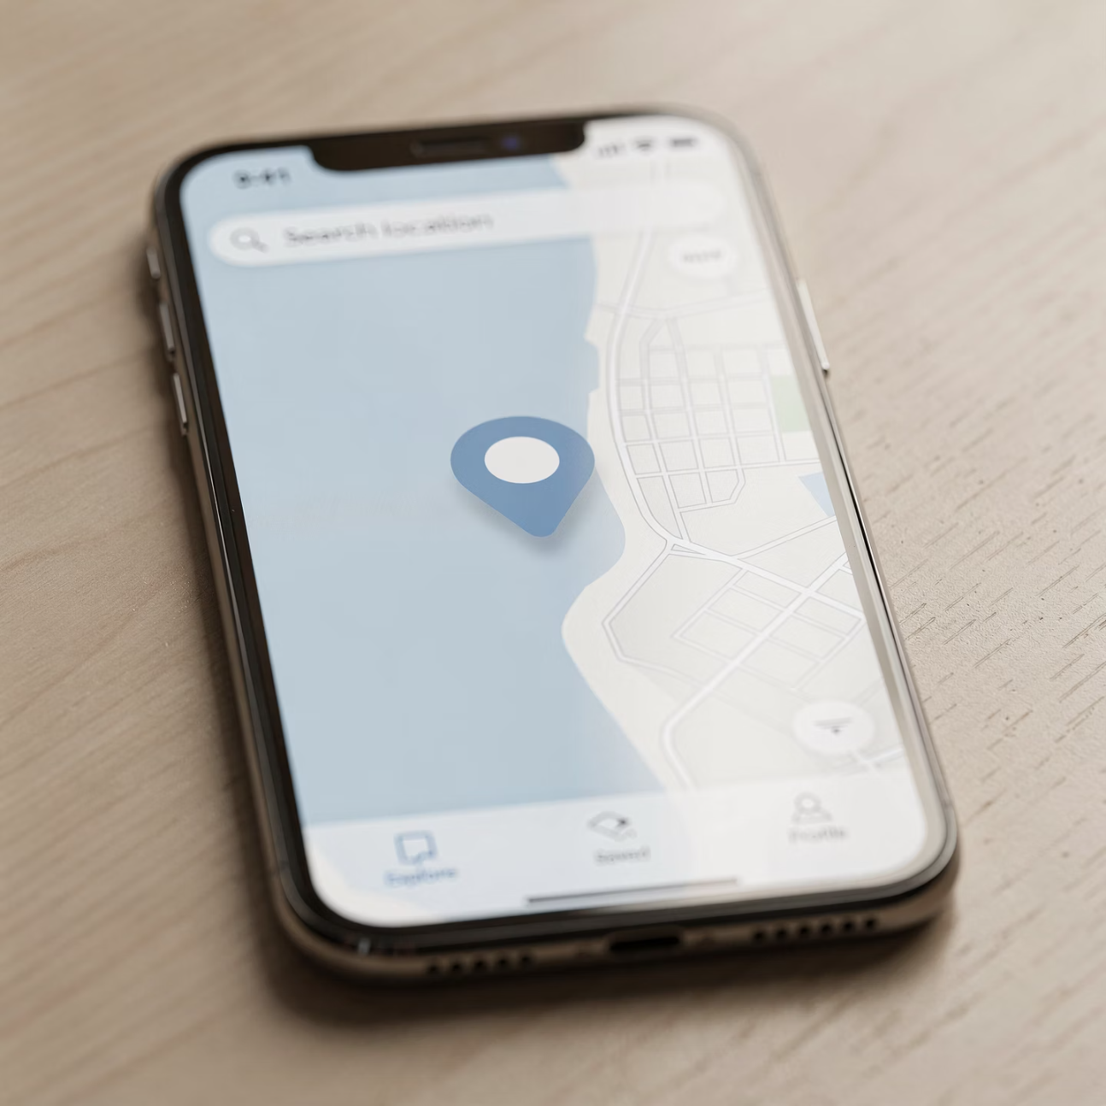
Slide 30
Find My iPhone
Locate lost phone
Track your device on a map if it goes missing.
Peace of mind
Notes:
Turning this on protects you even if you never need it.

Slide 36



Slide 31
Privacy & Permissions
Location
Camera
Microphone
Control which apps can see where you are.
Decide which apps can access your camera.
Choose which apps can use your microphone.
You are always in control of what apps can access. You can change permissions anytime.
Notes:
You are always in control of what apps can access — location, camera, and microphone permissions can be changed anytime. You’re not locked in.

Slide 37


Slide 32
Safety Summary
Protect yourself
Stay calm
Safety is about habits, not fear.
Notes:
Safety is about habits, not fear. Stay calm, pause before acting, and ask for help when unsure.

Slide 38
Wrap-Up
Part 3
Notes:
Wrap Up

Slide 39

Slide 33
What You Can Do Now
Customize your phone
Communicate confidently
Stay safe
You now have the tools to use your iPhone with confidence and calm.
Notes:
You now have the tools to customize your phone, communicate confidently, and stay safe. That’s real progress.

Slide 40
Slide 34
Catching Up If Needed
Review Parts 1 & 2
Archives available
Go back anytime to refresh your memory.
All previous sessions are saved for you.
The archives are there to support you — not to test you.
Notes:
The archives are there to support you, not to test you. Go back anytime to refresh.

Slide 41


Slide 35
Support Options
Free Tech Tuesday 1-on-1s
Optional in-home help
Get personalized help on your schedule.
Assistance available in the comfort of your home.
Help is always available when you want it.
Notes:
Free Tech Tuesdays and optional in-home help are always available. You’re never on your own with this.

Slide 42

Slide 36
Final Reassurance
You're not behind
You're in control
You didn't break anything. You learned step by step — and now you truly own your iPhone.
Notes:
You’re not behind. You’re in control. If there’s one sentence I want you to remember from this entire series, it’s this: you didn’t break anything — you learned step by step. And now your iPhone belongs to you, not the other way around.

Slide 43

You're More Capable Than You Think
You've learned so much already. Take a moment to recognize your progress — you can now customize your phone to fit your needs, communicate with friends and family confidently, and use your device safely in a way that works for you. These aren't small accomplishments. They're real skills that expand your world.
Notes:
At this point, you can customize your phone, communicate with confidence, and use it safely. You don’t need to do everything at once. Even one small improvement — like adjusting text size or understanding Wi-Fi — is real progress.

Slide 44

Pause and Notice the Difference
You Know More
You Feel Calmer
Your understanding has grown with each lesson
Uncertainty has given way to confidence
You Know Where to Get Help
Resources and support are at your fingertips
Notes:
Take a quiet moment to notice how you feel compared to when we started this series. You understand more, you’re calmer, and you know where to go for help. That’s confidence — and it matters more than memorizing steps.

Slide 45



Review & Reinforcement
Forgetting Is Normal
Rewatching Helps
Clarity Comes With Time
Your brain is processing a lot of new information. Be patient with yourself.
Going through lessons again reinforces what you've learned and fills in gaps.
Understanding deepens gradually. Each review brings more confidence.
Notes:
It’s completely normal to forget details. That’s why these sessions are recorded. Rewatching even one section later often makes things click in a way they didn’t the first time.

Slide 46

Catching Up If Needed
Missed a Session?
No problem at all. Life happens, and that's perfectly okay. These lessons aren't going anywhere, and there's no deadline hanging over you. You can pick up right where you left off, or start fresh if that feels better. Learning at your own pace isn't just allowed — it's encouraged.
Notes:
If you missed Part 1 or Part 2, nothing is lost. The archive exists so learning can happen at your pace, not on a clock. Many people learn best by watching once live and once later.

Slide 47
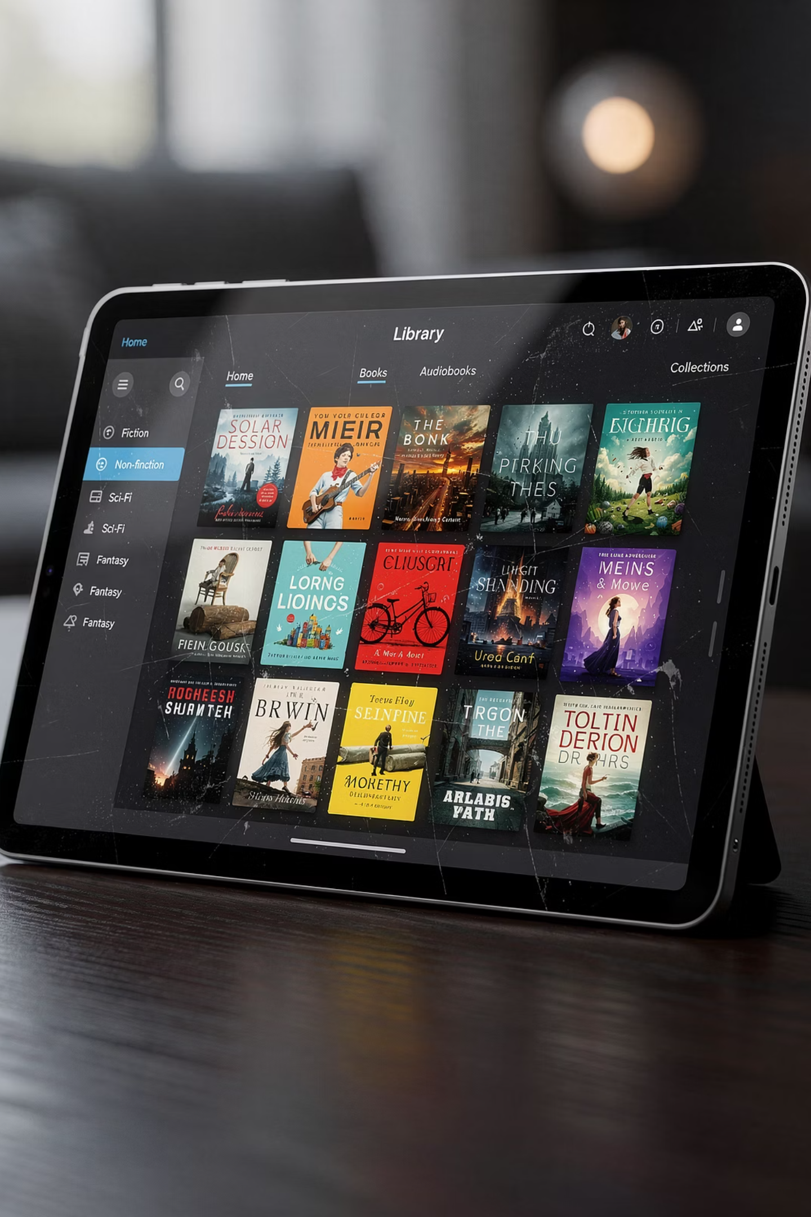
How to Use the Archives
Think of the archives as your personal support library. They're designed to work around your schedule and learning style. Pause when you need time to practice. Rewind when something didn't quite click the first time. Skip around to focus on what matters most to you right now. This flexibility puts you in control of your learning journey.
Notes:
The archives aren’t homework — they’re support. You can pause, rewind, and skip around. Use them when it’s convenient for you, not because you feel you should.

Slide 48


Support Options Available to You
Free Tech Tuesdays
Optional In-Home Support
Drop in for quick questions, troubleshooting help, or just a friendly conversation about technology challenges you're facing.
Sometimes hands-on help in your own space makes all the difference. Personalized assistance is available when you need it.
You're not on your own in this learning process. Help is always within reach.
Notes:
You don’t have to solve things alone. Free Tech Tuesday one-on-one help is always available, and optional in-home support is available if you prefer help in your own space.

Slide 49

When to Ask for Help
Don't wait until frustration builds. Reach out early when something feels off. Ask for help when a task seems confusing, when you're feeling frustrated with a feature, or when something feels risky or unsafe. These are exactly the right moments to connect with support — not signs of failure, but smart moves toward success.
Notes:
If something feels confusing, frustrating, or risky — that’s the right moment to ask for help. Asking early usually saves time and prevents stress. It’s efficiency, not failure.

Slide 50

Learning Is an Ongoing Journey
Technology Changes
You Adapt
Confidence Grows
Keep Learning
Technology keeps evolving, and that's actually okay. You don't need to master every new feature or update. What matters is adapting calmly to changes that affect how you use your phone. Each time you work through something new, you build resilience and problem-solving skills that make the next change easier.
Notes:
Technology keeps changing, and that’s okay. The goal isn’t to know everything — it’s to know how to adapt calmly and where to turn when something changes.

Slide 51



What This Series Focused On
Comfort
Understanding
Ownership
Feeling at ease with your device, reducing anxiety around technology.
Building real knowledge of how your phone works and why.
Taking control of your device and making it work for your life.
Notes:
This trilogy was designed to give you comfort first, understanding second, and ownership third. If it did that for you, then it succeeded.
Use what helps you. Ignore what doesn’t. Your phone should adjust to you, not the other way around.

Slide 52

Thank You for Being Here
Thank you for showing up to each session, for asking thoughtful questions when things weren't clear, and for trusting the process even when it felt challenging. Your willingness to learn and grow has been inspiring.
IPHONE ESSENTIALS INTRO 101 — PART 3 COMPLETE
Notes:
Thank you for showing up, asking questions, and trusting the process. Learning technology takes patience, and you brought that with you.
This concludes iPhone Essentials Intro 101 — Part 3. Remember: you’re not behind, you’re not alone, and you now have the tools and support to use your iPhone with confidence.

